Slide 1
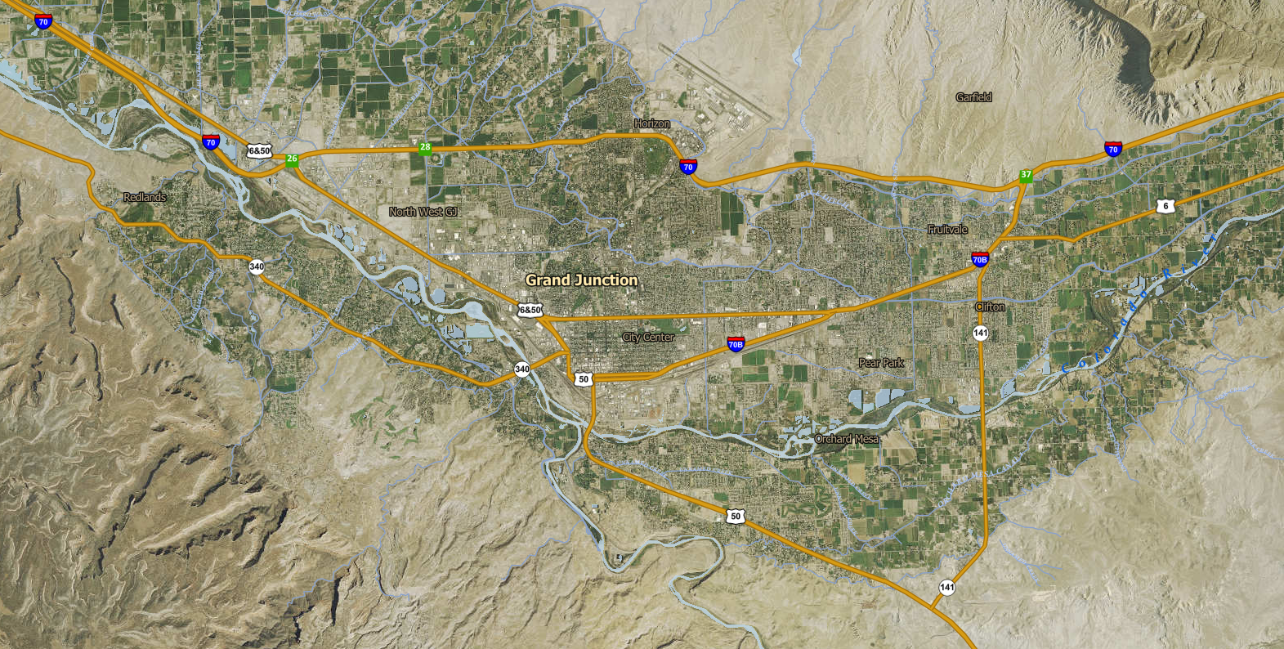
Existing – Site #1
New I—70 Site #3
Existing – Site #2A - removal
New Hwy 50 Alt – Site #2b
City of Grand Junction Entry Signs

Slide 2
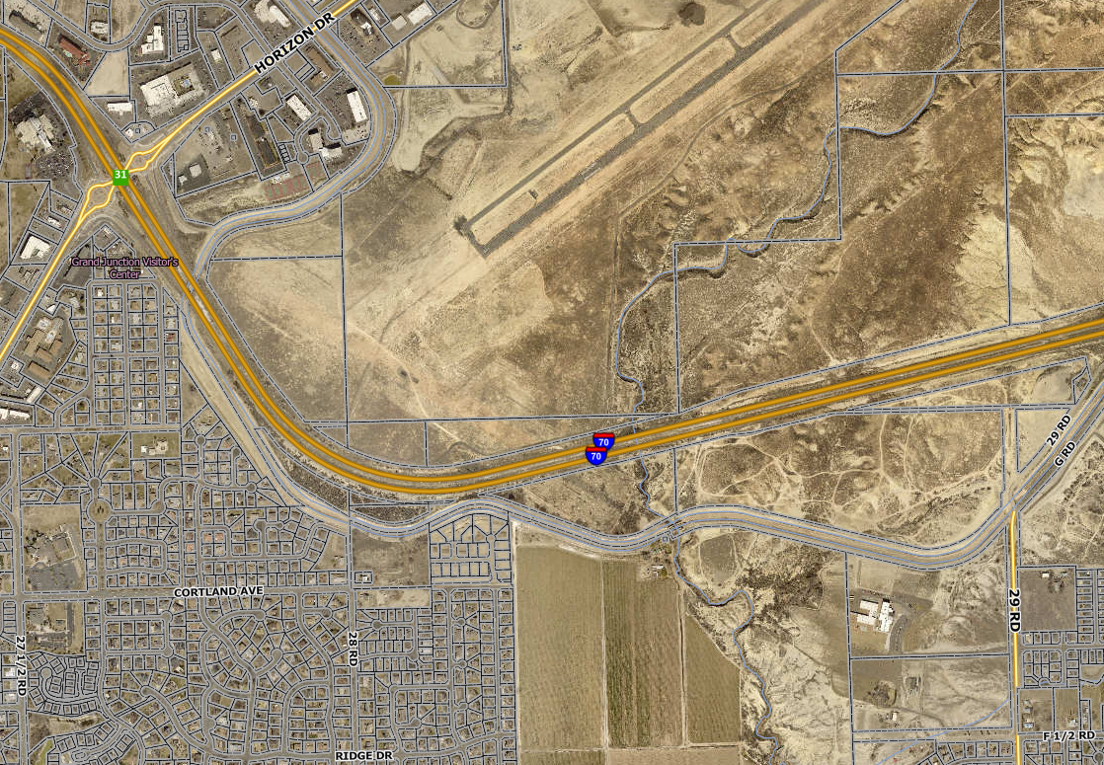
City of Grand Junction Entry Signs
I-70 East of Horizon Drive (Existing) – Site #1

Slide 3
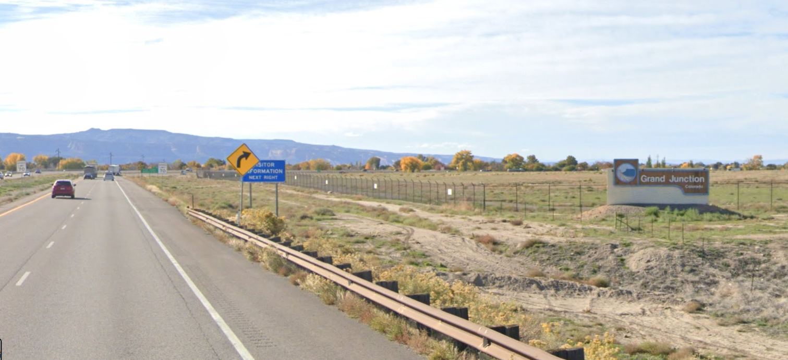
City of Grand Junction Entry Signs
I-70 East of Horizon Drive (Existing) - Site #1

Slide 4
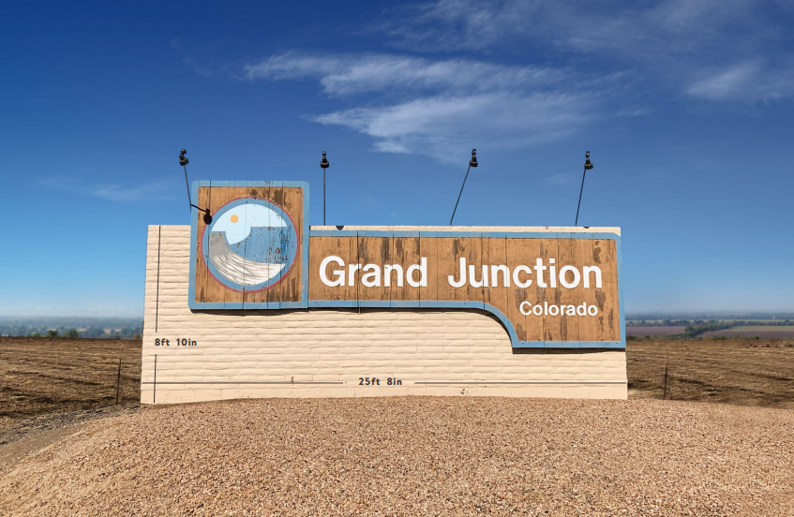
City of Grand Junction Entry Signs
I-70 East of Horizon Drive (Existing) - Site #1

Slide 5
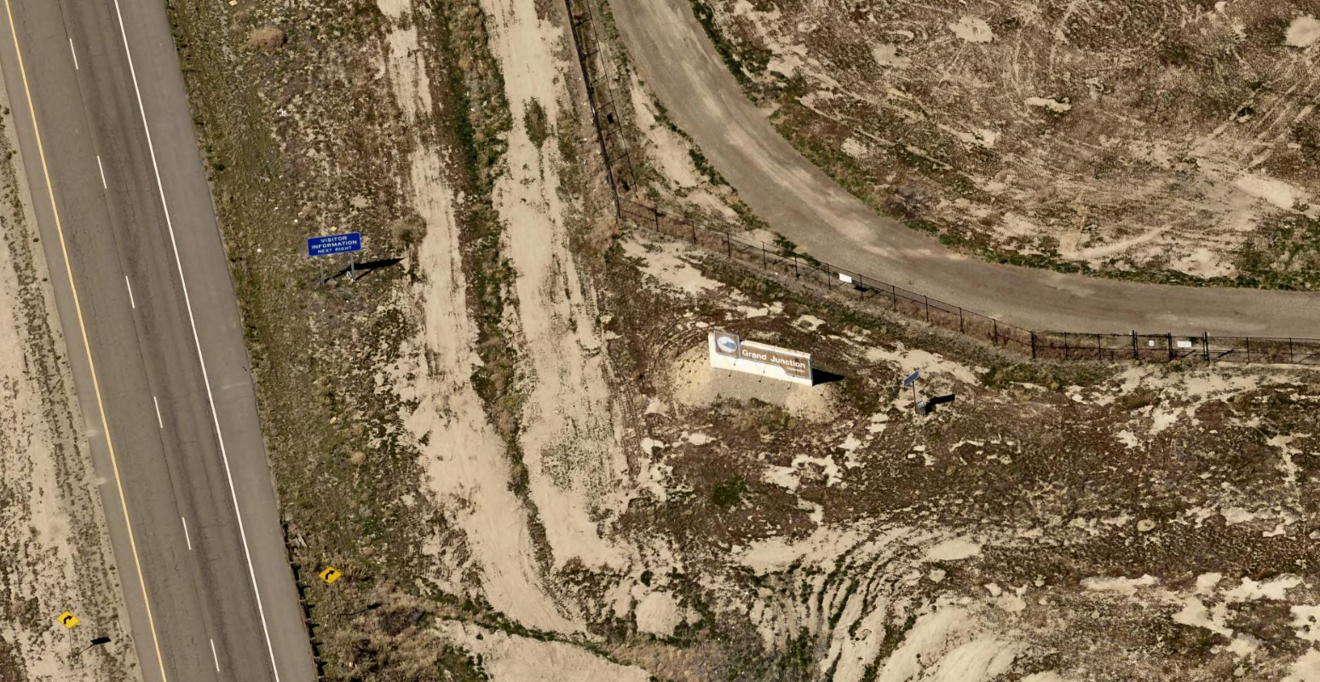
Access via Gate #13
Grand Junction Regional Airport
City of Grand Junction Entry Signs
I-70 East of Horizon Drive (Existing) - Site #1

Slide 6
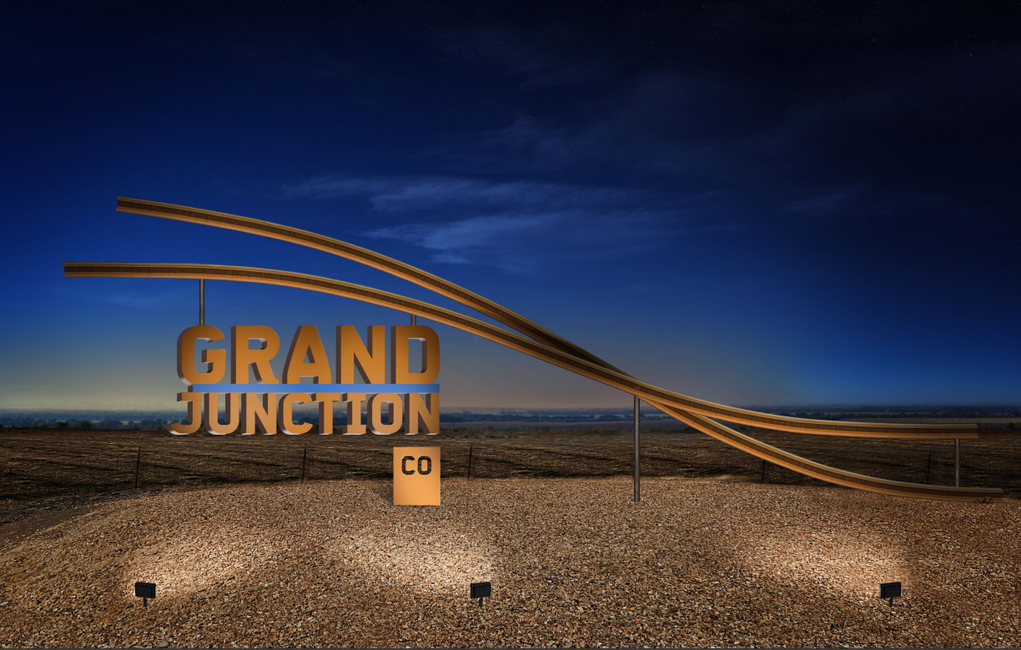
Design Narrative
Nod to our railroad and industrial history
Two rivers converging is represented by the railroad tracks
They will be lit with a light blue at night to add a pop of color and further nod to rivers
The font is not our destination brand font, but similar
It's meant to be avant-garde, look like it's floating, and be very original
Artist Rendering

Slide 7
56 feet
18’6”
8’10”
25’8”
Artist Rendering – size comparison to existing

Slide 8
Artist Specifications/Dimensions

Slide 9
Artist Rendering – inset led lighting

Slide 10
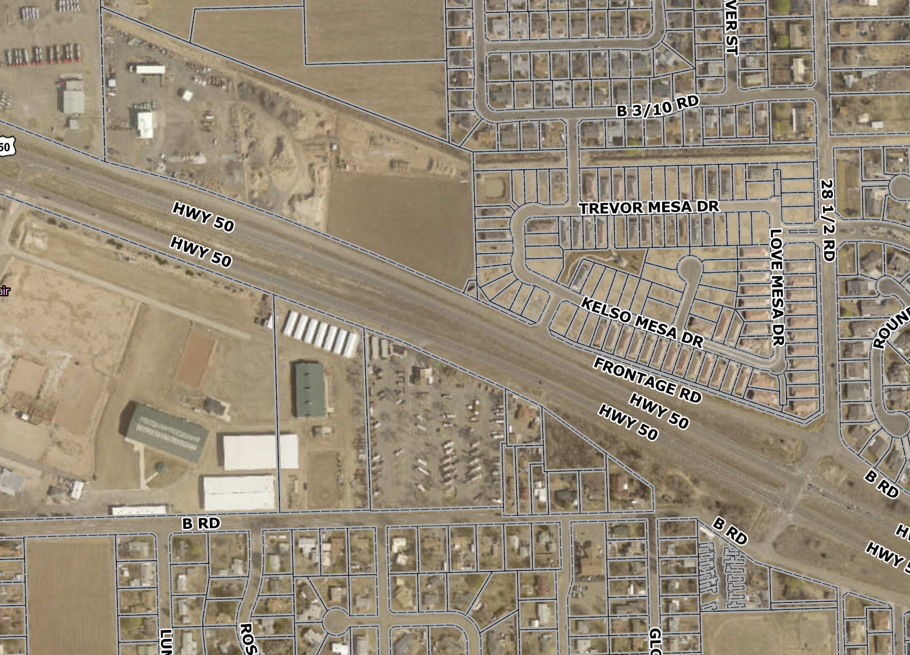
City of Grand Junction Entry Signs
Orchard Mesa west of 28 ½ Rd (North of fairgrounds) – Westbound Highway 50 (Existing) Site #2a

Slide 11
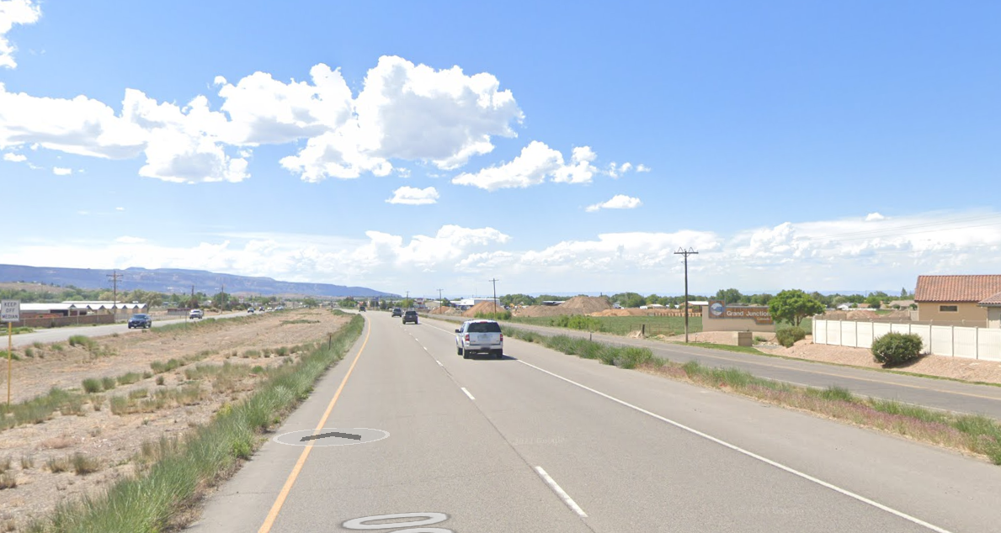
City of Grand Junction Entry Signs
Orchard Mesa west of 28 ½ Rd (North of fairgrounds) – Westbound Highway 50 (Existing) - Site #2a

Slide 12
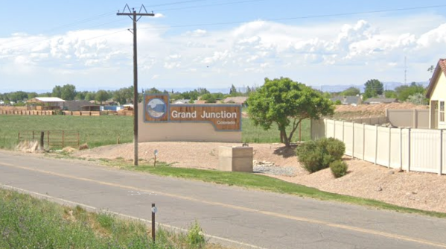
With subdivision to the east – sign seems less prominent than when originally constructed
City of Grand Junction Entry Signs
Orchard Mesa west of 28 ½ Rd (North of fairgrounds) – Westbound Highway 50 (Existing) – Site #2a

Slide 13
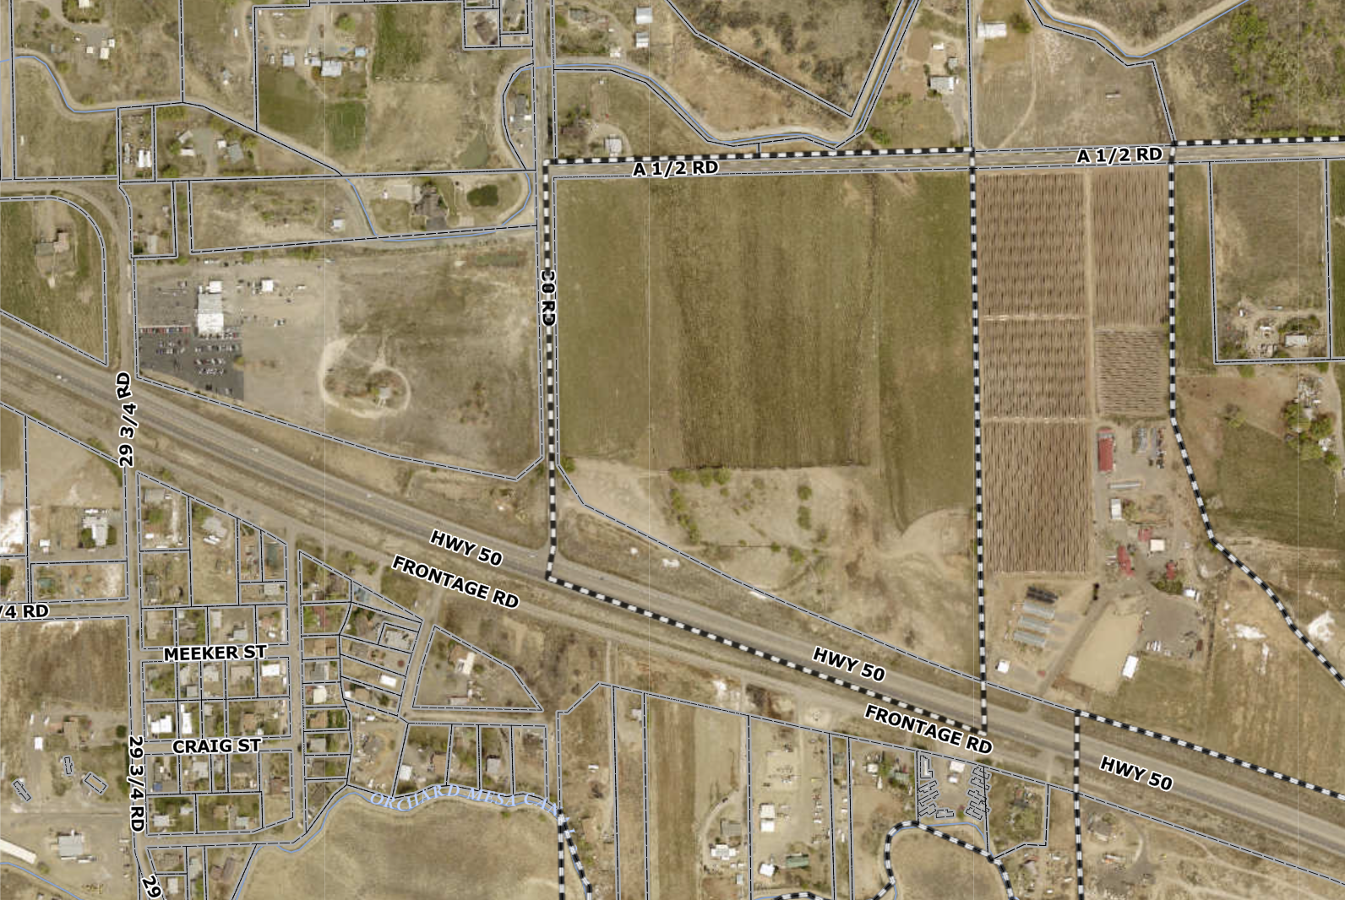
Alternative Hwy 50 Location – 30 Road
City of Grand Junction Entry Signs –
Orchard Mesa at 31 Road – Westbound Highway 50 - Orchard Mesa Potential Alternative Site – 30 Road – Site #2b

Slide 14
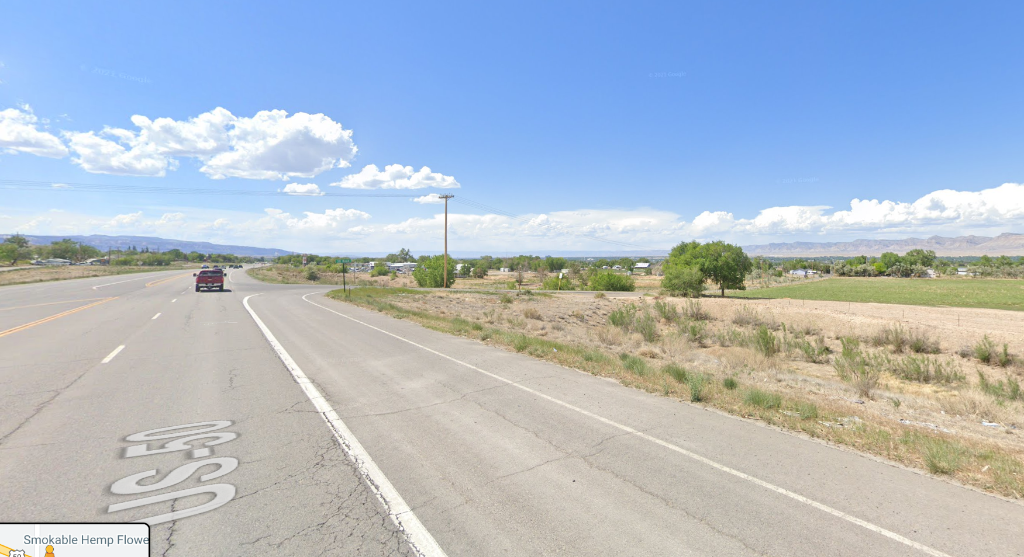
Alternative Hwy 50 Location – 30 Road
City of Grand Junction Entry Signs –
Orchard Mesa at 31 Road – Westbound Highway 50 - Orchard Mesa Potential Alternative Site – 30 Road – Site #2b

Slide 15
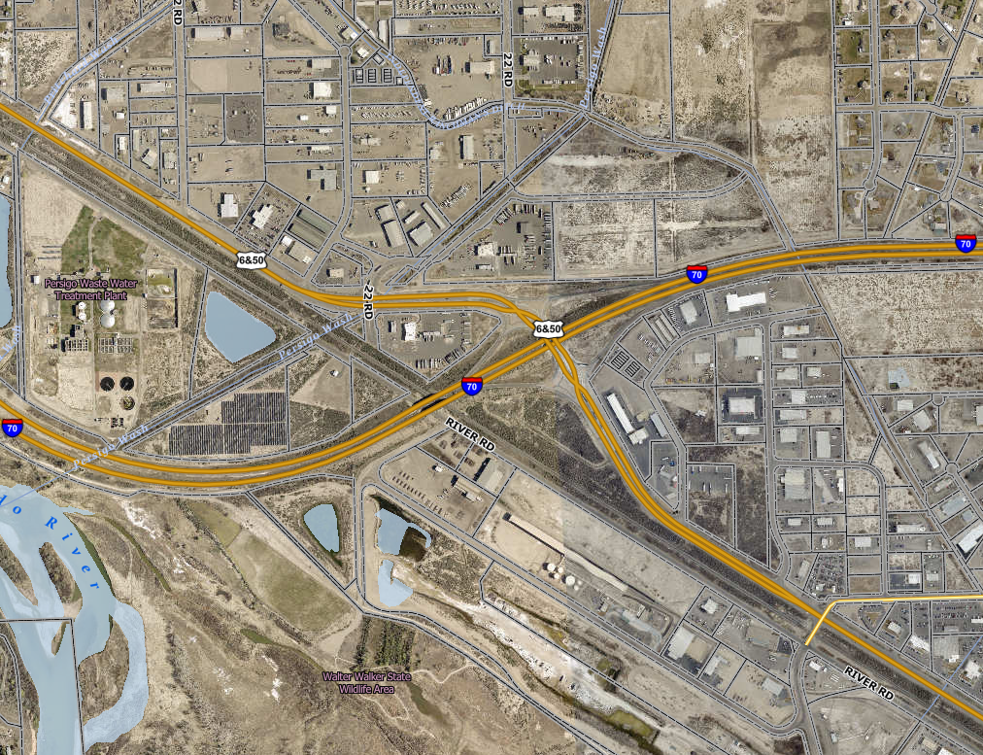
City of Grand Junction Entry Signs – potential site
West side of Exit 26– Eastbound I-70 (NEW) – Site #3

Slide 16
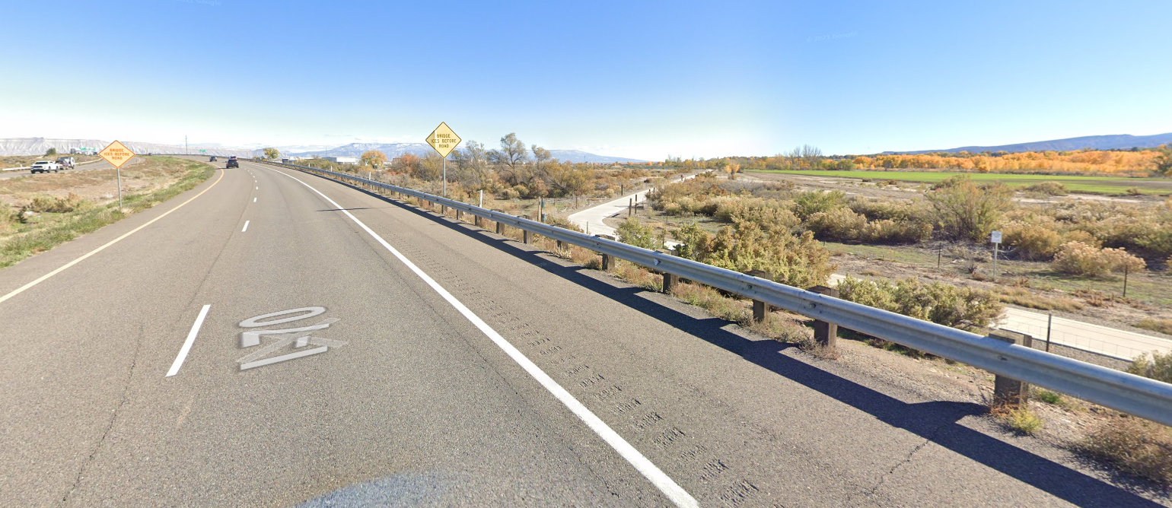
City of Grand Junction Entry Signs – potential site
West side of Exit 26– Eastbound I-70 (NEW) – Site #3

Slide 17
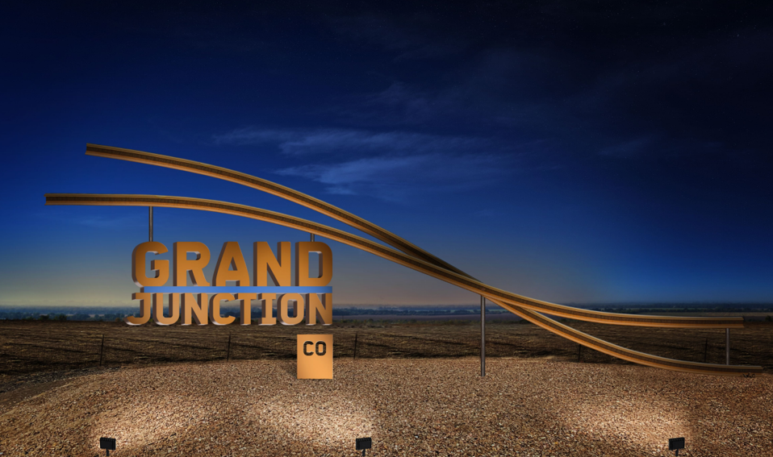
Schedule
Design/Build RFP available 6/17
Proposals Due – 7/18
Final Negotiations – 8/2
Council Award 8/17
Construction complete 12/16/22

