Slide 1
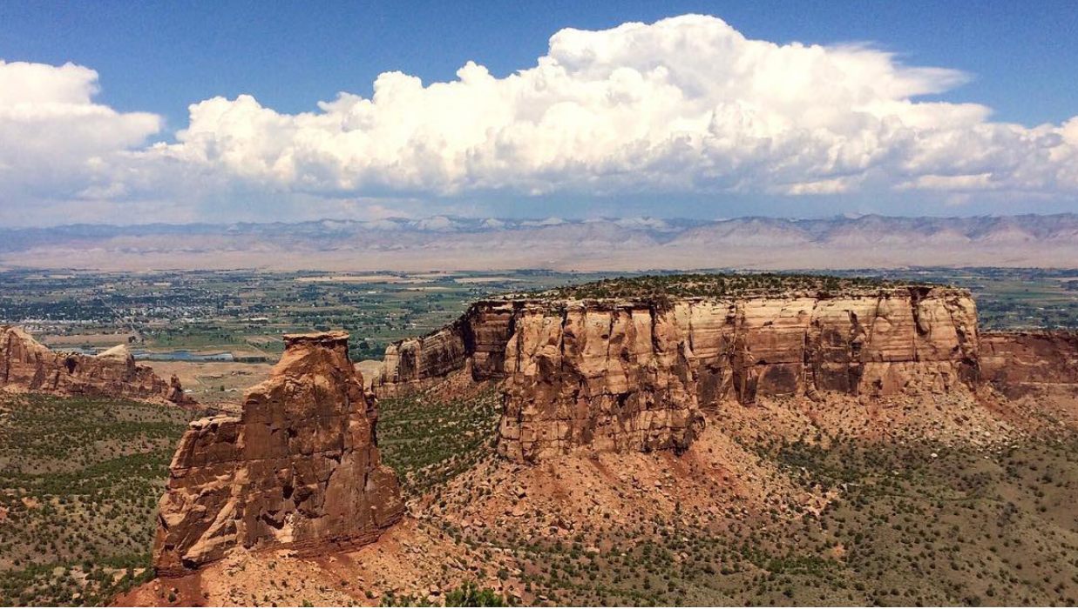
Grand Junction community RECREATION CENTER
Commission on arts & culture
presentation
October 23, 2024

Slide 2
DESIGN THREADS
ADAPTION
The natural medium of the landscape. The beauty in expressing how these materials are changed and sculpted by the forces of nature and by human interaction.
FACETED
Forces of nature, human interaction, and how they are celebrated in the form and function of the building. A direct response to a moment in time.
CONVERGENCE
The allure, culture or sense of place created by deep connections between building an environment. Ever changing by day, by season, over the years.

Slide 3
DESIGN THREADS
HORIZON
The colors of light and shadow
| light & shadow | circadian |
| water | rock | vegetation | sunlight |
| strata | lithification | sedementary | erosion |
| woven | layered |
| jagged | smooth | reflection |
| weathered | patina|
Travelers passing thorugh on the Old Spanish Trail wrote of the grand scenery. Written records depict cathedrals and fortresses high above, all bathed in beautiful colors. These forms have been slowly formed by the elements for millions of years. Their materials,

Slide 4
COLOR PALETTE
HORIZON
The colors of light and shadow
| light & shadow | circadian |
| water | rock | vegetation | sunlight |
| strata | lithification | sedementary | erosion |
| woven | layered |
| jagged | smooth | reflection |
| weathered | patina|
Travelers passing thorugh on the Old Spanish Trail wrote of the grand scenery. Written records depict cathedrals and fortresses high above, all bathed in beautiful colors. These forms have been slowly formed by the elements for millions of years. Their materials,

Slide 5
MATERIAL ZONES
EXTERIOR
Lithification is the process of sediments becoming solid under pressure. Different stripes across the book cliffs create unique patterns animated by light and shadow.
The shale bed at the base, soft in appearance, but very dense, has been sculpted by the elements over millions of years.
The softer upper layers crumble and erode away with water, wind, and gravity.
The materials in the building emulate layers of strata, various textures, and how light and shadow animate their appearance.

Slide 6
MATERIAL ZONES
ZONE 1 - ACTIVITY
The building’s circulation, faceted, meanders through the building like a river eroding away rock.
ZONE 3 - GATHERING
Different spaces for celebrating, learning, creating, playing..etc.
ZONE 2 - WATER
The pools, locker rooms, and restrooms. Spaces associated with water.
ZONE 4 - ATHLETIC
Spaces for heath and fitness

Slide 7
ZONE 1: ACTIVITY

Slide 8
ZONE 1: ACTIVITY MATERIAL/COLOR PALETTE
DESIGN CRITERIA:
Durability & Maintainability
Acoustics - Higher NRC of surfaces
Have a feeling of the outdoors.

Slide 9
ZONE 2: WATER

Slide 10
ZONE 2: WATER MATERIAL/COLOR PALETTE
DESIGN CRITERIA:
Durability & Maintainability
Resist Water & Chemicals
High dcof of flooring.
Acoustics - Higher NRC of surfaces
Connection to ground

Slide 11
ZONE 3: GATHERING

Slide 12
ZONE 3: GATHERING MATERIAL/COLOR PALETTE
DESIGN CRITERIA:
Adaptable / Multi-occasion
Resist wear and tear, easy to clean
Acoustics - Higher NRC of surfaces

Slide 13
ZONE 4: ATHLETIC

Slide 14
ZONE 4: ATHLETIC

Slide 15
ZONE 4: ATHLETIC MATERIAL/COLOR PALETTE
DESIGN CRITERIA:
Adaptable / Multi-occasion
Durable, easy to clean.
High impact resistance.
Acoustics - Higher NRC and IIC
Relate to sky/ light/ dynamic/ active

Slide 16
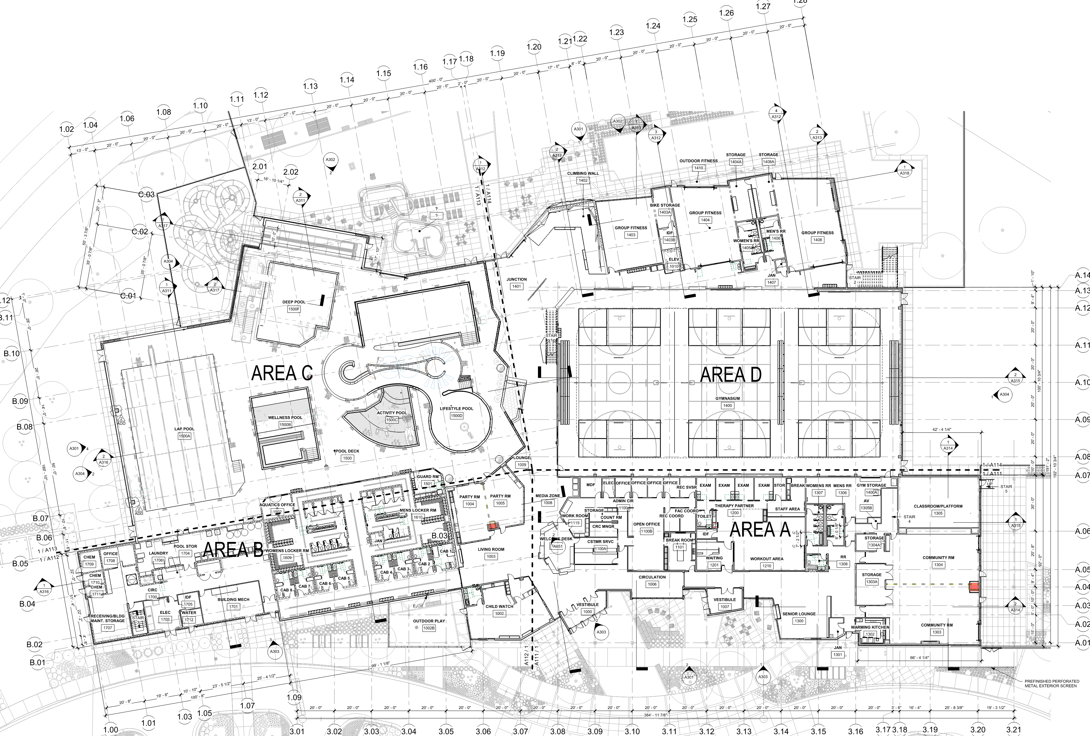
INSTALLATION LOCATIONS – FIRST FLOOR
WALL GRAPHICS
NATATORIUM INSTALLATIONS
MURAL ‘A’ LOCATION
D
C
MURAL ‘B’ LOCATION
RECEPTION INSTALLATION
WALL GRAPHICS
A
WALL GRAPHICS
B
WALL GRAPHICS
CHILD WATCH

Slide 17
INSTALLATION LOCATIONS - MEZZANINE
WALL GRAPHICS
ACOUSTICAL PANELS

Slide 18
LIGHT INSTALLATION

Slide 19
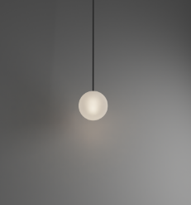
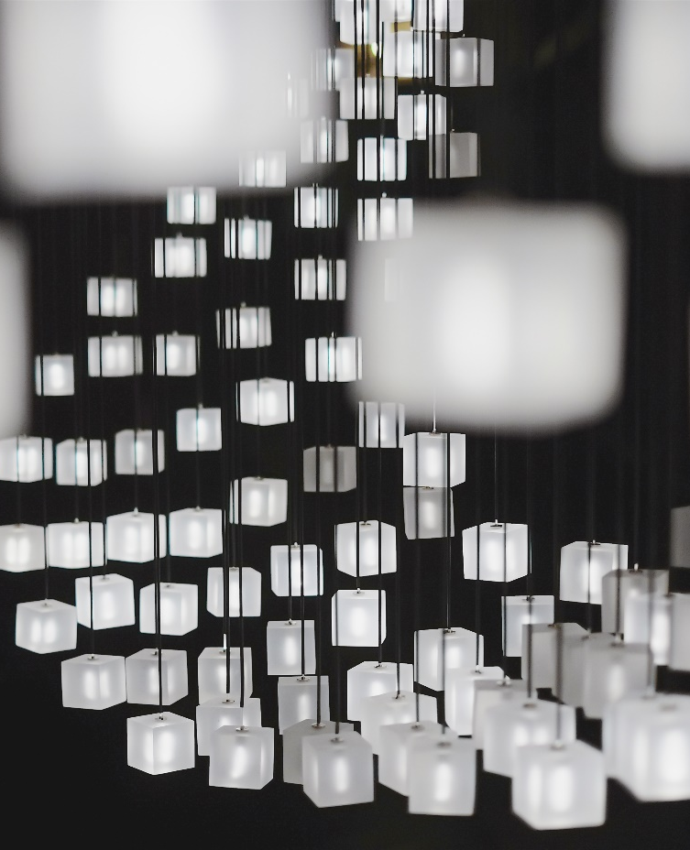
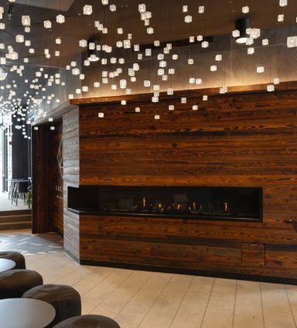
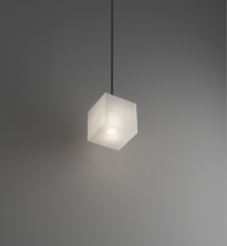
GREYPANTS – LIGHT FIXTURES
SPHERICAL
CUBE

Slide 20
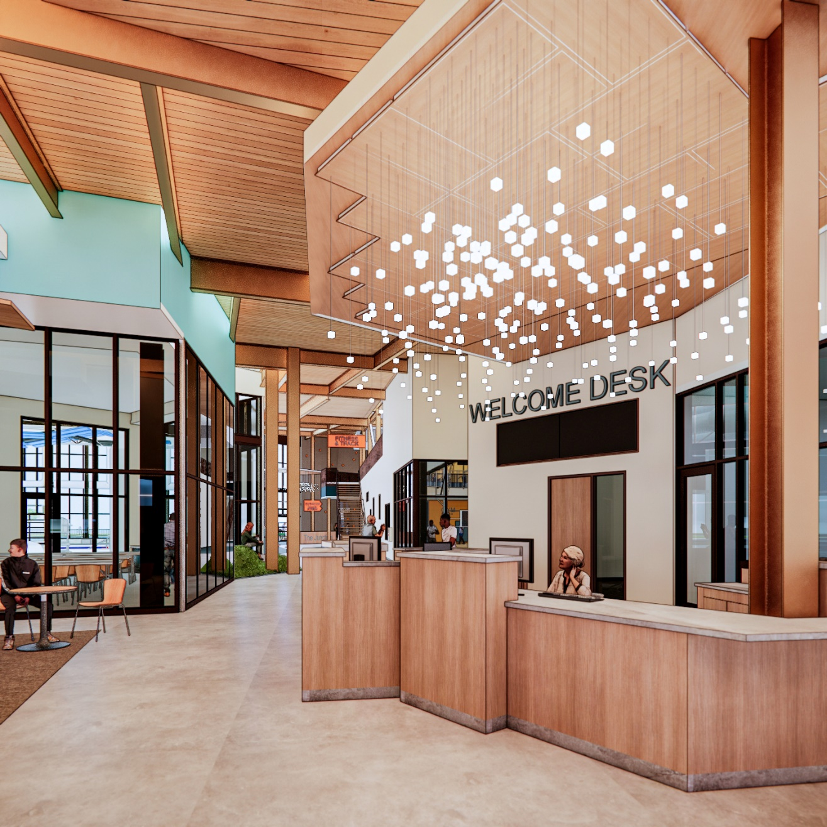
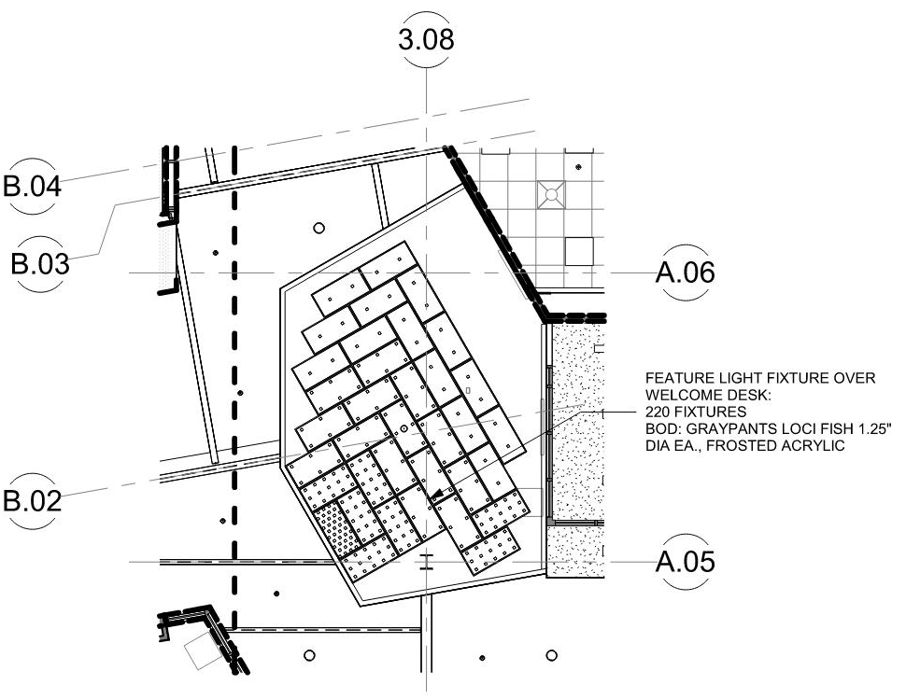
WELCOME DESK – LIGHT FIXTURE

Slide 21
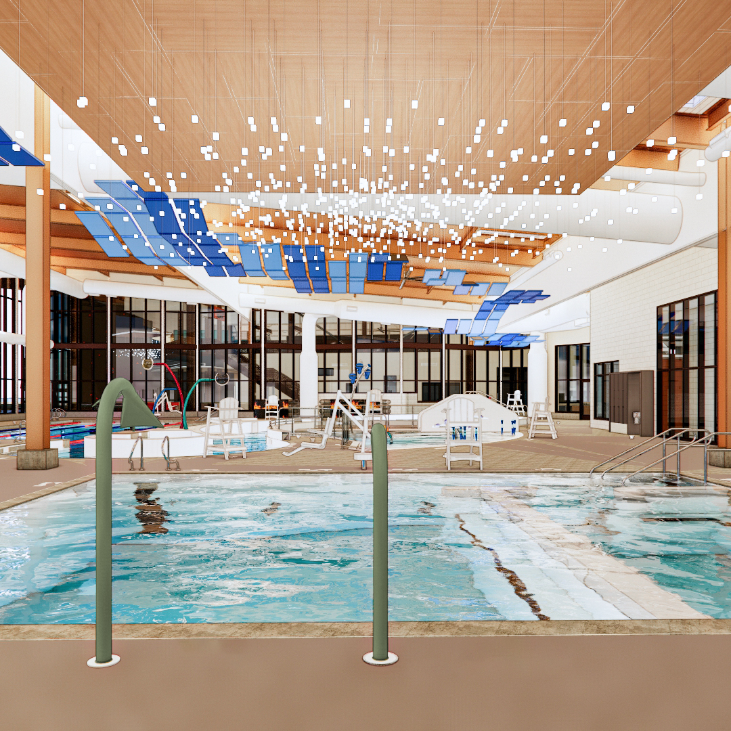
NATATORIUM – LIGHT FIXTURE

Slide 22
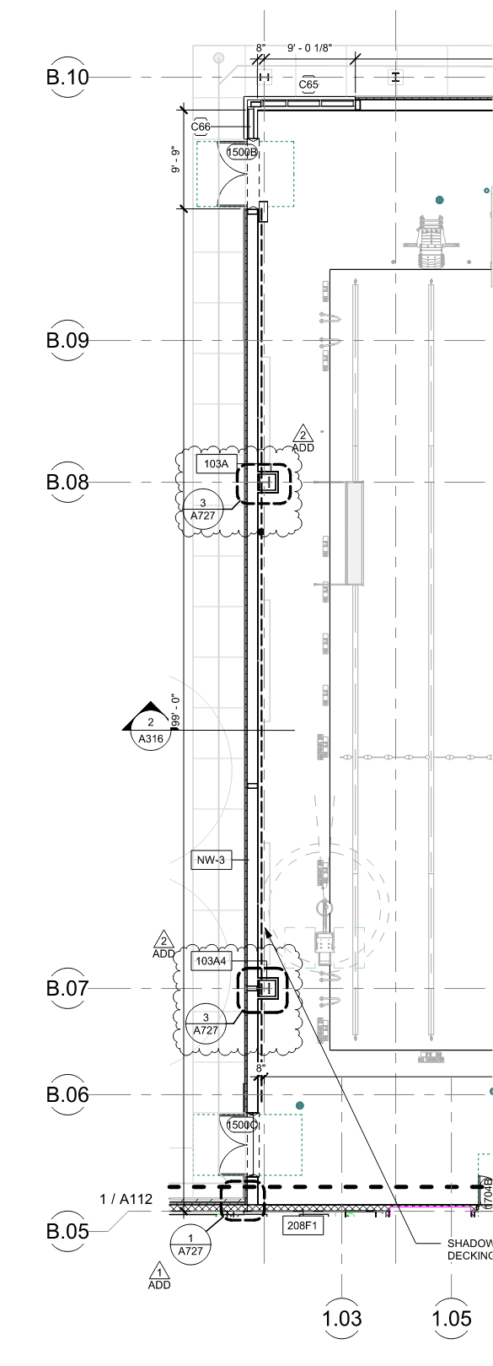
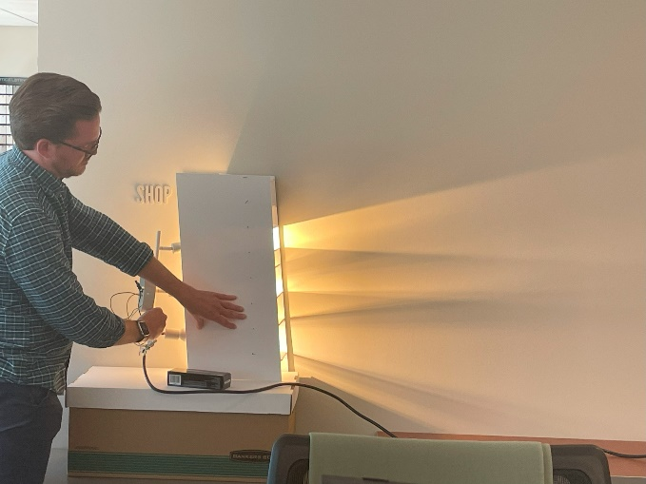
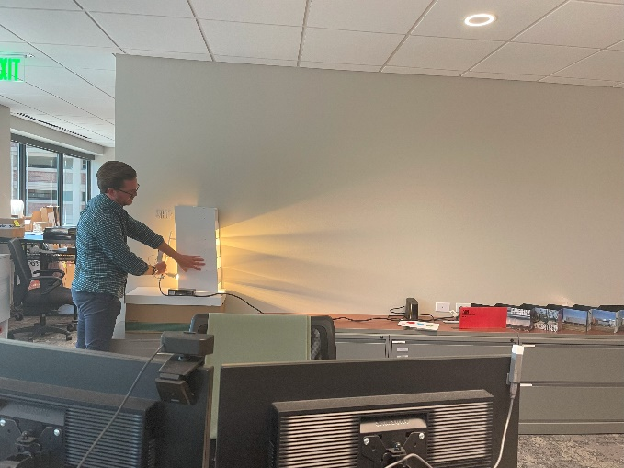
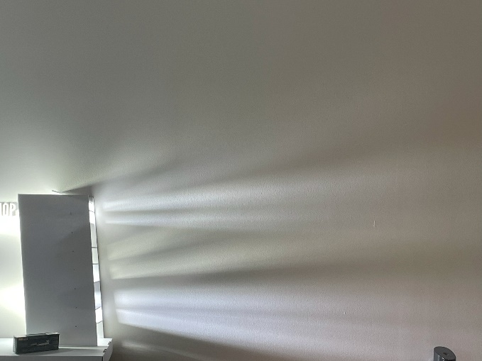
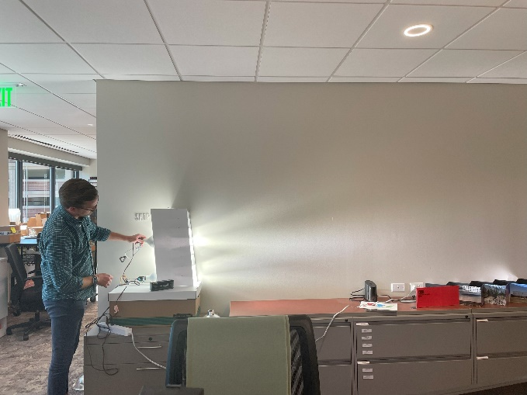
NATATORIUM – CUSTOM LIGHT FIXTURE

Slide 23
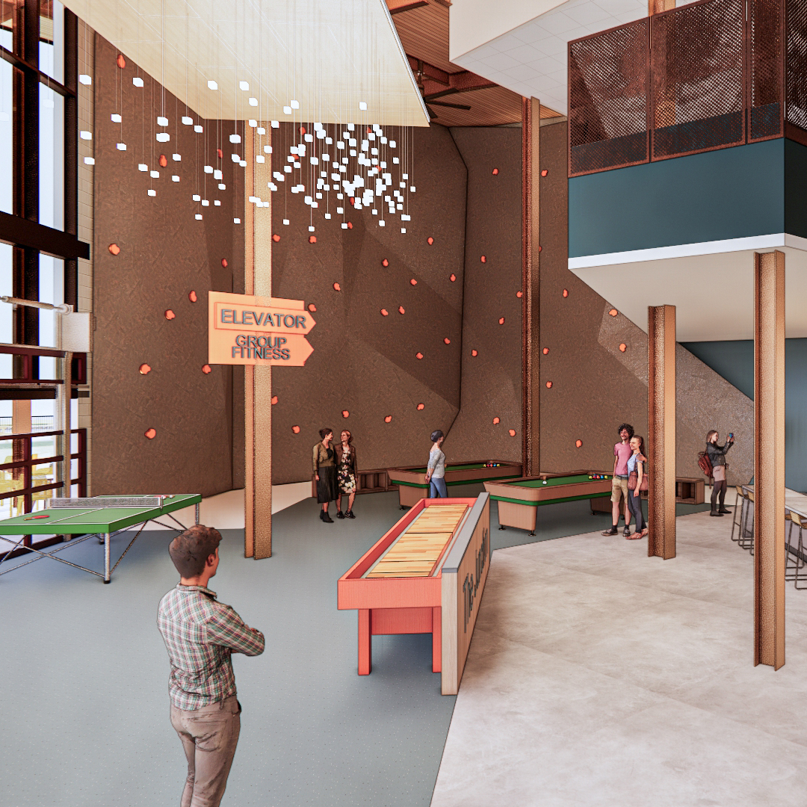
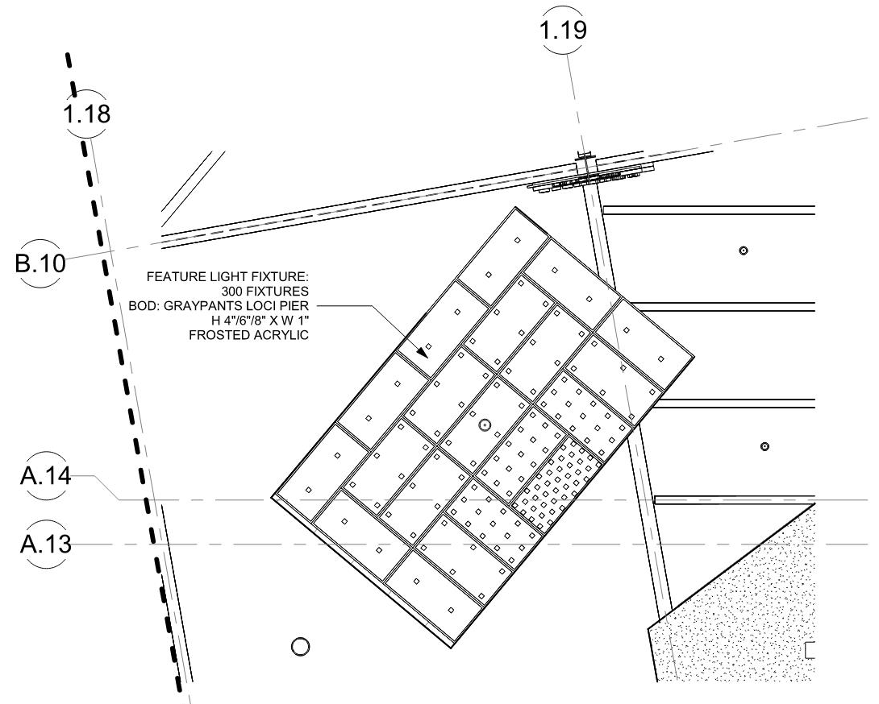
JUNCTION – LIGHT FIXTURE

Slide 24
ACOUSTIC CLOUDS

Slide 25
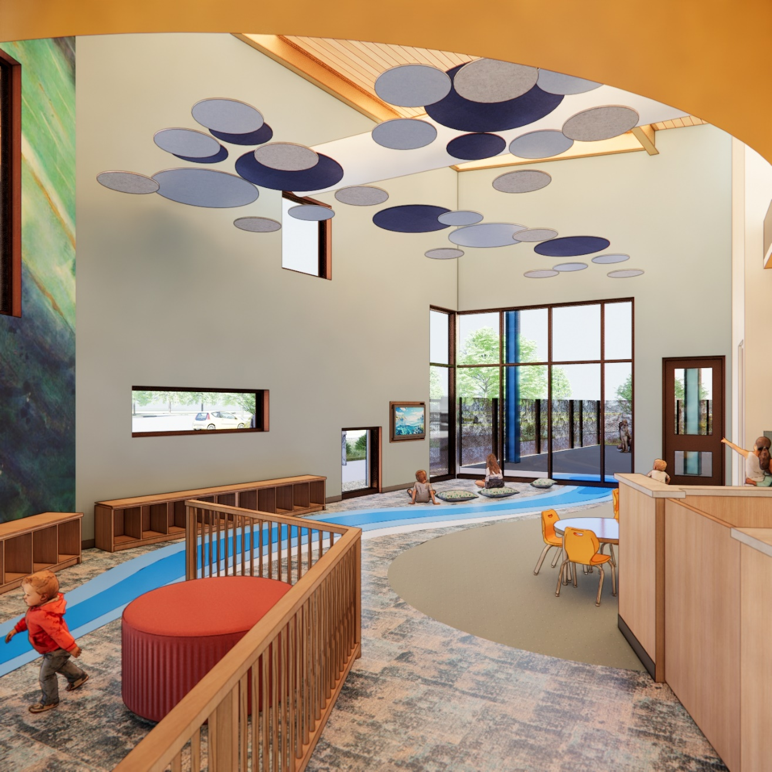
CHILD WATCH – CEILING CLOUDS

Slide 26
CHILD WATCH - RIVER

Slide 27
EXTERIOR MURALS

Slide 28
MURAL “A”– GYMNASIUM EXTERIOR WALL
Approximately 3,550sf of wall surface
Stucco exterior wall
Will need to complete a call for artists
102’-8”
34’-5”

Slide 29
MURAL “B” – NATATORIUM EXTERIOR WALL
Approximately 2,600sf of wall surface
Stucco exterior wall
Will need to complete a call for artists
32’-5”
24’-9”
94’-11”

Slide 30
EXPERIENTIAL WALL GRAPHICS

Slide 31
CHILD WATCH – GRAPHICS
Photo image printed on vinyl
BRS to design w/ input from City & Arts Commission

Slide 32
LOCKER ROOM – GRAPHICS
Photo image printed on tiles
Intent is to purchase licensed image / custom art
Will need a call to artist

Slide 33
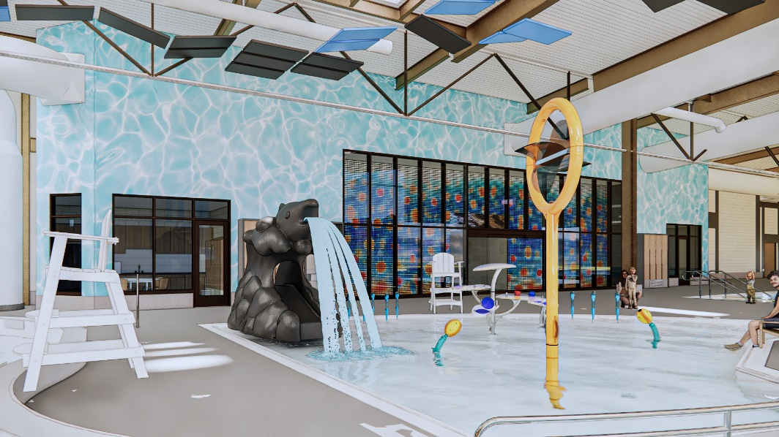
NATATORIUM– GRAPHICS
Photo image printed on vinyl
Intent is to purchase licensed image / custom art
Will need a call to artist

Slide 34
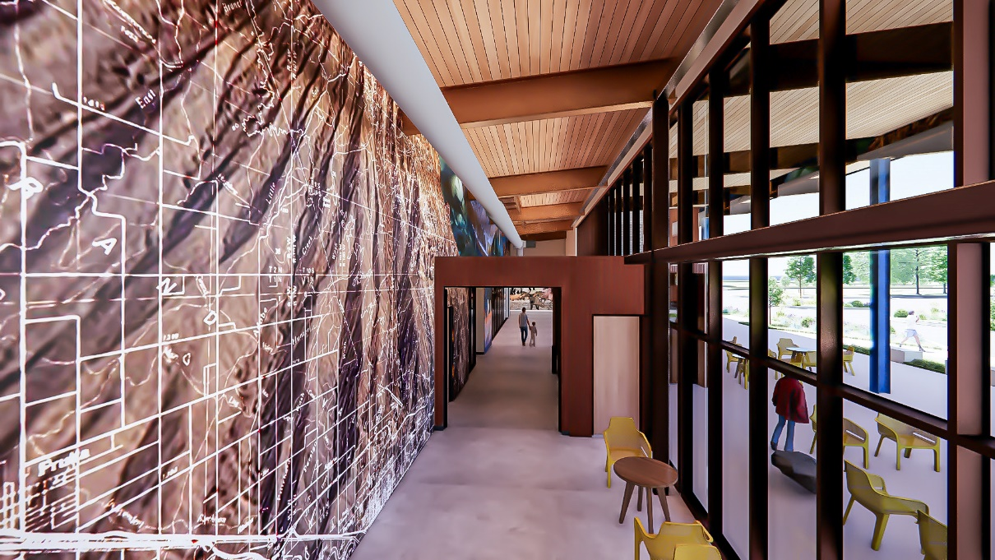
CIRCULATION – GRAPHICS
Photo image printed on vinyl
Intent is to purchase licensed image / custom art
Will need a call to artist
UPDATE

Slide 35
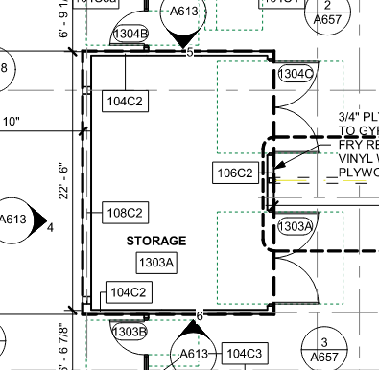
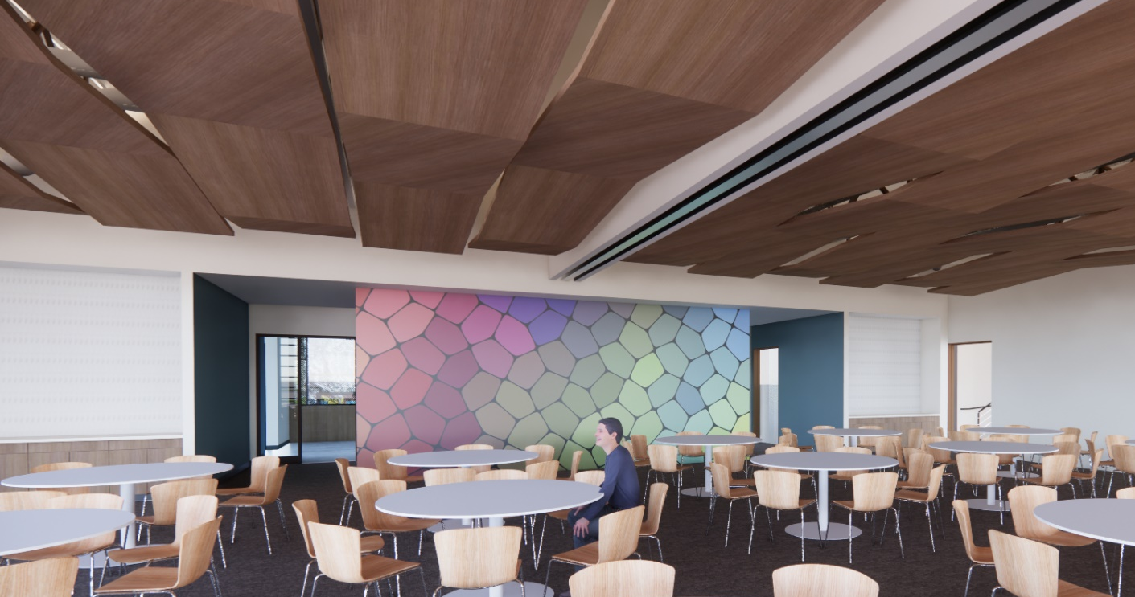
COMMUNITY ROOM – GRAPHICS
Photo image printed on vinyl
Intent is to purchase licensed image / custom art
Will need a call to artist

Slide 36
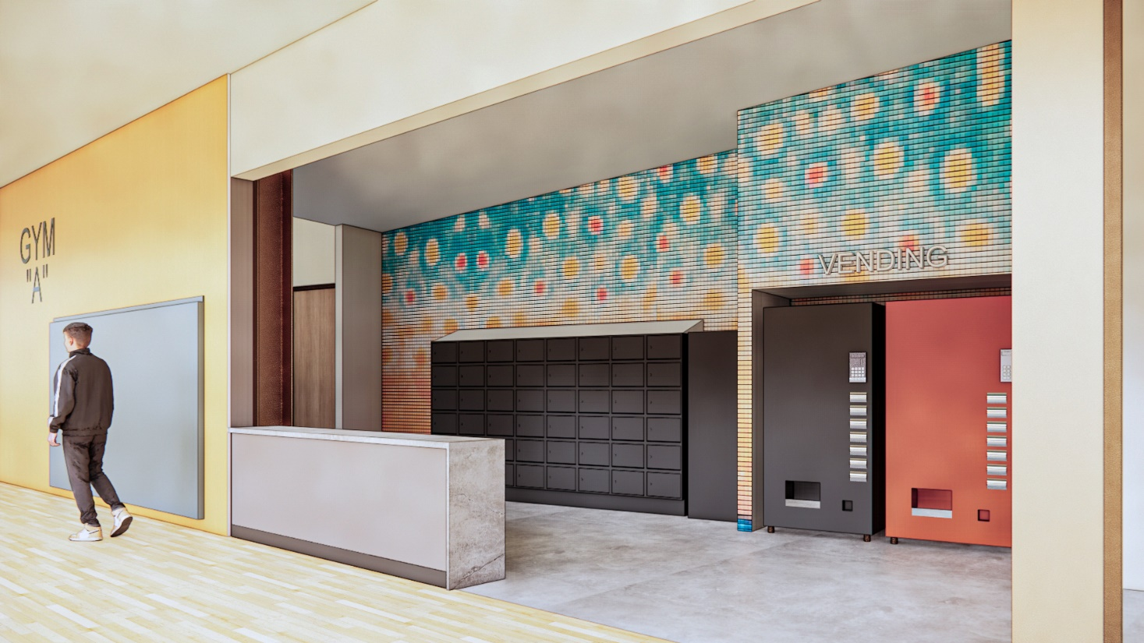
GROUP FITNESS – GRAPHICS
Photo image printed on vinyl
Intent is to purchase licensed image / custom art
Will need a call to artist
UPDATE

Slide 37
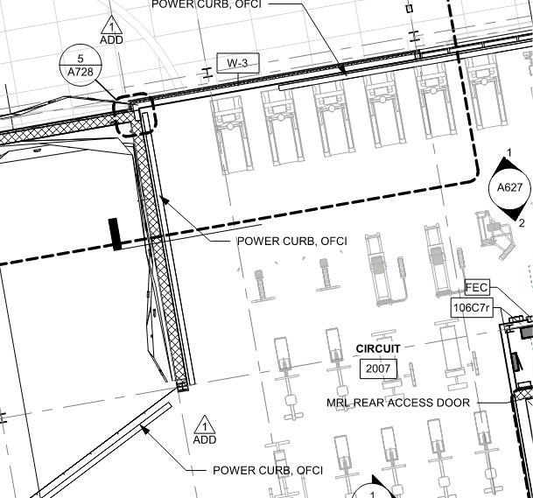
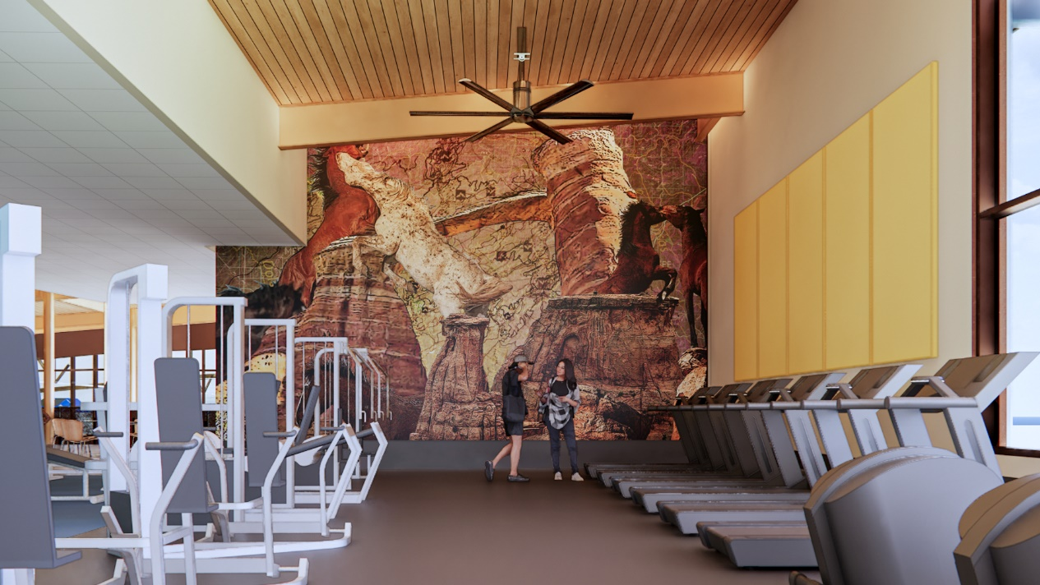
CARDIO – GRAPHICS
Photo image printed on vinyl
Intent is to purchase licensed image / custom art
Will need a call to artist

Slide 38
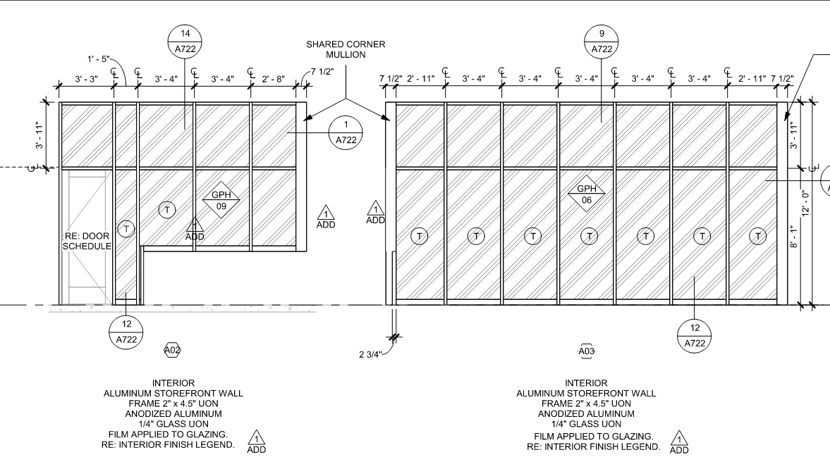
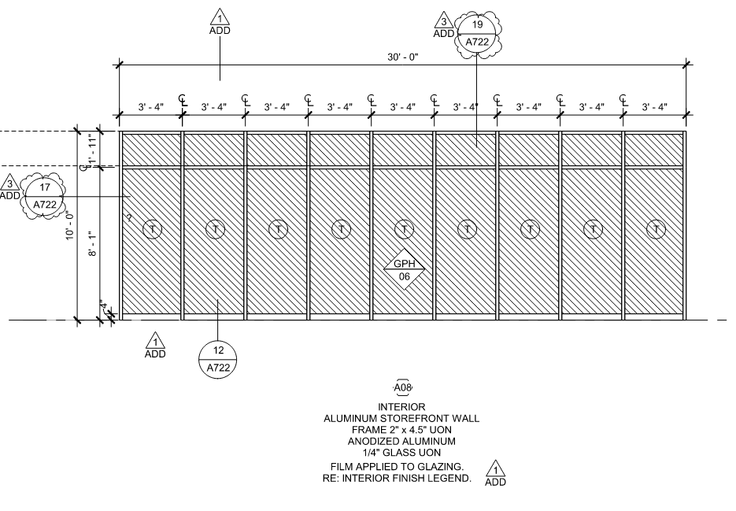
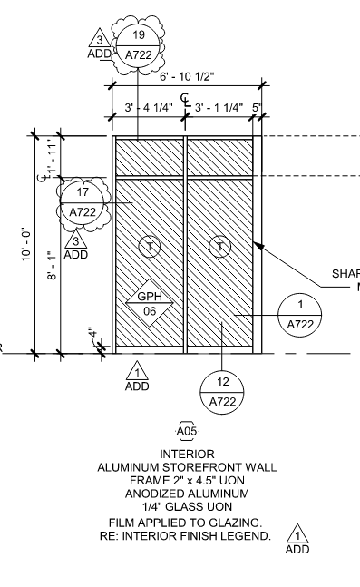
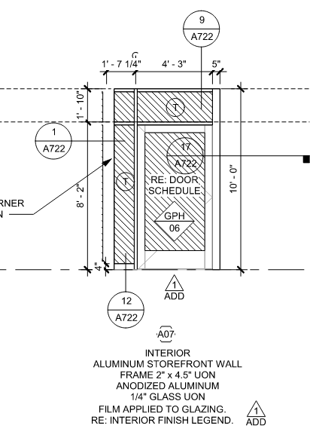
CUSTOMER SERVICE & THERAPY PARTNER – STOREFRONT GRAPHICS
Photo image printed on translucent vinyl
BRS to design w/ input from City & Arts Commission

Slide 39
CABANA DOORS– STOREFRONT GRAPHICS
Photo image printed on translucent vinyl
BRS to design w/ input from City & Arts Commission

Slide 40
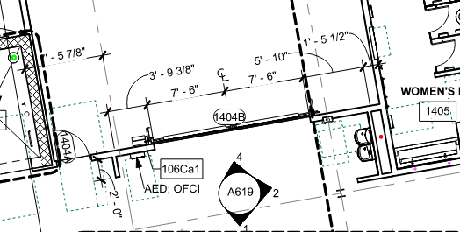
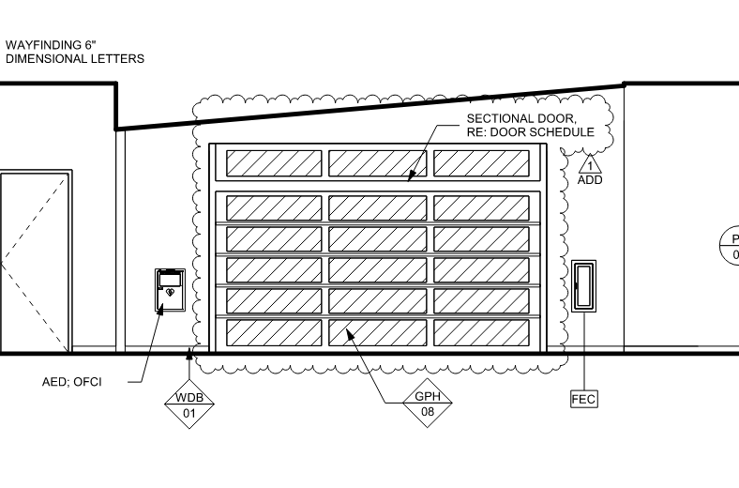
FITNESS AREA – STOREFRONT GRAPHICS
Photo image printed on translucent vinyl
BRS to design w/ input from City & Arts Commission

Slide 41
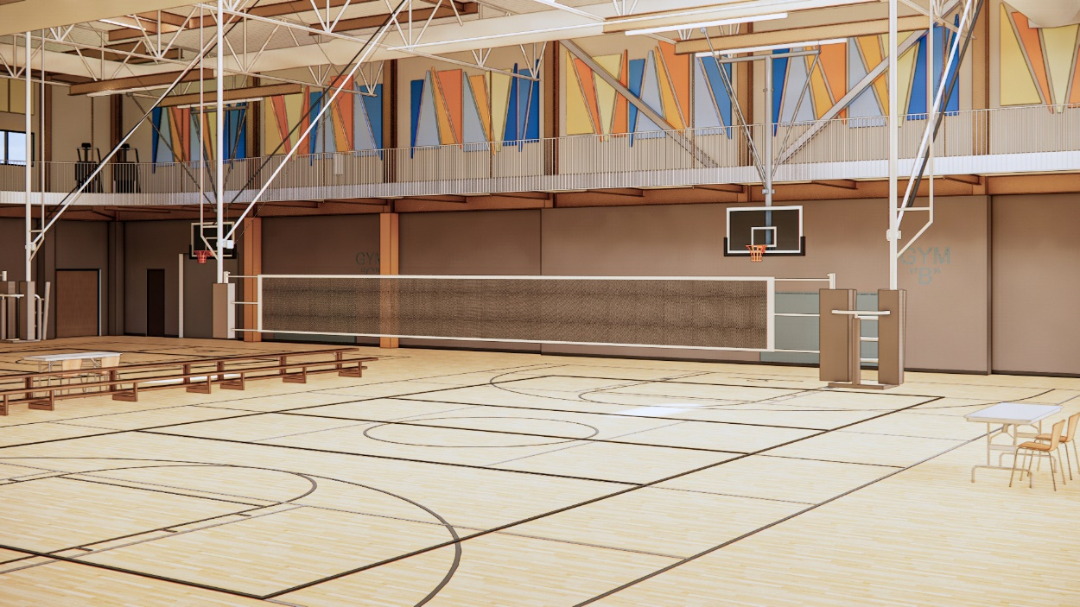
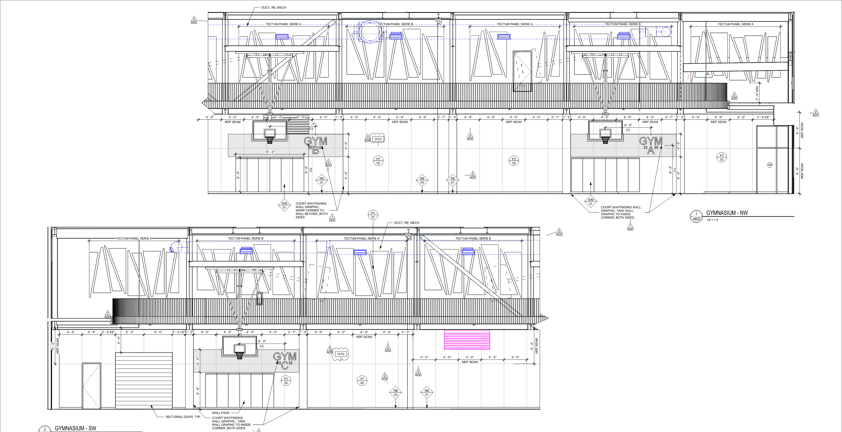
WALKING TRACK / GYM – ACOUSTIC WALL PANELS
UPDATE
Custom cut tectum acoustical panels

