Slide 1
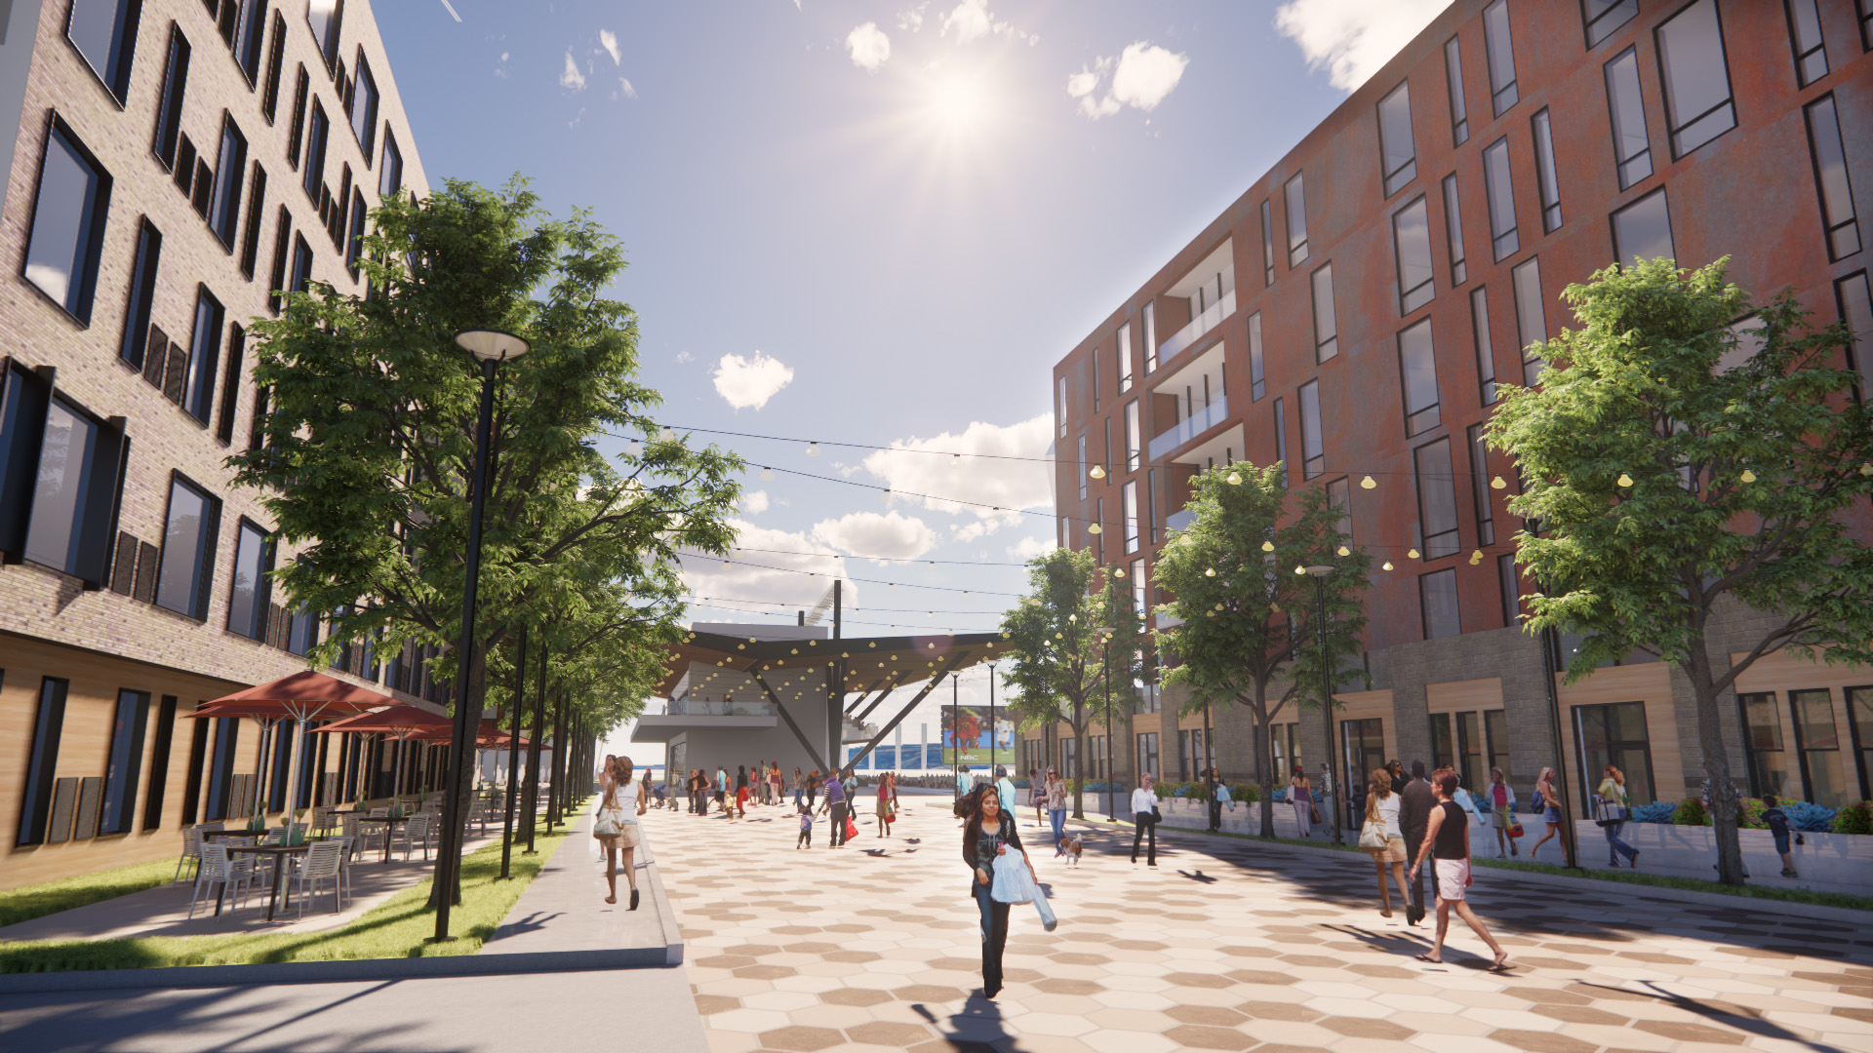


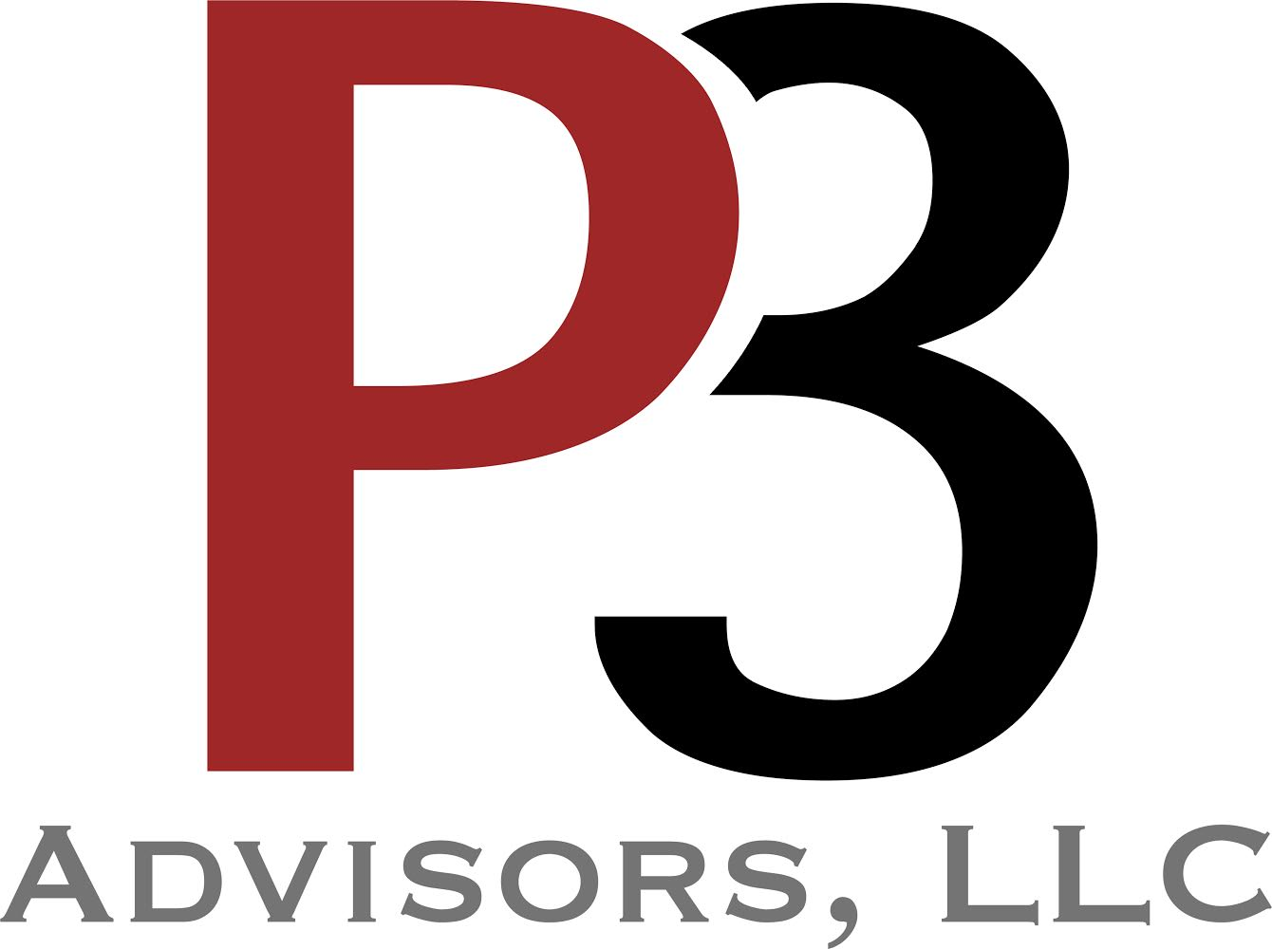
City of Grand Junction
Redevelopment of the Sawmill Site
13 February 2025

Slide 2
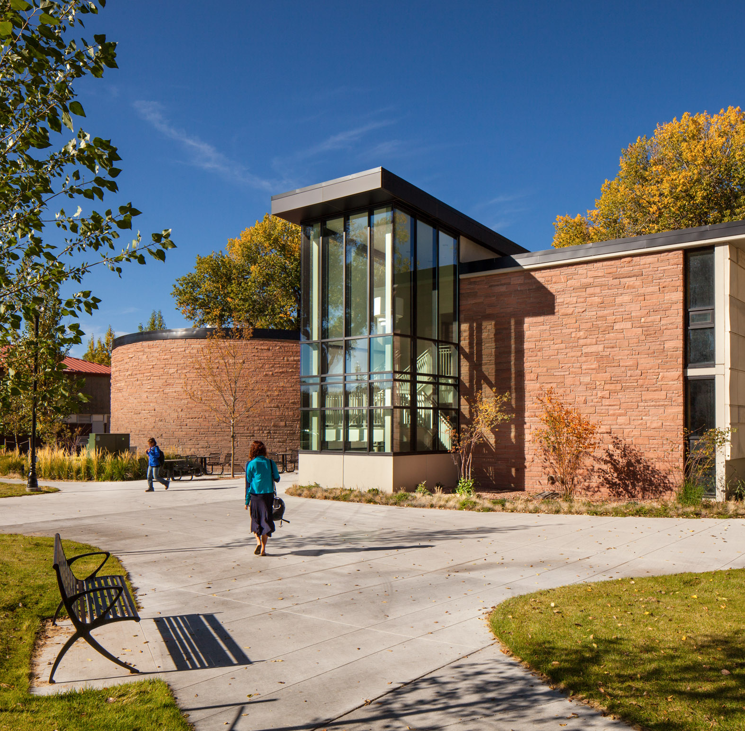
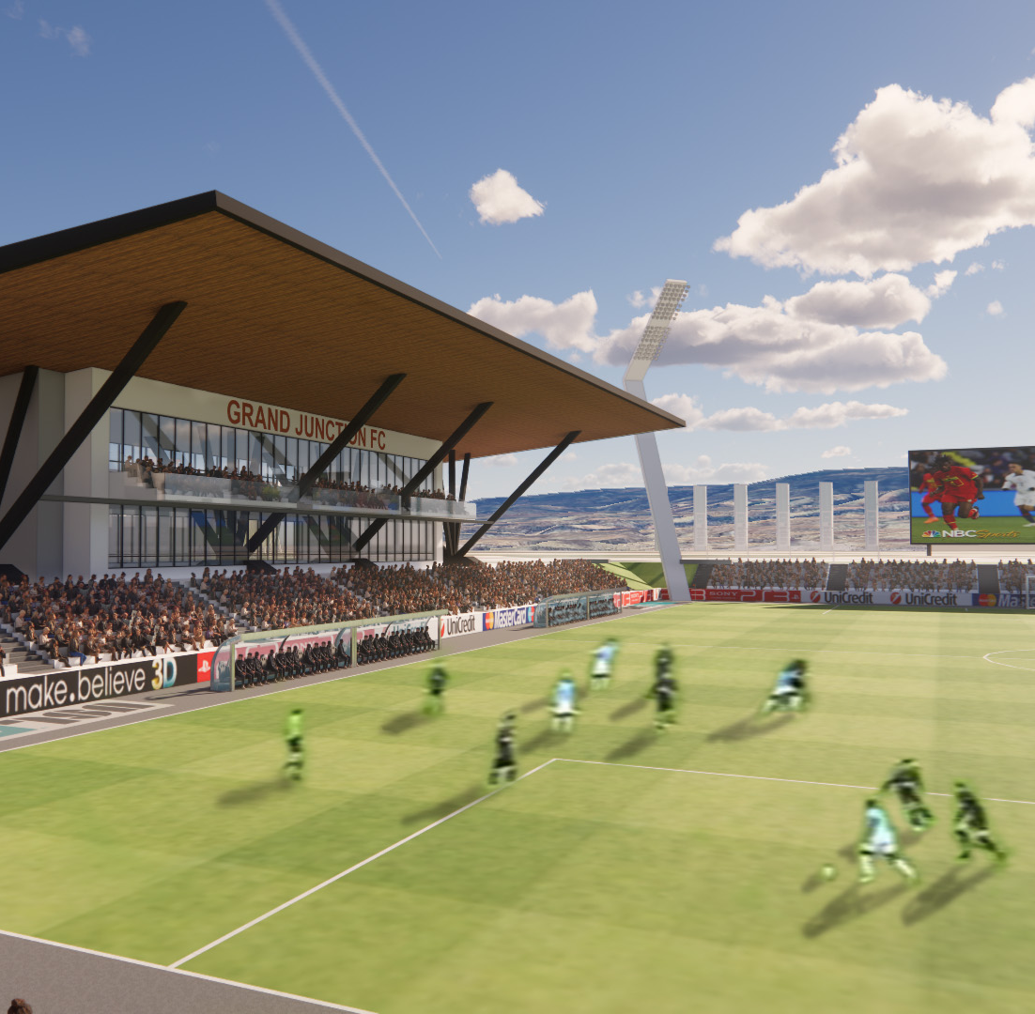
Agenda
Team Introduction
Market Conditions
Site Constraints
Existing Site Conditions
City’s Capital Investment
Affordable Housing Experience & Breakdown
Q&A
Closing Statement

Slide 3
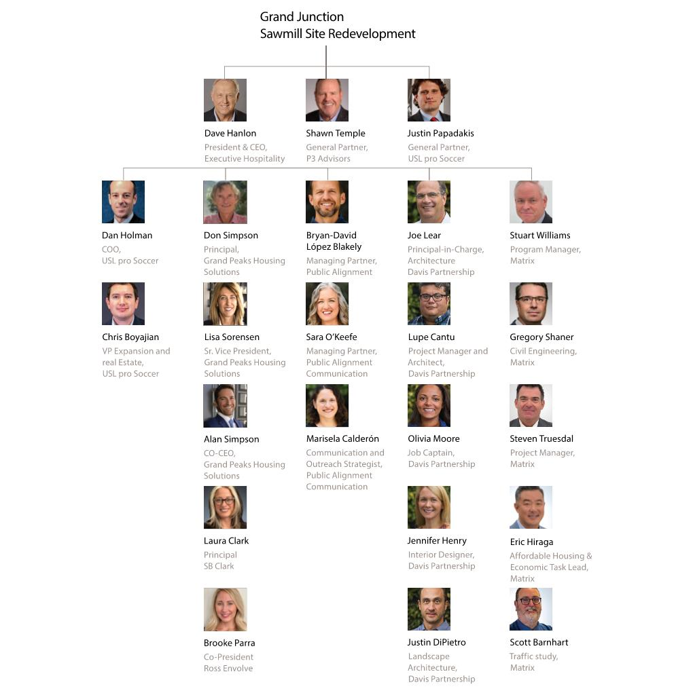
Team overview

Slide 4
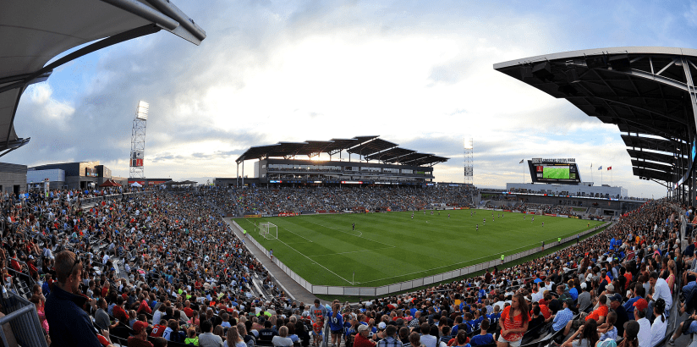
Market Conditions

Slide 5
Housing / Mixed use / United Soccer League
Market conditions
Housing
  Discussed more in Affordable Housing section
Mixed Use Districts
  Year-round, multi purpose facilities
  Concerts, conventions, other live events
  Added value to surrounding developments
  Increase in programming capabilities – Increase in revenue generated
United Soccer League
  Benefits the surrounding community
  Local job creation
  Adding office and residential programming brings in year-round traffic
  Active, vibrant environment

Slide 6
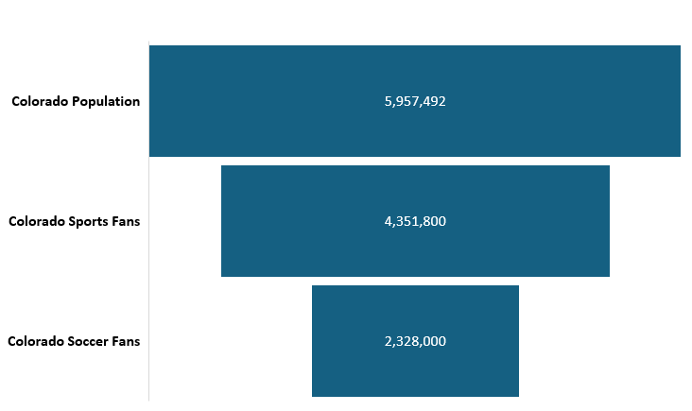
COLORADO HAS A ROBUST BUILT-IN SOCCER FAN
BASE PRIME FOR NEW, HOMETOWN TEAM
Colorado has a huge upside, in terms of soccer fan concentration, in addition to having a large casual sports fan consumer base.
Population Size
Decoder, January 2024 – June 2024; A soccer fan is a resident of the market whose level of interest ranks 2-7 on interest scale of 1-7, 1 being not interested and 7 being extremely interested, in the following leagues: USL, MLS, NWSL, USWNT, USMNT, Liga MX, Liga MX Femenil, EPL, La Liga, Bundesliga, Ligue 1 & Serie A.

Slide 7
COLORADO SOCCER FANS BRING A
DIFFERENTIATED AND VALUABLE CONSUMER
The Colorado soccer fan represents a young, diverse, educated, and financially influential market.
Colorado soccer fan index compared to the Colorado DMA (13+)
Read as: Colorado soccer fans are 27% more likely to fall between the ages of 18-34 when compared to the Colorado DMA.
The soccer fanbase in Colorado is younger than the general DMA. This suggests a strong opportunity for a USL club to engage with a young audience and build a foundation for the long-term customer value.
Colorado soccer fans have higher spending power which is notable given the younger age profile and cultural makeup of the fan base
The younger Colorado soccer fan segment is also highlighted by those with a full-time employment status and under-indexing for retirees.
Decoder, December 2023 – November 2024; A soccer fan is a resident of the market whose level of interest ranks 2-7 on interest scale of 1-7, 1 being not interested and 7 being extremely interested, in the following leagues: USL, MLS, NWSL, USWNT, USMNT, Liga MX, Liga MX Femenil, EPL, La Liga, Bundesliga, Ligue 1 & Serie A.

Slide 8
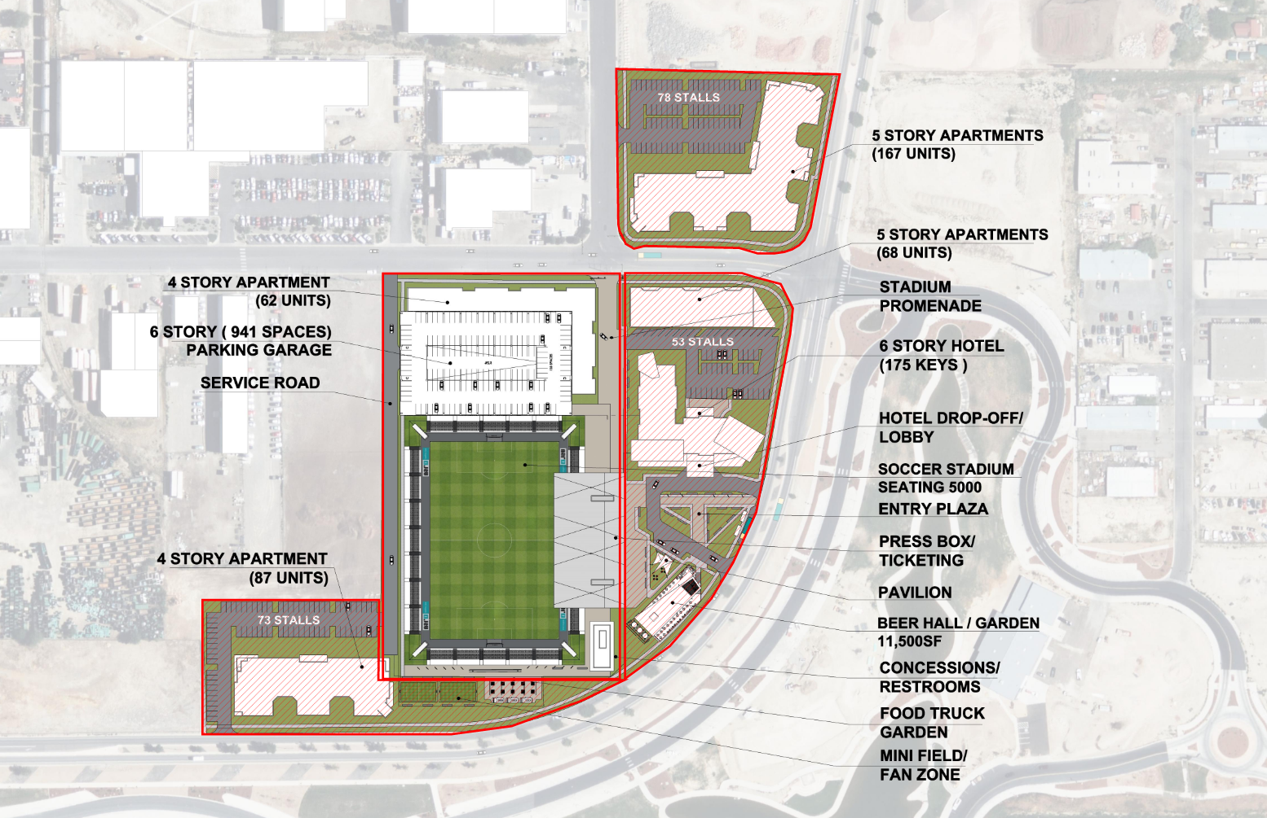
Site Constraints

Slide 9
DOE Covenant Boundaries
Site constraints
  Possible difficulties with developing these areas
  Environmentally focused development strategy
  Team’s strong relationship with CDPHE

Slide 10
Site Development Strategy
SITE CONSTRAINTS
Does the DOE Covenant specifically prohibit Housing?
  From the Language in the document, this does not seem like the case
Keep CDPHE involved during planning for the residential locations
  CDPHE experience with other mine tailing sites in CO
  Possible CDPHE Requirements:
Phase II Environmental Site Assessment
  Needed to address the 3 Recognized Environmental Conditions (REC) in the Phase I report
  Identify possible Voluntary Cleanup concerns (residual radiation, groundwater quality, soil quality)
Other Assessments
  Residual surface radiation survey
  Confirm report that radiation values are below EPA levels
  Soil quality assessment
  Geotech borings (for pavement/foundation design as well as environmental sampling)
  Detailed review of historical site data from Phase I report
  Plan B if the initial proposal is problematic

Slide 11
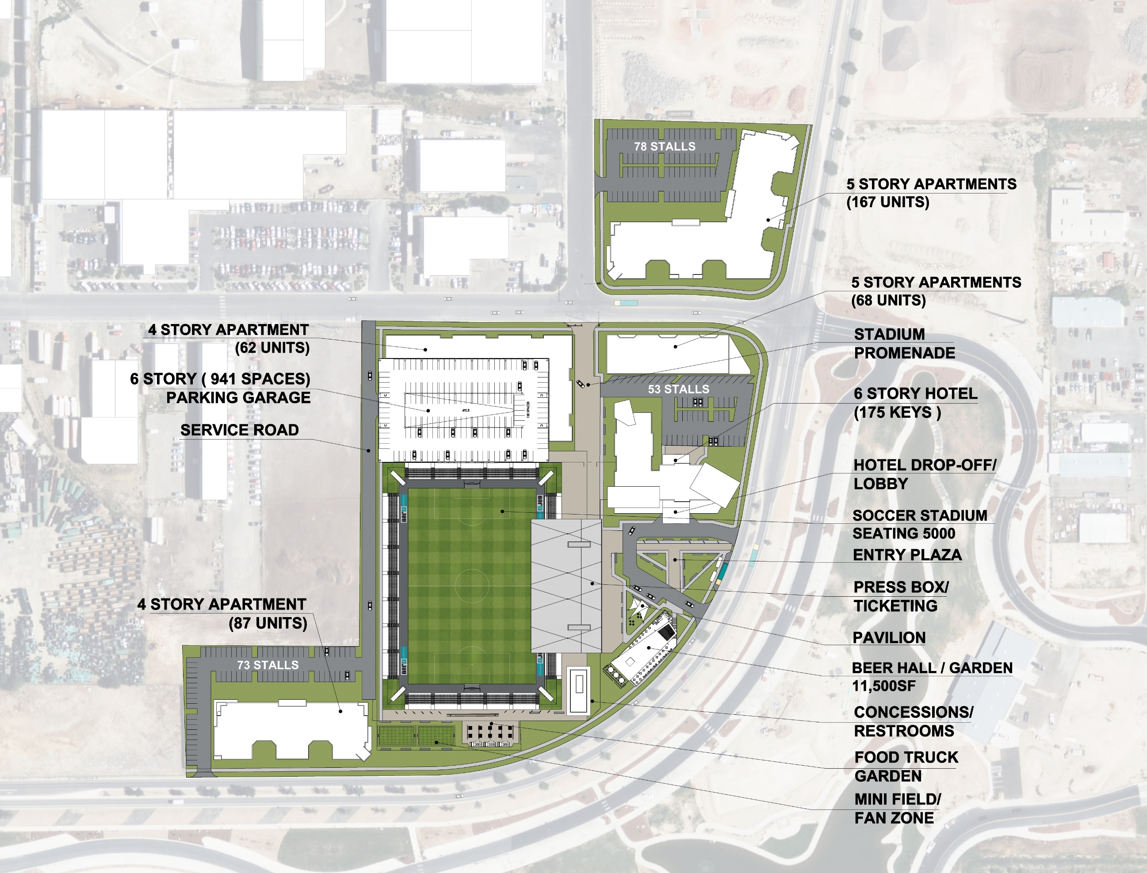
Initial Concept
Site constraints
DOE Covenants
  “Used for Public purposes”
    Retail
    Food & Beverage
    Lodging
    Focus on pedestrian spaces
  Radon Ventilation
    Separation of occupancies

Slide 12
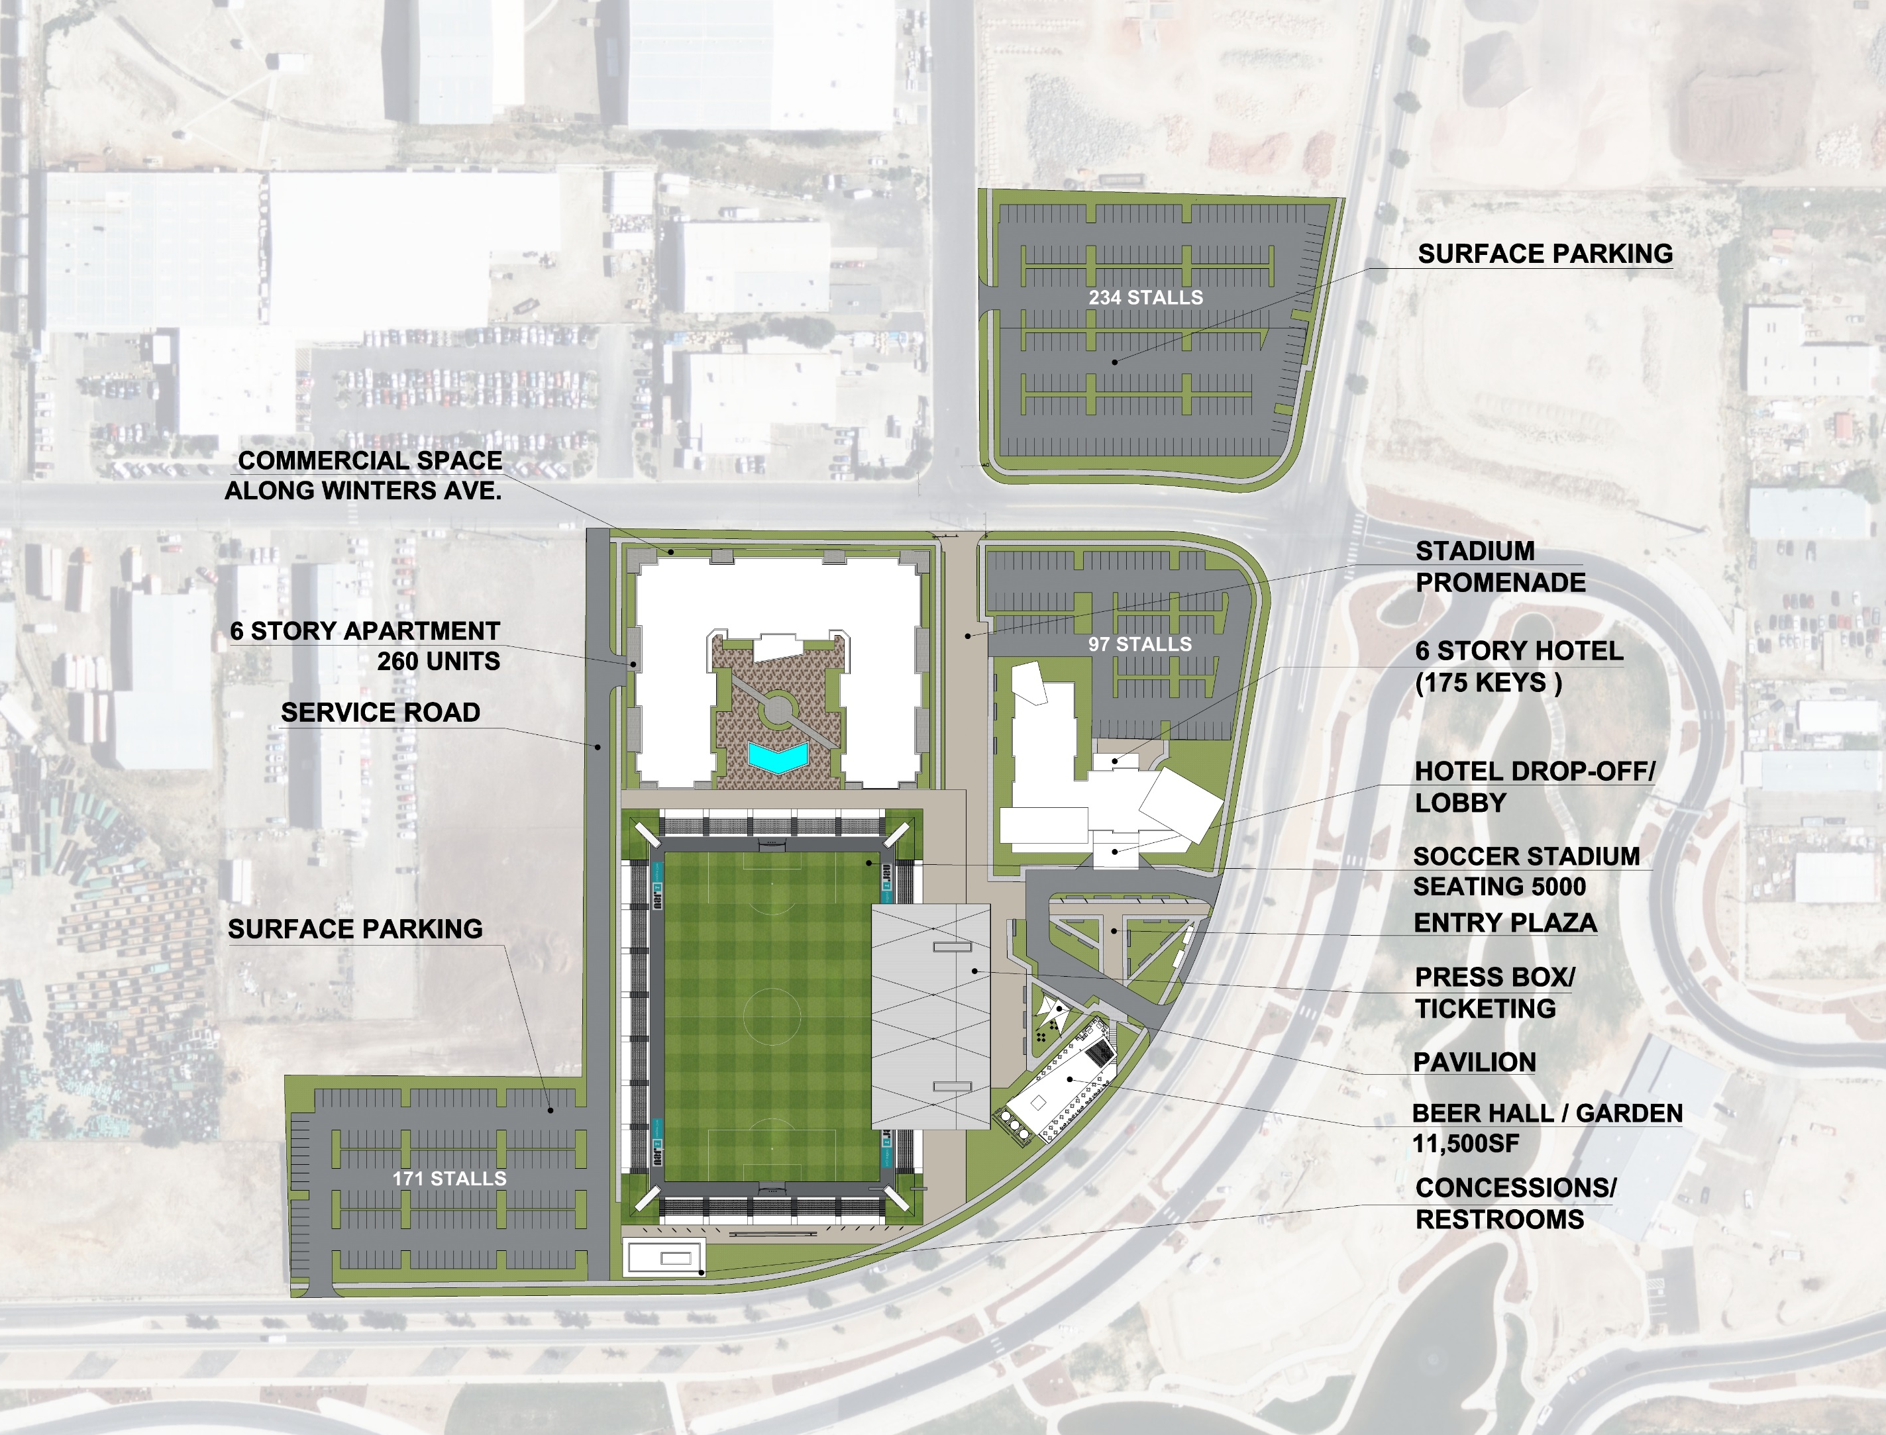
Updated Concept
Site constraints
  All residential outside of Covenant areas
  Surface Parking to replace parking garage
  Retail along Winters Ave.
  Geotech report to determine ground water elevation – sunken field or at grade

Slide 13
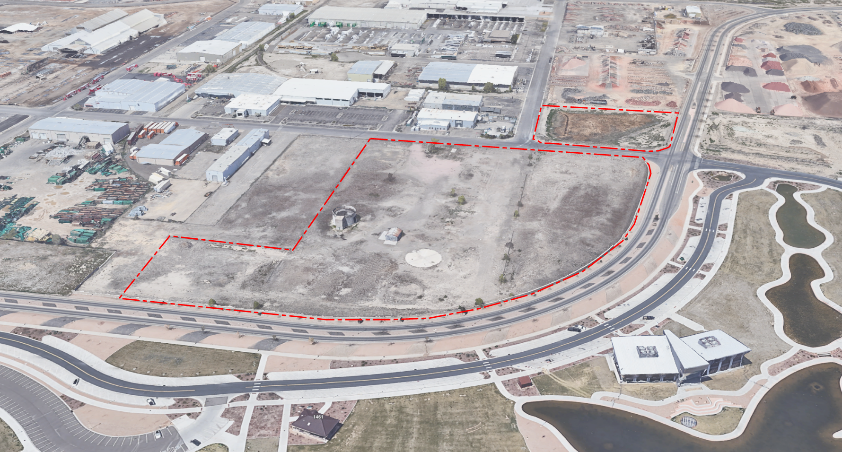
Existing Site Conditions

Slide 14
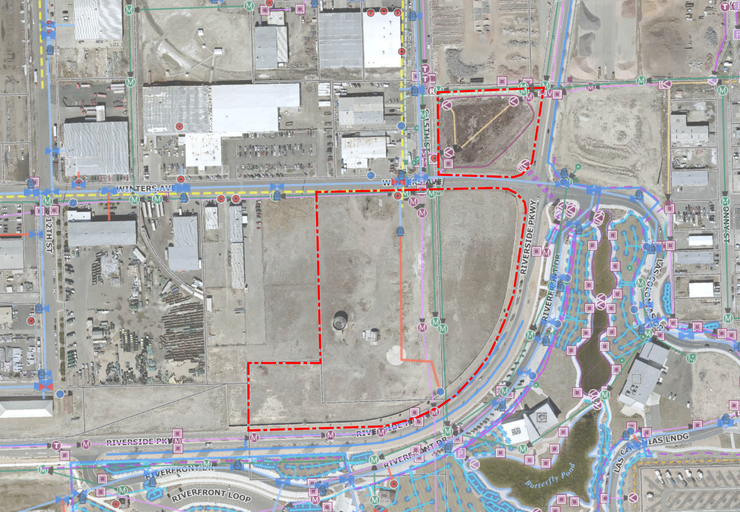
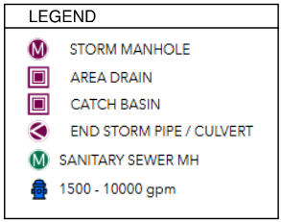
Known Conditions
Existing site
conditions
  Water detention area - North parcel
    Detention vault
  Existing Structures
  Existing Utilities
    Locations
    HV overhead power
    - Relocated

Slide 15
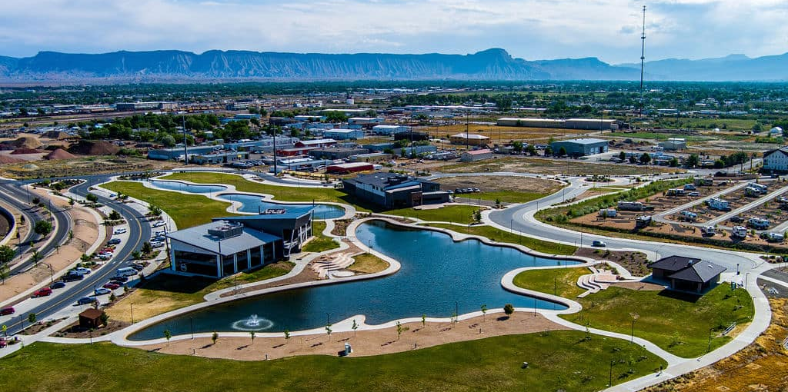
City’s Capital Investment

Slide 16
City Partnership
City’s capital investment
City involvement with overall investment
  Development of the site and other communities needs
  Shared vision of reimagining the Sawmill site to enhance city investment in Las Colonias Park
  Utilization of Local, State and Federal tools / grants
  Work with local stakeholders to build community support
Possible Public Finance tools:
  Land Cost
  TIF URA, BID, DDA
  Special Districts Metro
  Sales Tax Share Back
  PIF, Public Improvement Fee
  Add On PIF Tickets, Hospitality, Retail, F&B
  Hotel Tax
  501c3 Publicly Owned Hotel
  CPACE Mesa County
  Philanthropy

Slide 17
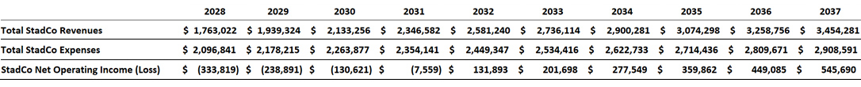
Stadium Investment
City’s capital investment
Stadium Cost
$35-45m
  Additional costs covered by special districts and other development parcels:
    Land Acquisition
    Utilities
    Site work
    Parking
    FF&E
    Soft Costs
Benefits
  Economic Stimulation: Boosts local economy through increased tourism, hospitality, and retail spending on game days and during events.
  Increased Tax Revenue: Even if the stadium weren’t profitable itself, surrounding businesses benefit from increased activity, leading to higher sales and property tax revenues.
  Community Engagement: Provides a venue for local events, concerts, and community gatherings, enhancing civic pride and cohesion.
  Boost to Local Businesses: Restaurants, hotels, and shops in the vicinity benefit from increased foot traffic on event days.
  Branding and Image: Elevates the city's national or international profile, making it more attractive for future business investments and residents.
  Real Estate Development: Encourages new residential and commercial developments in surrounding areas, increasing property values and local amenities.
Stadium Pro Forma*
*Pro forma does not include debt service. Actual financial outcome will depend on the funding strategy. Once the funding details are finalized, debt service will be added to assess the stadium’s overall profitability and financial sustainability.

Slide 18
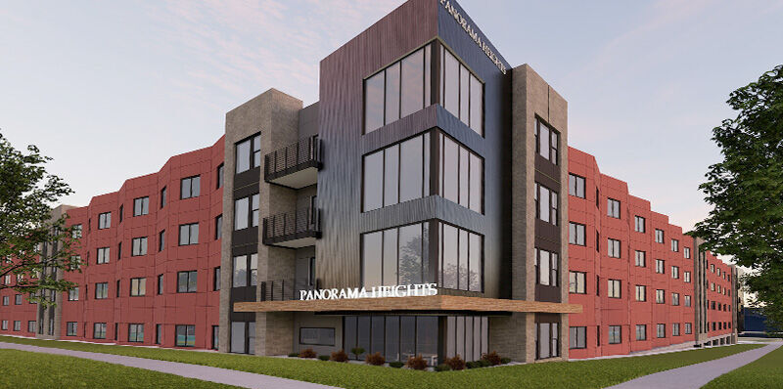
Affordable Housing Experience & Breakdown

Slide 19

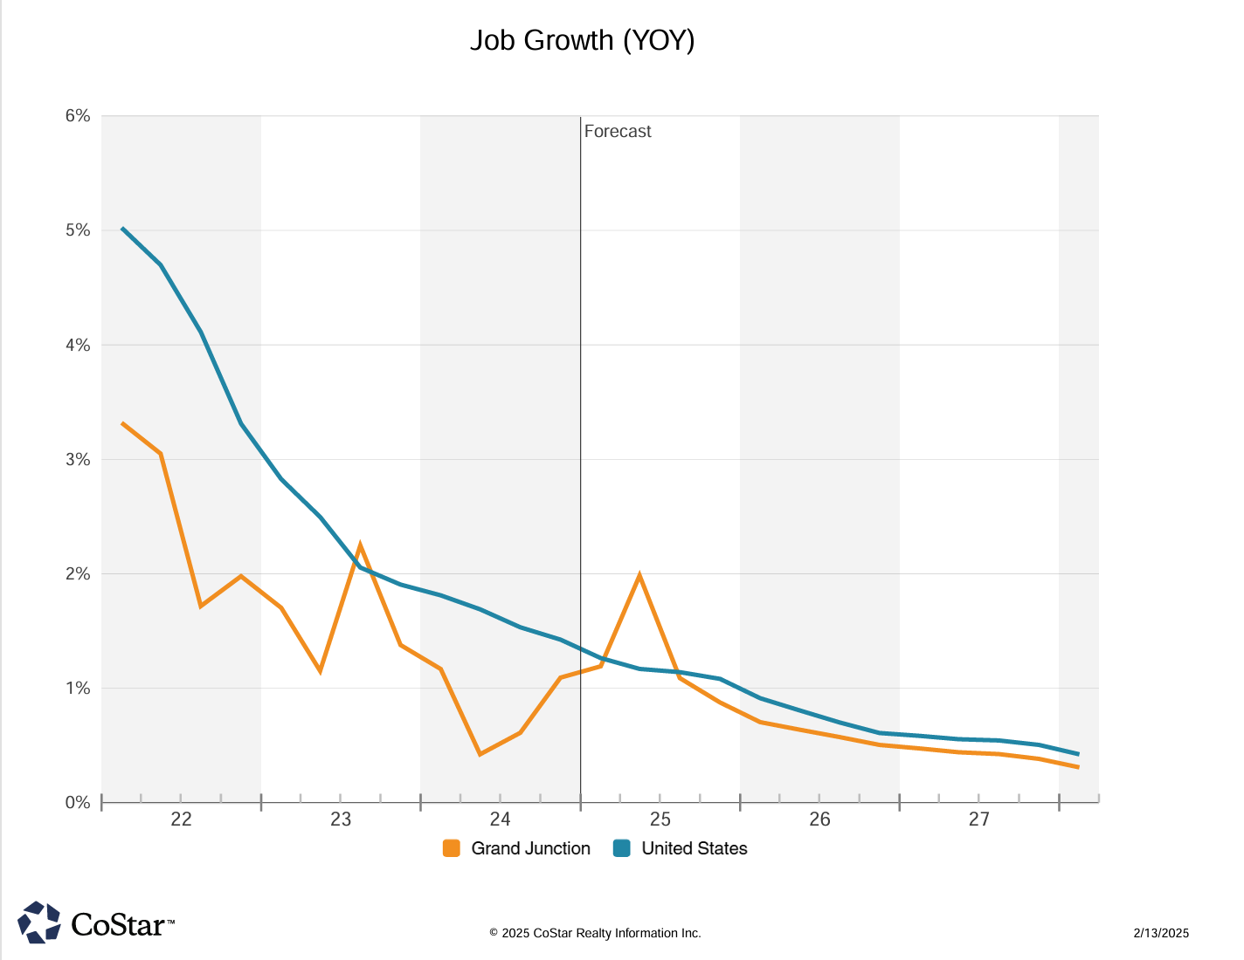
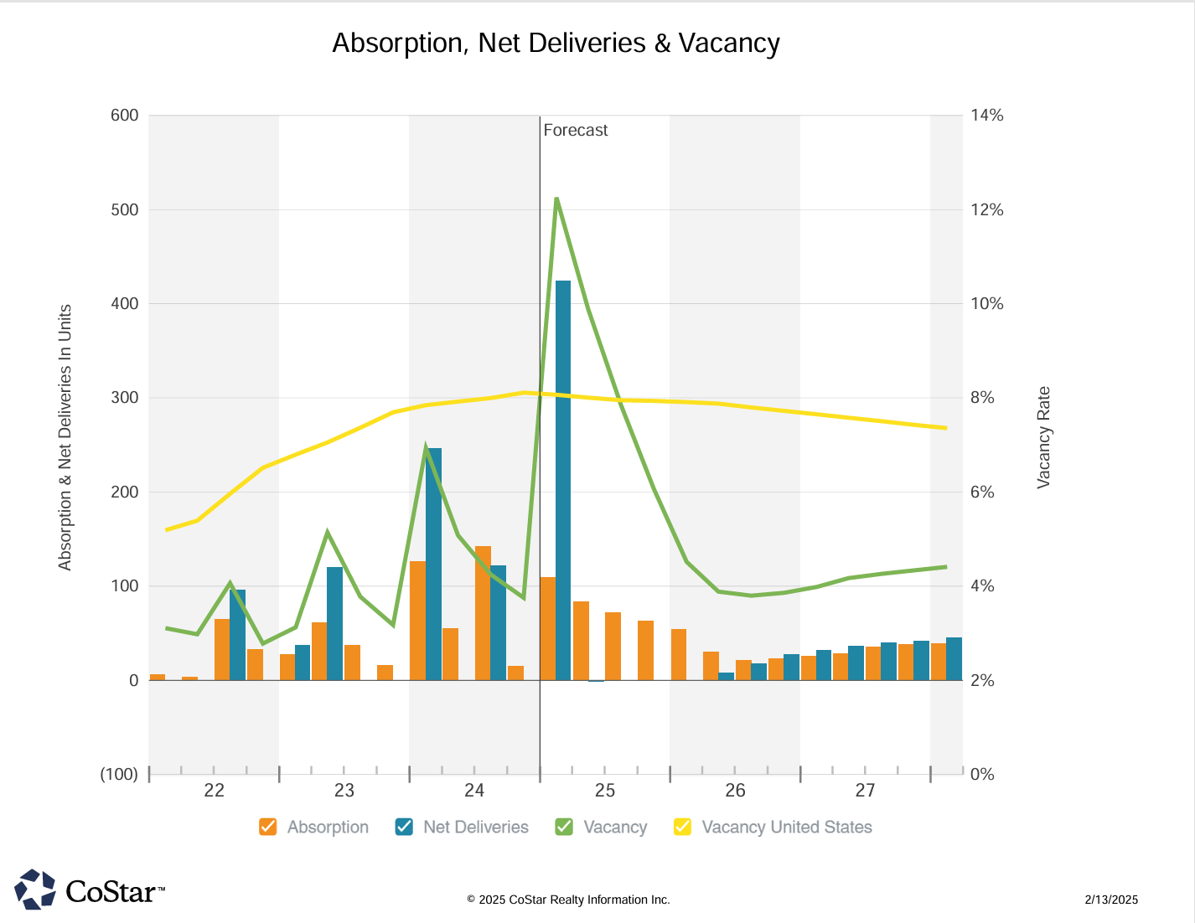
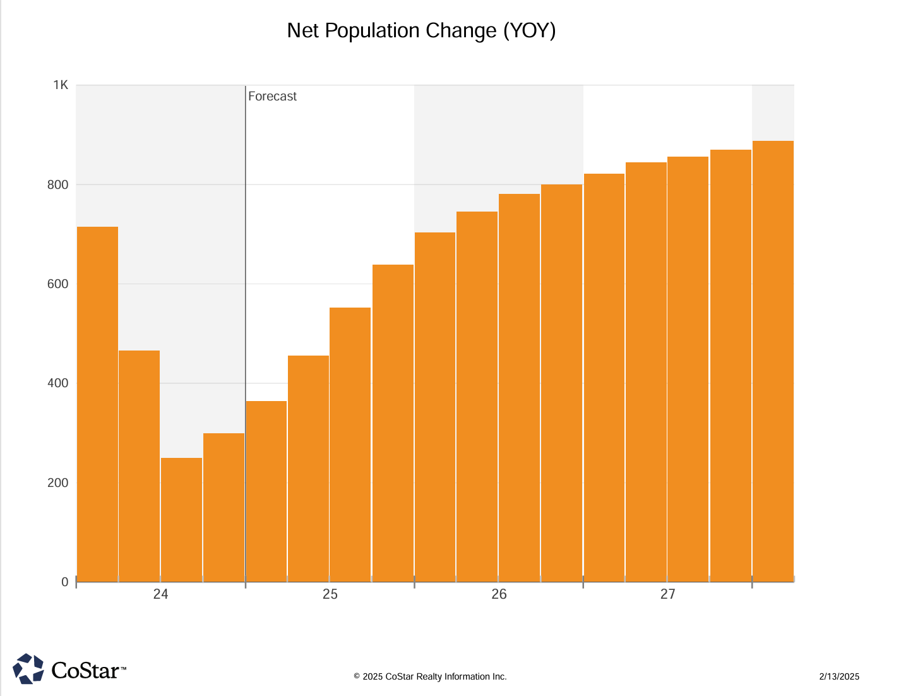
Grand Junction Job/Housing/Population Growth
2025 Spike will Increase Demand
MKT Deliveries this year but, then…
Population is back on the rise
Source: 2025 CoStar Realty Information Inc.

Slide 20
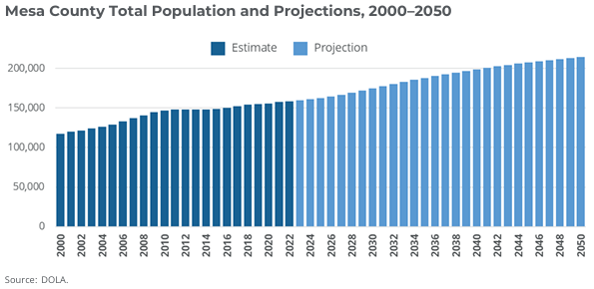
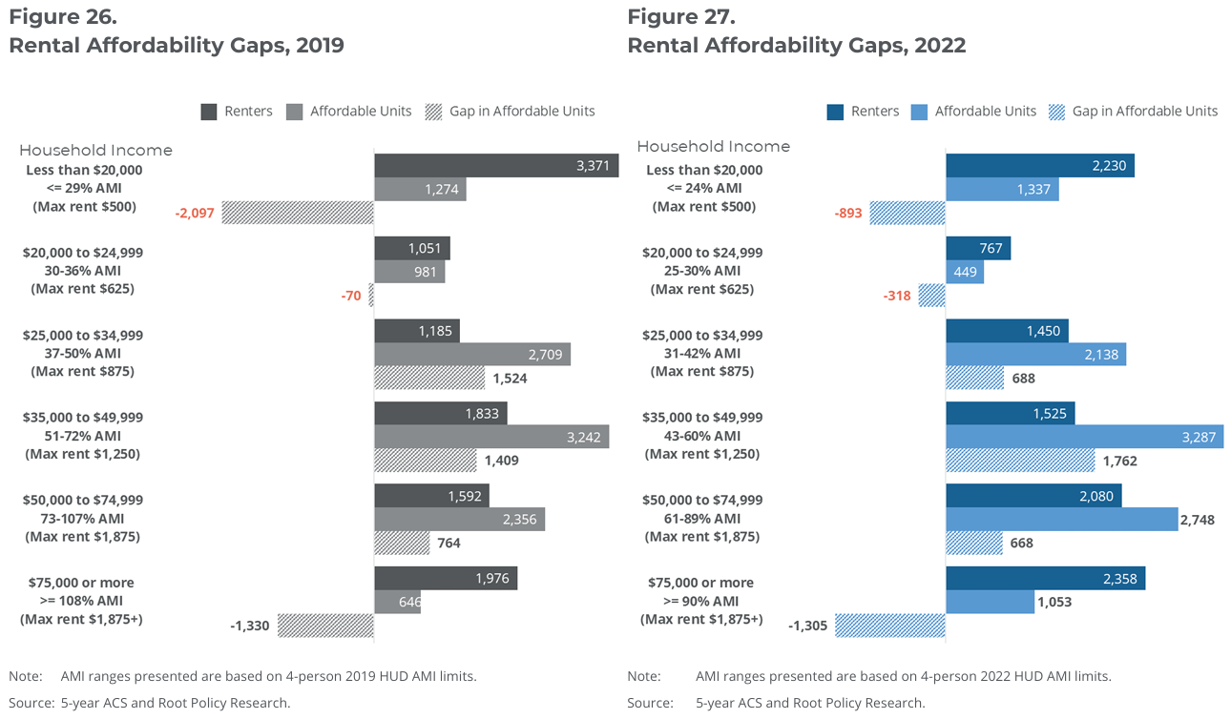
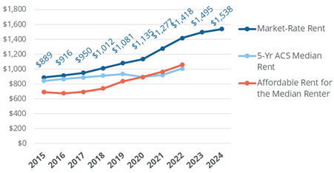
Regional Growth and the Need for Housing
Population and employment growth (Amazon/ExoPower/West Star) creates even greater housing needs to catch up.
Progress on affordability but, pain points are largest at the lower (<=36%) and higher (>=90%) end of the spectrum.
New area supply is Market Rate (Kimball/Struthers/Eddy/Lofts on Grand)
Immediate area supply insufficient (Struthers@48/Eddy@96)
GJH Strategy Update Stakeholder Survey’s Top Concerns
  Limited Rental Housing (Overall and for Seniors)
  Lack of Accessible Housing Stock
  Inability to Attract or Retain Workers
  Inability to Attract or Retain Families
Market/Affordable rent gap continues to grow.

Slide 21
Grand Peaks Housing Solutions upholds the below values to meet the needs of diverse populations while fostering strong partnerships with cities, counties, development teams, and funding sources.
Good partners. Good neighbors.
Affordability
Providing multi-family homes that cater to residents within the 30% - 140% Area Median Income (AMI) range, ensuring
that housing options are financially accessible.
Quality
Commitment to delivering safe, high-quality living environments that enhance the well-being of residents and foster community pride.
Collaboration
Establishing strong partnerships with cities, architects, state agencies, and non-profits to secure necessary funding and resources, ensuring a comprehensive approach to housing development.
Community Integration
Partner with local neighbors & businesses to make connections and promote social cohesion and enhance the quality of life for all.
Longevity
A focus on long-term partnerships, with a commitment to holding properties for 15
years or more, which promotes stability and community investment.
Attention to Detail
A dedication to meticulous planning and execution, ensuring that projects meet the promised standards and fulfill the needs
of the community.
Sustainability
Build better buildings that minimize negative effects on our environment
and promote health
Perseverance
A willingness to navigate the complexities of financing and project development, demonstrating resilience
in overcoming challenges to see projects
through to completion.
Integrity
A guiding principle of honesty and commitment to serving communities, ensuring that the developer remains accountable to residents and stakeholders throughout the process.

Slide 22
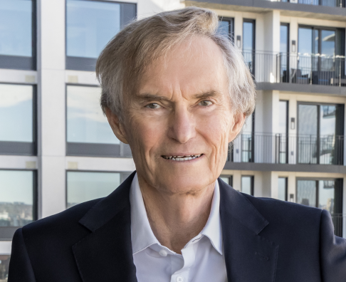
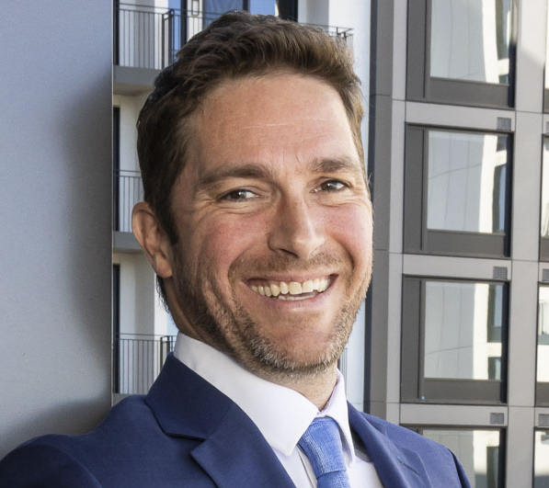
Don Simpson
Chairman - Grand Peaks Properties & Grand Peaks Housing Solutions
Lisa M. Sorensen
Senior VP - Grand Peaks Housing Solutions
Alan Simpson
Director - Grand Peaks Housing Solutions
Don was a pioneer in the LIHTC industry and, became one of the largest aﬀordable housing developers and operators in the nation. During his career, Don Simpson served as the Master Developer for the Revelstoke ski area and mountain resort in B.C. The Simpson family has demonstrated their passion for housing solutions through initiatives with the Denver Public Schools Foundation to provide free housing to local teachers, as well as the funding of the University of Denver’s Aﬀordable Housing Certiﬁcation Program.
Lisa M. Sorensen is a seasoned real estate development and finance professional with 30 years of experience in affordable housing. She has a strong track record managing complex development projects from site selection through move-in, securing financing, and fostering strategic relationships with key stakeholders, including governmental and non-profit boards, investors, and business partners. Lisa has delivered multiple large-scale housing projects, utilizing a broad range of funding sources, including both the LIHTC and NMTC programs. She has held leadership roles at prominent organizations such as Cohen-Esrey Development Group and the Denver Housing Authority, where she led teams in the successful creation of hundreds of housing units.
Alan began his career in 2008, working on the marketing for Revelstoke Mountain Ski Resort in British Columbia. Following time in leasing, operations and asset management, he joined Grand Peaks' development department in 2021, developing sites in Arizona and contributing to the acquisition, rehabilitation, and development of over 1,400 units across 5 properties. During this time, he grew concerned with how expensive and unsustainable housing options were in his home state of CO. In recent years, he has shifted focus to creating more affordable housing and technology solutions to create a more sustainable and prosperous future. He has worked with the Colorado Energy Office, Winn-Marion, and Xcel Energy to provide electric vehicle and energy use optimization services to Grand Peaks communities.

Slide 23
Financing Methods / Populations Served
Goal to create a community through partnership and consultation with Grand Junction that reaches populations from 30-140% AMI.
Approach to Affordable Housing utilizes multiple project finance methods:
Mixed Income Housing
(Avg. AMI 120%)
Growing Local Workforce
Families and Female-Headed Households
Disabled and Special Needs
USL Players, Coaches and Staff
Veterans
Seniors wishing to downsize and age in place
Housing Choice Voucher Program
LIHTC Program
(4% and 9%)
Dev. Impact and TCP Fee Waivers
Property Tax Abatement
DDA Tax Increment Financing
Solar/45L Credits
Local/County/State Grants
HOME Program
CHFA Middle-Income Access Program

Slide 24
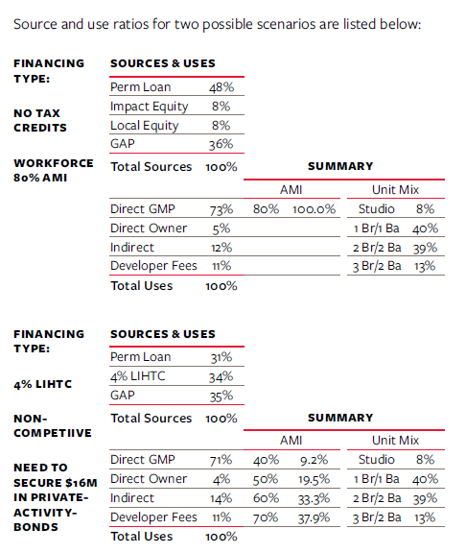
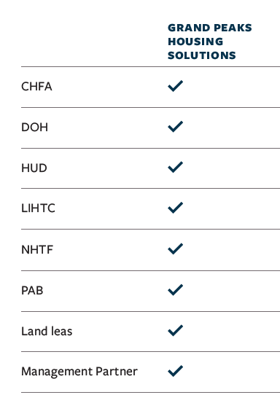
Organization Experience / Sources & Uses
GPHS leadership has worked successfully with Federal and State financing organizations to bring high-quality housing to those in need. A partial list of past and present partners is below.

Slide 25
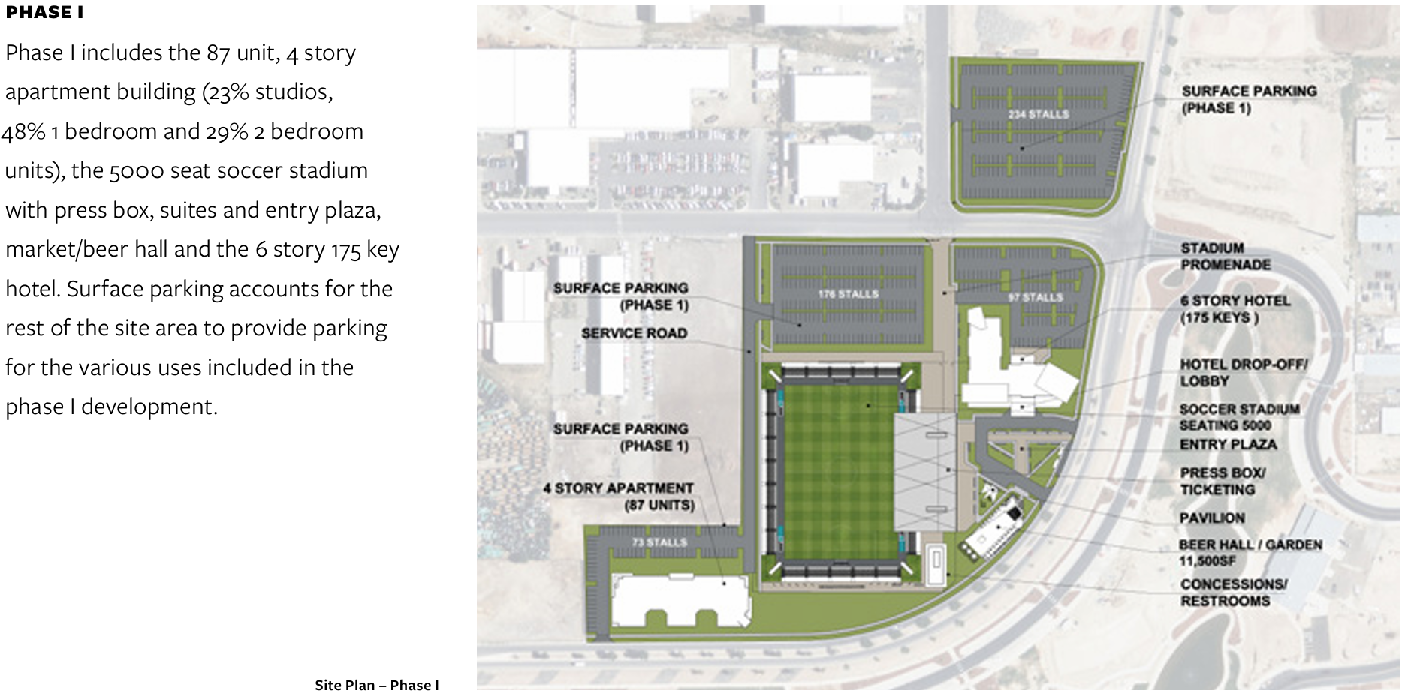
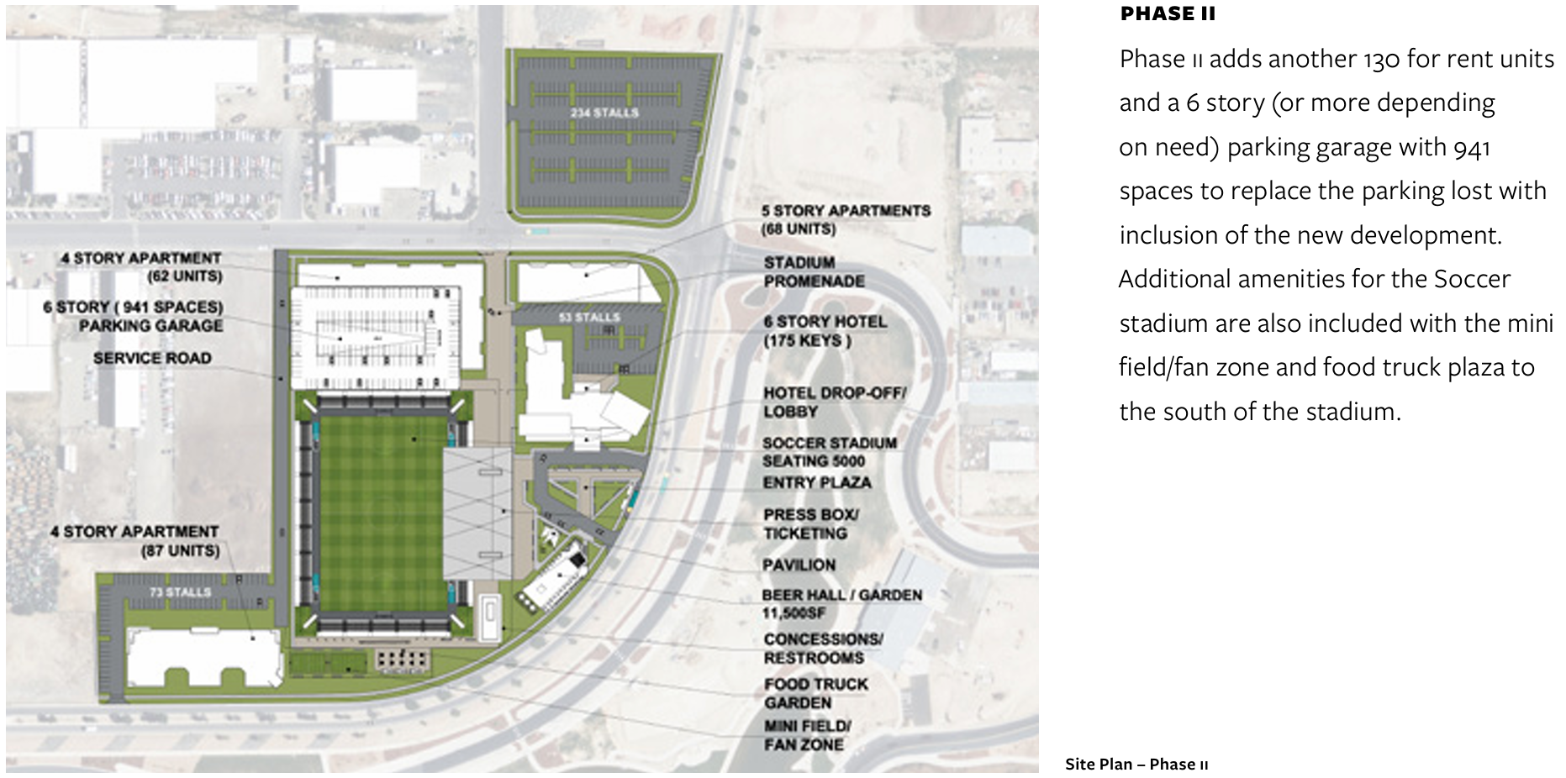
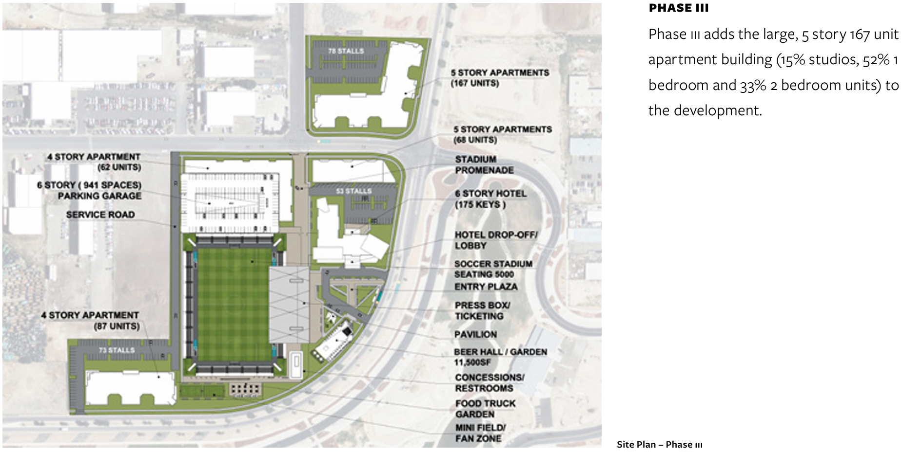
Scenario 1
3 Phases – 384 Homes

Slide 26
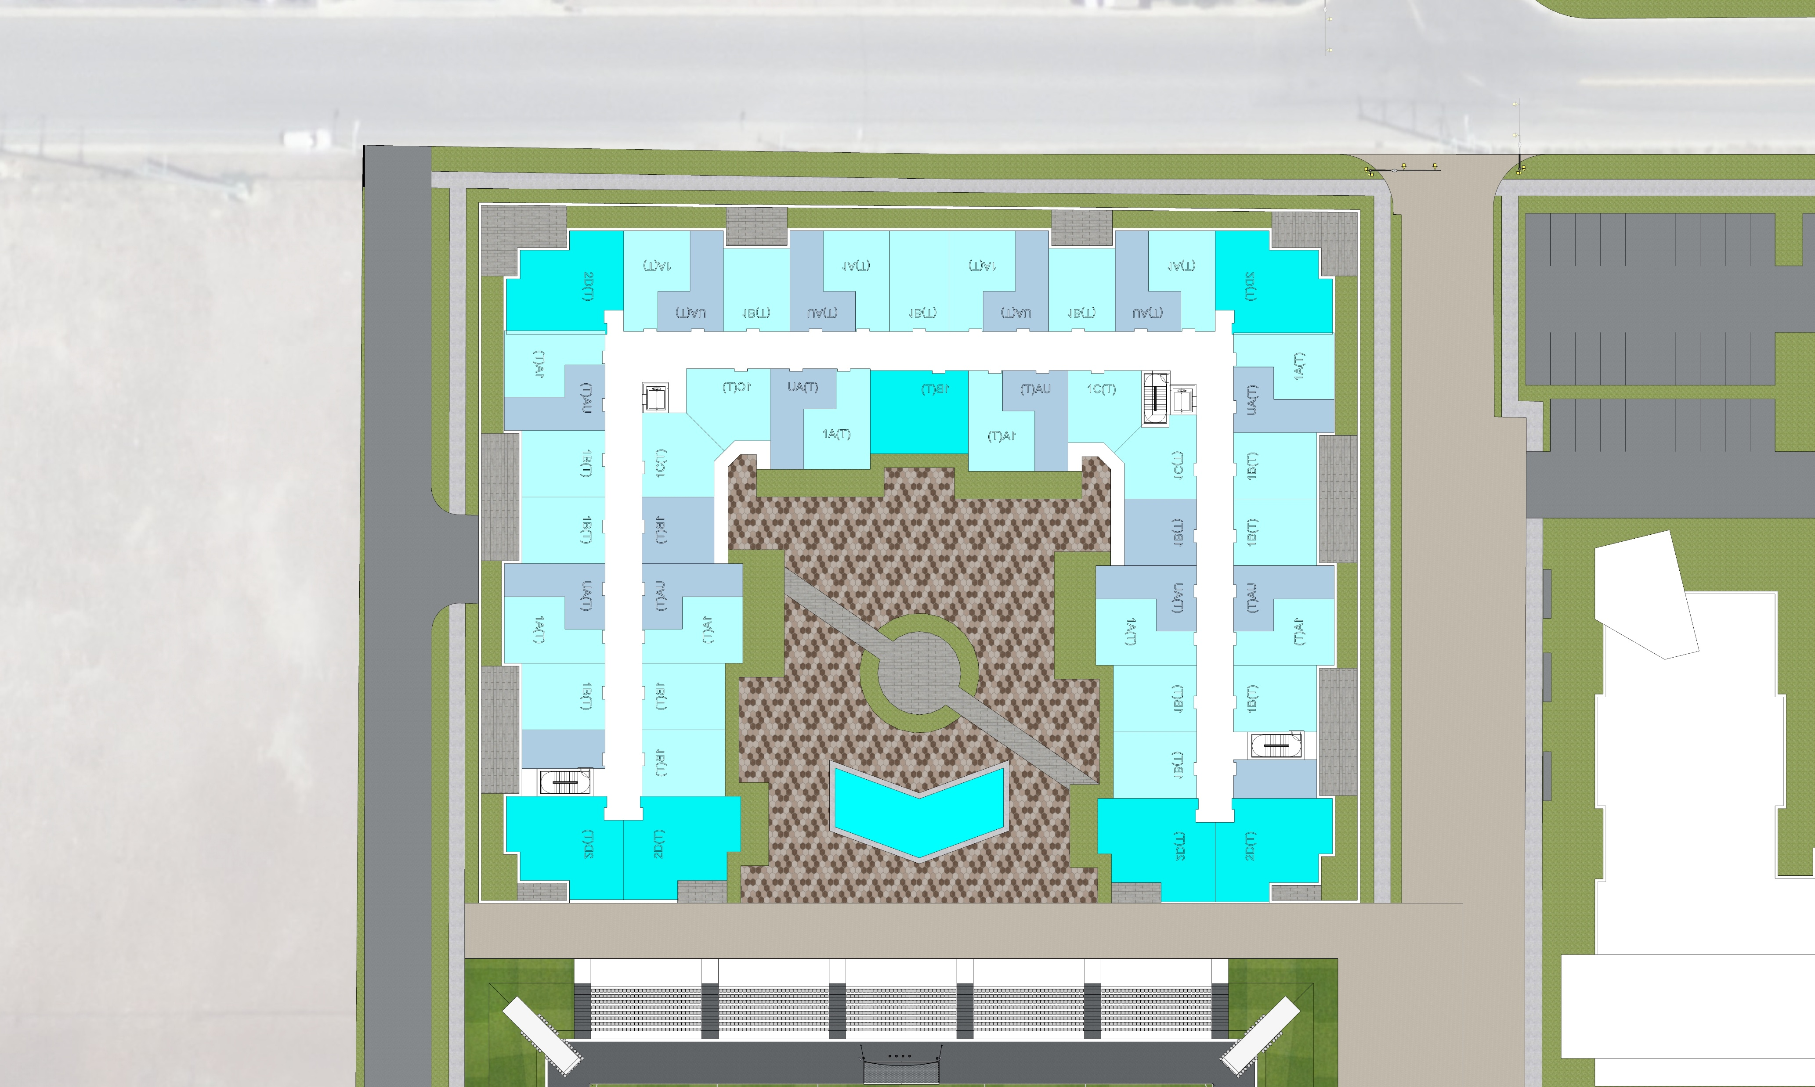
Scenario 2
Single Phase – 260 Homes
Should the public use ruling from CDPHE prevent Scenario 1 from being realized, one alternative solution will be to combine the four phases from our previous slide into one central housing development inside the primary parcel’s bounds on the North side of the stadium.
This would consist of a single-story concrete podium to house commercial spaces on the perimeter with covered garage parking in the center. Five stories of wood-framed housing would extend above the podium along the West, North and East, with a pool and amenity deck over the parking and southern facing commercial area.
Parking capacity we lose in the removal of the 6-story garage planned in the first scenario can be made up by providing surface parking on the CDPHE restricted land outside the primary parcel.
Total = 260+ Units

Slide 27
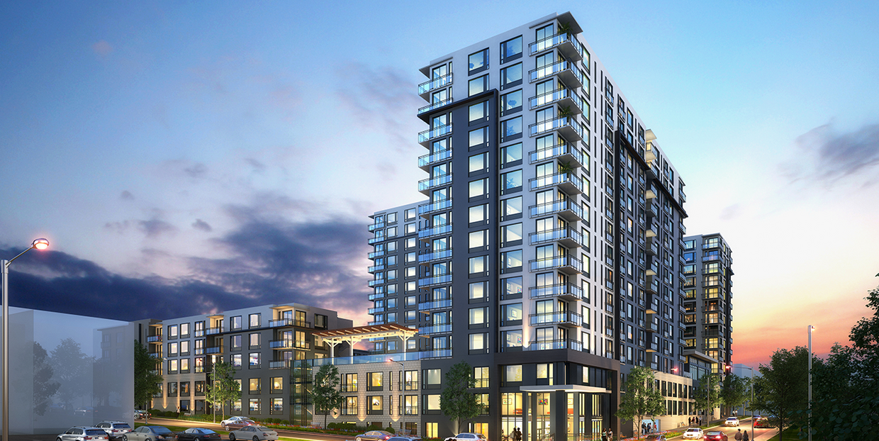
Scenario 3
Single Phase – 312+ Homes
260 units represents 5 stories of wood-framed construction above a concrete podium and respects the existing 65 ft. height limit.
However, should the city wish to add more housing here, we also have the experience and ability to build taller.
This would involve switching from a wood-framed structure to either a concrete or light-gauge steel structure and may remove the potential for building a fully modular project above 7 stories.
Pictured above and right is our 15-story Skyline at Highlands project, completed in 2024. Skyline provides 533 apartment homes and a 96-unit Sonder Hotel surrounding a pool and amenity deck above a 3-story parking structure in Denver’s Highlands neighborhood.
While Skyline is a larger version of what is contemplated for the Sawmill site, we hope the project serves to demonstrate that a taller scope is entirely feasible for us to build, should you desire to explore that route.
Total = 312+ Units

Slide 28
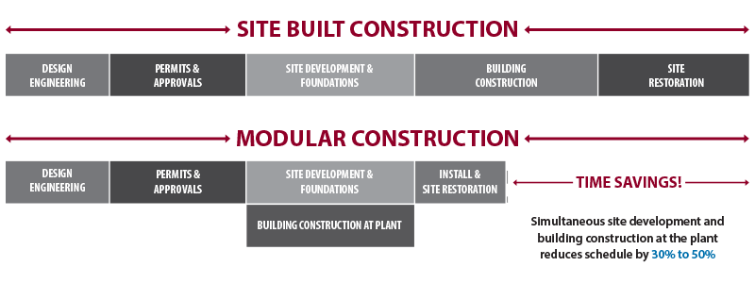

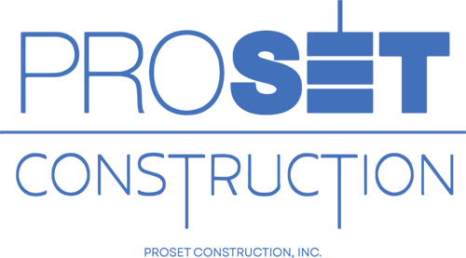




Creative Building Options for Increased Affordability
Off-Site Construction
Translational kinks in planning, financing, insuring and permitting plagued the enterprise early on
Over the last 10 years, the industry has matured
More feasible with each passing day
GPHS has been tracking the evolution of off-site construction and has built relationships with several modular groups as they address these issues, each in their own unique ways.
Materials/Design
Panelized Construction
3-D Printed Houses
Repurposed Shipping Containers
Automated Factory Production
Finance
Modular Housing Tax Credit
IHIP performance grants ($9.6M)
Modular Factory Loans ($38M)
Regulatory
Regional Building Code for Factory Built Structures (SB 25-002)

Slide 29





PARTNERSHIPS:
Pedestrian connectivity, Bicycle, Pets,
Stakeholder Meetings
Resident Services
Grow Community, Serve Residents, Support Athletes
Affordable
Building relationships based on input from all, open communication, and transparency to brainstorm, learn & create a community to serve the residents and provide flexibility
City of Grand Junction
Local Employers
Housing for Athletes
Financing $$

Slide 30
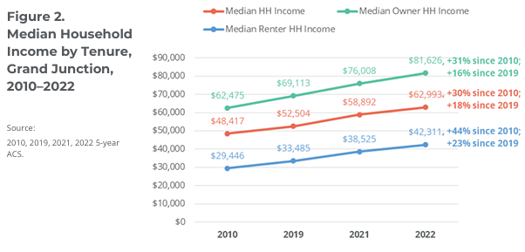
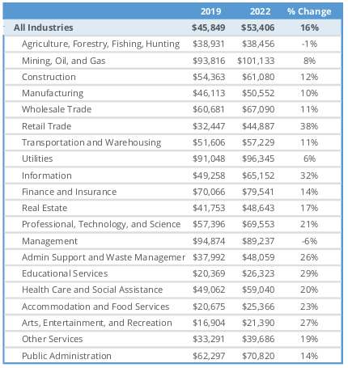
Approach to Rental Project Financing
Our approach utilizes housing choice and project-based voucher programs, LIHTC 4% and 9% tax credit programs, as well as local and state grants, impact fee and tax abatements. Our intention is to build a mixed-income community in close consultation with the City of Grand Junction and Mesa County, aiming to serve populations in income categories from 30% AMI and upwards.
While we acknowledge that serving lower AMI ranges may require a portion of market rate units to subsidize this path, every effort will be made to capitalize on our wide range of debt and equity sources, as well as the programs noted above, to maintain an average income across the project of 120% AMI.

Slide 31
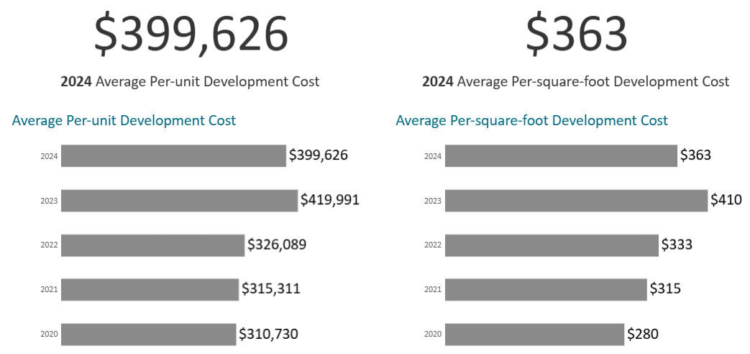
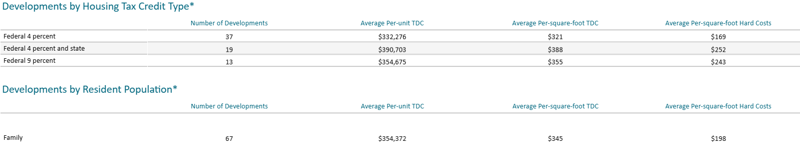
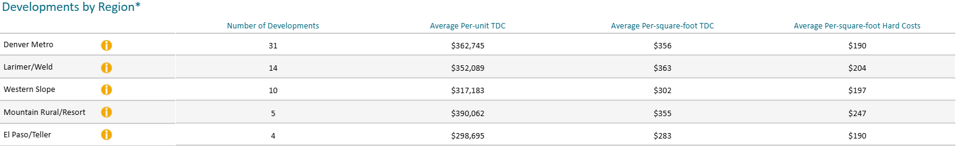
Total Development Costs – Scenario 1 – No Elevator

Slide 32
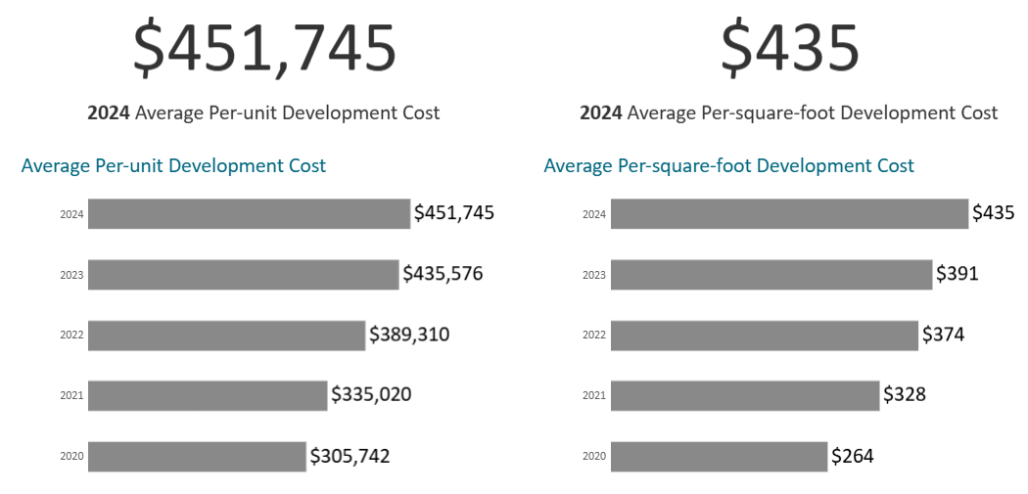
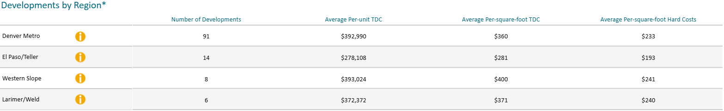
Total Development Costs – Scenarios 2/3 - Elevator

Slide 33
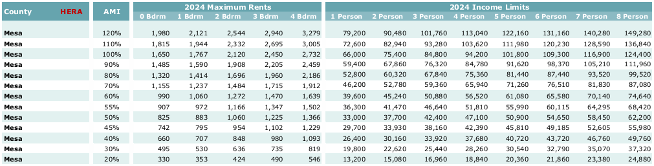
Serving Grand Junction’s Needs

Slide 34
Q&A

Slide 35

Together we are driven
to create spaces that inspire
elevating the joy and dignity
of the human experience.

