Slide 1
City of Grand Junction 2014 Budget
Rich Englehart, City Manager
December 4th, 2013
Notes:
Mayor and Council, I will begin this evening and present the 2014 Budget, answer any questions you may have or I have staff address it if I am unable to. I will then have Jodi come up and present to 2013 supplemental and 2014 appropriation ordinances to you.
I have said before that there is honor in service and before we get into the numbers, I would like to share some examples of our service.******

Slide 2
Service with Honor, Integrity, Teamwork, and Respect
July 23rd – Department Presentations to City Council
We Have Pride-We protect the character and promote the economic health of our community.
We Assist with Visions-We have a team that is there on the front end to support local business needs and those looking to join our community.
We Watch Over the Neighborhood-Planning and zoning keeps our community clean and safe and balanced.
We Promote and Highlight the things that enrich our community and attract visitors; cultural events, tours, trade shows and conferences.
We Enhance the Quality of Life-We provide indoor and outdoor recreation activities in pools, and on courts, fields, parks, and trails.
Notes:
Let me take you back to July 23rd of this year when we started our budget process with City Council. This was a time to introduce our organization *****to the new Council after the election. This start to the process was an opportunity for the Council to begin to put in place the budget policies based on how we provided services to our community.
We talked about our departments, what we have done in the past, where we are today and what was on the horizon for delivering the particular services to our community. This slide and next few talks to “who we are” and how server with honor, integrity, teamwork and respect.******

Slide 3
Service with Honor, Integrity, Teamwork, and Respect
We Answer Your Call-The Communication center is there 24/7 in order to address that emergency you hope never happens.
We Serve and Protect-Our men and women in blue work hard to keep you safe through enforcement, education, and building relationships in the community.
We Rescue-We are there for you when there is a fire or accident to serve with compassion no matter the circumstances.
We Go With the Flow and Take it From Here-We provide the highest quality and reliable drinking water. We safely treat and dispose of wastewater and solid waste while leading the way in sustainability programs that reduce, reuse, and recycle.
Notes:
***** As you see, each of statements relate to our operations and when reading these it brings to mind a couple of stories related to service with honor.
When we say we serve and protect - This past Halloween we witnesses just what it means, when we take our time to train our officers prior to hitting the street. Officer Cody Kennedy, one of our officers in the police department, demonstrated his skills when confronted by a person with a toy gun picking the “wrong” next person to intimidate. Cody was simply walking the streets of downtown, building relationships and in an instant was confronted with this situation. Using his, education, training and instinct in a split second, did not pull his trigger. He told me he can not put in words how close he came…. We have not compromised our standards over the past year when we have been down in numbers in our police department. I thank the Chief for holding strong on that, and thank those employees who have filled the gaps while we are getting our numbers back up. I happy to report that we are moving in the right direction in filling our police vacancies.
When we talk about “we rescue” well we not only rescue people but their loved ones,,, with four legs. Recently you saw the video put out by the Daily Sentinel about Guadalupe Bravo’s two dogs that were rescued from a culvert near Eagle Rim Park. Employee’s from our Parks and Recreation department and fire personnel served with passion and care. This was not the only non-human rescue this past year, we had a number of exciting, dangerous and successful rescues of other family pets including a horse North of our City.
There is an expectation from this community, the City Council and myself that when you drink from your water faucet, it is safe; when you place your trash out it will be picked up and when you flush your toilet it does not end up in your bathtub….at least when it is on our side of the line. We strive to provide the highest level of quality in all of our utility services.******

Slide 4
Service with Honor, Integrity, Teamwork, and Respect
We make it Clear, Pave the Way, and Direct Traffic-Keeping the traffic moving and the streets open, safe and free of snow during the winter.
We are committed to resource management through conservation and innovation.
We Have Answers-When you have questions about your community our municipal government can provide you with answers.
We Support-We take care of our own to support them in what they are called to do in service.
Most importantly, We Listen-It is your ideas, vision and leadership that will shape the future.
Notes:
*****The last line states Most Importantly, We Listen. This budget is built on your direct input, your ideas, the communities input and a vision that will indeed shape our future.******

Slide 5
Building the Budget City Council Budget Sessions
August 5th & 8th – Budget Policies and Philosophies
compensation policy, TABOR, reserves
August 19th – Budget Considerations
revenue projections, insurance increases, capital priorities
September 30th & October 7th
2009-2013 history of resources and uses, balancing, capital, economic development, internal service funds
October 28th
enterprise funds, rates & fees, fund balance worksheets, budget by department
November 18th – Final Wrap Up
Notes:
***** The budget development has been the source of many of your meetings since July. This slide is a small sampling of the numerous topic discussions we had once we finished up the departmental reviews. Seven meetings and numerous hours later we have prepared the 2014 budget for your review and approval.
I want to thank you all for your commitment and the time you took in order to work together to produce this proposed budget. ******

Slide 6
2014 Budget Overview
$132.4 million Total Spending Budget
8% decrease from 2013
Operating Expenses (includes internal services but not labor)
Flat with 2013
$2 million in City Council Economic Development & Community Partnerships
Labor Expense
2.5% increase from 2013
Complete 2012 Market Wage Implementation
Increase in Health Insurance Costs
No New Positions
Notes:
The 2014 proposed budget contains the allocated resources to meet the coming year’s needs according to Council’s priorities.
*****– Total budget of 132.4 Million which is an 8% decrease from 2013 adjusted budget. The 2013 budget was adjusted beginning early this year due to reduction in resources, particularly sales and use taxes and continues to be as we work towards the end of the year. This number is up since our last meeting and reflects a change in the Avalon Project. FCI ran their numbers on where they think they will end the year on project costs. Jay Valentine requested that we reduce this years number and increase next years based on %complete. This is simply a shift in funds from 2013 to 2014 and does not change any financial relationships we have, nor the targeted completion date. I would just note that the 2013 adopted budget was $145.8 million.
.
***** – The operating expenses are flat with 2013 and Council has again committed $2 million towards economic development and community partnerships.
***** On the Labor side of this, Council has committed to complete the implementation of 2012 market-driven wage adjustments which began this year and will complete a 2 year implementation plan. In total 35% of staff are at market and will receive no wage adjustment. A majority of the remaining 65%, are within public safety.
In the expenses related to health care we have a projected 9.7% increase in our Health care costs, the employees and organization will share in the increases. Health care on all fronts seems to change on a daily basis so Claudia and her staff will continue to keep us posted with the most updated information and we will be spending this coming year really evaluating our health care benefits.
There are no new full time positions in the 2014 budget and vacancies we experience now and into 2014 will be evaluated on a case-by-case basis. We will continue to put resources towards hiring the right person, train and work towards retention of the City’s specialized workforce. Council’s support has allowed us to build a budget that protects that investment in human capital which in turn meets the community needs. ******

Slide 7
2014 Budget Overview (continued)
10% Decrease in Debt Service
Capital
Fire Training
Fire Station Relocation
Las Colonias
Horizon Drive Interchange
Streets & Sidewalks
North Avenue Streetscape
Avalon Theatre Renovation
Water & Sewer Systems
Notes:
*****Debt service will decrease in 2014 due to some payoffs of some of our existing debt. In 2015 we will see further reductions with the final payoff of the 2004 bonds on the Riverside Parkway.
*****Although less than 2013, this budget contains a substantial capital investment for the coming year. The 2014 budget reflects one year of capital, however early in 2014 staff and Council will begin to put together a multi-year capital plan. This plan will call for us to sit down together to review the results of the Pavement Condition Index, look at other capital needs and then plan a strategy to maximize the use of capital dollars in the areas of most need.
*****Here are some examples of where the 2014 resources are dedicated. In the upcoming slides you will see more specifics related to these areas.*****

Slide 8
2014 Source of Revenues
Nearly 3/4 of Taxes are from Sales and Use Taxes. Also includes property, lodging, highway users, severance, and franchise tax.
The majority of Charges for Service comes from utility fees, rural fire district contract, ambulance transports, and the E911 surcharge.
Interfund revenues are the internal charges for fleet, technology, and insurance.
Intergovernmental revenue is State or Federal grant revenues.
Other revenue is made up of fines, tap charges, licenses, permits, and interest.
Notes:
This chart shows the source of revenues for the City***** This is what we use to begin the process of allocating the expenses by projecting what we have to work with. and as you know we have conservatively projected 2014.
*****Taxes are our single most significant source of revenue and support all our general government operations including public safety, streets, and parks. The blue section represents this and includes property taxes, highway user’s tax, and severance taxes. Sales and Use tax Revenues make up the majority of the general fund revenues and we have conservatively projected these revenues to be flat with 2013.
*****The red section is charges for services and includes utility fees, the rural fire district contract, ambulance transport fees and the E911 surcharge revenue.
*****------*****The green and purple sections combined make up 21% of revenue and include internal charges for fleet and technology as well as grant revenues, followed by fines, license, and permit fees. *****

Slide 9
Spending By Type
Notes:
*****This chart will show where the 2014 dollars are planned to be spent, and the relative percentage of the pie based on the $132.4 million dollar total budget.
*****Labor expenses are 46% of our budget.
*****Internal Service expense is the cost of technology, fleet, insurance, and the E911 Regional Communication Center and is 11% of our budget
*****Operating expense is 19% of our budget and includes expenses for things like ammunition, road salt, chemicals and fertilizers, vehicle parts, repairs & maintenance, utilities, contract services, economic development, and community partnerships
*****Debt Service is 8% of the budget. As mentioned beginning in 2015 we will experience the full benefit of the refinance of parkway debt, with a corresponding reduction of the Parkway debt service by $1.4 million.
*****The capital spending in 2014 is at $20.5 million or 16% of our budget.

Slide 10
Spending By Department
643 Total Full-Time Employees
Notes:
*****This next pie will show the 2014 operating budget of $100.7 million by department. This budget includes labor, internal service charges, and operating expenses. With some minor exceptions, the departments have the same % of operating budget as they did in 2013.
*****We have 643 authorized full time positions and during the height of our seasonal time we add another 300 positions at the equivalent of about 86 full time positions. As you will see the majority of employees are in the public safety and public works areas.
*****The police department with 197 employees makes up the largest piece of the operating budget at nearly $26 million per year. This includes all of police operations as well as the E911 Regional Communication Center.
*****Public Works, Utilities, and Planning are nearly the same size as Police with 137 employees and 25% of the budget. This department includes the water, sewer, trash, traffic, streets, and engineering operations as well.
*****Economic, Convention, and Visitor Services have 22 employees and are 4% of the budget at $4.5 million. This includes our Visitor and Convention Bureau operations as well as Two Rivers Convention Center and the Avalon Theatre.
The next 4 pieces of the pie are what are considered our internal support of the organization and combined have 119 employees.
*****First is titled Administration and includes the City Council’s economic development and community partnership budget as well as internal support functions of Finance, Human Resources, Purchasing, and Facilities.
*****Next is our Information Technology operation which includes our GIS division and support, maintenance, and replacement of the advanced and complex technological systems of the City
*****The fleet operations maintains all of the City’s rolling fleet including Trash trucks, patrol vehicles, fire engines, and dump trucks.
*****Self insurance manages the health, property, liability, and employment insurance needs for the organization.
***** The next section is our Fire department which includes fire response, emergency medical services, and ambulance transport. Fire has 122 employees and makes up 14% of the budget.
*****Last but not least is the Parks and Recreation department with 68 employees and 10% of the budget. Parks & Recreation includes the operation of 2 swimming pools, 2 municipal golf courses, recreation programs, numerous parks and open spaces which now is the home to 11 new and popular pickle ball courts. *****

Slide 11
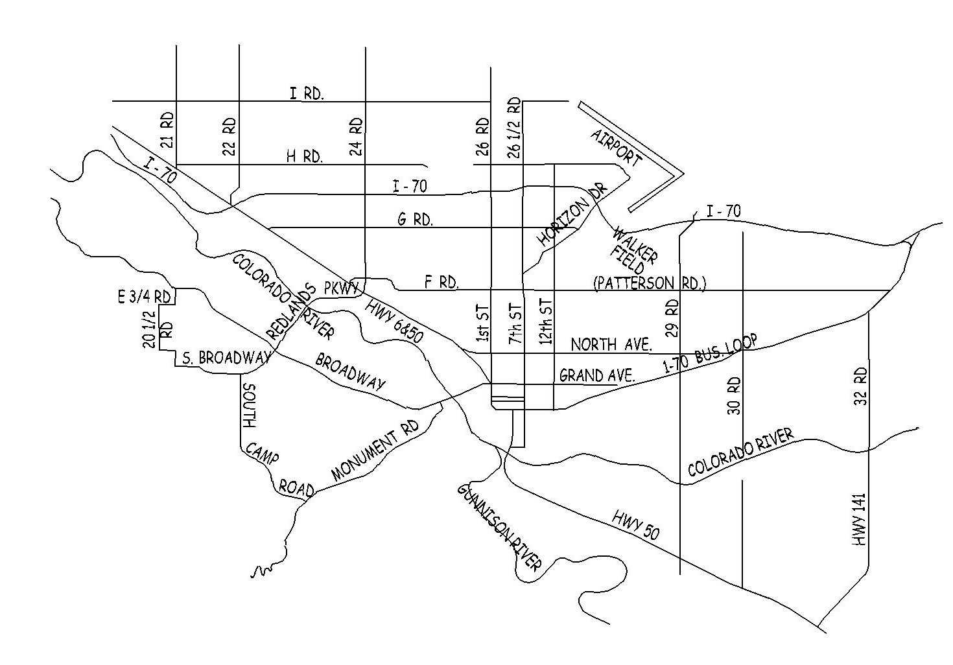
Community Investment
by Location
Sewer Line Replacements
Bridge Improvements 27 & H Roads
Bridge Replacement 31 & F ½ Roads
Community Hospital (TCP)
Horizon Drive Interchange
GVT Transfer Facility (TCP)
Veteran's Administration Turn Lane (TCP)
North Avenue Streetscape
CNG Slow Fill Stations
Sewer & Water Line Replacements
Avalon Theatre Renovation
City Market Fueling Station (TCP)
Las Colonias
Sewer Interceptor Repair & Replacements
Fire Station Relocation
Chipseal Program
Other Improvements: Kannah Creek flowline improvements, Police Department covered parking, Lincoln Park pool filter replacement, Two Rivers Convention Center improvements, training facility grant match, curb, gutter, and sidewalk improvements.
Notes:
This next slide will give you an idea of where the City’s capital investment will be made in the coming year
*****over $5 million will be put into water and sewer lines replacements
*****we will be working on the Fire Station #4 design and relocation to better serve our citizens East of 29 Road
The next four projects are the transportation capacity projects for the year *****and include work on a new City Market fueling station at the corner of 1st and White, a right turn lane for the new Grand Valley Transit station north of Patterson on 24 ½ Road, the start of the Community Hospital project and a turn lane for a new parking garage at the Veteran’s Administration Hospital.
*****As of this presentation we have been notified that we were not successful in our GOCO Grant for Las Colonias park. We will be back to the table with our funding partners and Council to put a plan together based on that information.
*****The Avalon Theatre project will be complete in 2014 and will once again be generating activity in our downtown.
*****In partnership with a possible DOLA grant we will be expanding our Compressed Natural Gas system by construction an additional 10 slow fill stations, and adding a compressor to prepare us for future hook ups as we continue to build upon this very successful project.
*****The North Avenue Streetscape and Horizon Drive Interchange projects will be starting next year.
*****We have two bridge projects… one improvement and one replacement by partnering with the County and use of Federal grant funds
*****the Chipseal program will concentrate in the Orchard Mesa area next year and the budget was increased over last year.
***** and we have noted a few other capital projects planned as well. ****

Slide 12
2014 Community Investment
Total Investment $22.6 Million
Notes:
*****This chart shows a combination of the City’s capital projects, Council’s commitment to economic development, and many community partnership for a total investment of $22.6 million*****

Slide 13
Question & Answer
Rich Englehart – City Manager
John Shaver – City Attorney
Tim Moore – Deputy City Manager
Greg Trainor – Public Works and Utilities Director
Debbie Kovalik – Economic, Convention, & Visitor Services Director
John Camper – Police Chief
Rob Schoeber – Parks & Recreation Director
Ken Watkins – Fire Chief
Claudia Hazelhurst – Human Resources Director
Jodi Romero – Financial Operations Director
Notes:
With that, this concludes the presentation. Again I want to thank you all for your involvement in this process. This budget is not just the City Manager’s or the City Council’s, it is our community’ budget. I am proud of the process and the wise use of the tax payers dollars in a time where we are continuing to slowly climb out of the recession here on the Western Slope.
So we are hear to address any questions of Council at this time.

