Slide 1
Title (46 pt. HP Simplified bold)
HP Records Manager
user group
October, 2014
Subtitle (18 pt. HP Simplified)
Speaker’s name / Month day, 2012

Slide 2
Agenda
Agenda |  | Presenter
2:00 PM – 2:30 PM | Registration
2:30 PM-3:15 PM | Product roadmap – HPRM & ControlPoint | David Gould
3:15 PM-3:45PM | Upgrade considerations | Bill Manago
3:45 PM –4:30 PM | Highlights of HP Records Manager 8.1 & new modules including SharePoint 2013 integration & O365 | David Gould, Jaimie Tilbrook & Don Prekop
4:30 PM | Close

Slide 3
HPRM License model overview
David Gould, WW Director, HP Information Governance Software

Slide 4
Key customer licensing issues
Our current model is not flexible to meet customer requirements and competitor models
Seat base pricing for modules such as SAP, Workflow and Space Management do not make sense
SharePoint and Workflow modules are highly desired but not highly bought
“Not all my users use HP TRIM in the same way”
Market is demanding different licensing models

Slide 5
HPRM Upgrade edition for existing customers
Edition
Customer
HPRM license
Users
Optional modules
Specify edition
HPRM Upgrade
(Base, Space Mgmt., Multi-jurisdiction retention, Storage Optimization)
Specify user type and number
All existing users converted to RM /Administrator user type
Specify optional modules
(if licensed in legacy model).
SAP integration
OCR
Warehouse Integration
Auto-classification
Adv. disposal process
Result:
Equivalent or enhanced license with unlimited volume

Slide 6
HPRM upgrade edition
Who buys this edition and what do they get?
Target user:
Existing HP TRIM, Meridio & ARM customers
Provides equivalent or greater functionality to the existing license for this user.
Inclusions:
Base edition
Core records & document management functionality
MS SharePoint integration
Workflow
Space management
Multi-jurisdiction retention
Storage optimization
All RM/Administrator users
Optional modules:
SAP integration
OCR
Auto-classification
Advanced disposal processing
Rendering (includes VERS)
External warehouse integration

Slide 7
Transforming the single user type
One Price, One User
Knowledge Worker
Records Coordinator
Information Mgr/Admin
Casual Contributor
Inquiry User

Slide 8
Introducing HPRM user types
Information Manager/Admin
Core Records and IT Management
Set and administer policy via desktop client
Records Coordinator
Power users who look after records day-to-day
Manage review of departmental records via desktop or web client
Knowledge Worker
Business users for document and records management
Add and edit documents, approve content via web client or desktop
Casual Contributor
Users who use other ECMS but declare records into HPRM
Primarily input driven via web client
Inquiry User
Search and view
Read only via other ECM or web client

Slide 9
US List Pricing For New Seat Model
Information Manager/Admin = $1400
Records Coordinator == $1050
Knowledge Worker = $560
Casual Contributor = $350
Inquiry User = $105
Legacy Price = $990 per seat, quantity one
Entitlement: Base TRIM functionality of integrated document and records management, SDK and user interfaces
All Seats include SharePoint Integration, Workflow, Space Management, Multi-Jurisdictional Retention and Storage Optimization

Slide 10
Optional modules for upgrade edition
SAP Integration | The SAP Integration module allows organizations to capture, ingest and archive records created in an SAP system. The module includes both the HPRM product functionality AND the third party software module provided by KGS. A separate license from KGS needs to be activated (not purchased). The module is required for SAP connectivity whether the KGS license is activated or not (in some cases organizations will build a direct connection from SAP to HPRM using the SDK; however, they are still required to purchase the module PLUS corresponding volume packages).
1
Advanced Disposal Processing | HPRM 8.1 features a completely new disposition module that guides you through the processing of disposal consignments. For each consignment you can determine a responsible archivist, selection criteria and a set of processing rules. Once the consignment is created it will automatically check the records for any issues that would prevent disposal.
2
Auto-Classification | This new module allows HP Records Manager for the training of IDOL categories based on Classifications. You can choose to train the IDOL categories using notes, using the first 50 records or both. This module cannot be applied to content already contained in the repository.
3

Slide 11
Optional modules for upgrade edition
Rendering | The HPRM Rendering module provides a fully automated process for document format conversion (rendering) and for storing both original and rendered documents to a record. With HPRM Rendering, you can create TIFF, PDF, and PDF/A renditions of your documents as a server-side process to prepare documents for publication and to maintain long-term usability. The legacy VERS compliance module is now included in this module.
4
External Warehouse Integration | The new Advanced Request feature in HP Records Manager 8.1 is designed to support the management of physical records when stored at a third party location. This feature includes the integration to the first warehouse source.
5
Optical Character Recognition (OCR Indexing) | Allows HP Records Manager to extract text from image files and store it as a document rendition that can be indexed by IDOL. Image records are searchable without reliance on a third party imaging application.
6

Slide 12
Upgrading existing customers
What can and cannot be done
Additional seats can be purchased under new model according to user type required
They must be net new
Do not have to be RM/Administrator user type if not needed
Upsell opportunity is still very strong for expansion of user numbers
All current seats converted to Records Manager/Administrator license rights
Clients have the capability to maintain current permission configurations
This preserves maintenance, but allows migration without having to reconfigure the users.
Customers maintain all rights and privileges for existing seat license
Additional modules can be purchased under the new model
Advanced disposal processing, External warehouse integration, Auto-classification, OCR and SAP
Customers cannot convert existing licenses to new user types i.e. downgrade from RM to Contributor
This would have a negative impact on Maintenance and Support revenue.

Slide 13
Questions?

Slide 14
trans•for•ma•tion
The Changing World of Information Governance

Slide 15
What have we learned today?
You have HP standing behind you every step of the way
The HPRM of today is market leading in function and scope
There are great resources to help you manage and grow
Our new business model provides greater flexibility
We are committed to making your investment work harder, better and smarter

Slide 16
“The journey is the adventure.”

Slide 17
How to define Information Governance
Establish clear control for creating, retaining and disposing of information
Meet compliance, regulatory and organizational requirements while reducing risk
Manage for cost

Slide 18
Information Without Context
Findability
Compliance
Control
Policy Driven
Reduced Risk
Cost Management
Notes:
A few weeks ago, I had the privilege of speaking with Fernando Luccini, our chief technology officer. He explains Information Governance very eloquently. By implementing information governance policies, organizations have the capability to take datacenters full of data and making them meaningful to all users across the enterprise, from the people who set the policies and rules to those who have to access it, find it, and make use of it. Fernando says by adding context to information through the application of policy, we transform data from being just data to being something that becomes incredibly useful. By applying context to information, we can take full control of it. What do we mean by that? It means making information more findable, it means making information more protected, it means making information more preservable and, at the end of the day, it makes information more disposable. This is the crux of the problem that ControlPoint solves – it allows organization to destroy information that is not important and fully maintain and preserve information that is vital for the business. Providing ControlPoint led context to information allows organizations to fully comply, lower cost and also use information more intelligently by making it easier to find and access.

Slide 19
Information Governance is complex
Organizations don’t understand what they have, who owns it and what exists
Information value is changing
Access to and protection of sensitive data is a serious risk
The value and meaning of business data is not well known
Notes:
Organizations lack a data map of their unstructured data, and are often not aware of what
content they have, who owns it and how many copies exist.
■ Enterprises struggle with the appropriate access rights to information and the protection of
personally identifiable information.
■ Enterprises have a need to manage data systematically, but don't often know the business
value of their data and what it means to them.

Slide 20
This is not just about technology; it is about using policy to drive results.
Notes:
Policy is not about technology. It is about your organization, your culture, how you work, what you work.

Slide 21
To be successful with Information Governance…
Product
The technology provides value through reduction, migration, automation and managing in place
Solution
Policy
Process
Policy, not storage, drives decisions on how to best manage unstructured content. Without policy, organizations cannot make strong management decisions
Pushing the delete button requires signoff from legal, business unit and IT
Service
Notes:
What we have learned most about ControlPoint over the past six months. What we have learned most is that ControlPoint works best when it is part of a solution program that has strong process and business understanding. Pushing the delete or preserve button is not possible without having a strong service solution wrapped around the technology. ControlPoint’ s technology actually has outpaced the market’s capability to make good management decisions on how to defensibly dispose of data and also to optimize the preservation for long term retention and expanded business use. It is much a case for great service as great technology. The good news is that we now have a program that we you can sell that that addresses the Three P’s on this chart. Now I will turn it over to Jason to show and demonstrate our new Dark Data Assessment Service.

Slide 22
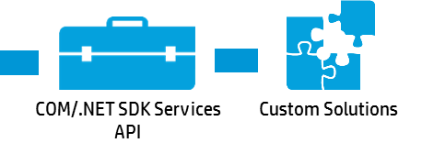
Records Management Governance Use Cases
Interactive
Document
Management
Regulatory
Record
Keeping
SharePoint Governance
ControlPoint
Auto Declaration
ControlPoint Legacy Data Cleanup
SAP ArchiveLink
AIO Structured
Records
Physical Records
HP Records Manager 8.1

Slide 23
The evolving state of Records Management
Records Management
15 % of corporate information
Managed retention and disposal
Driven by enterprise policy
Managed Retention
Record Keeping
Business information with high value, high risk
Managed retention for archival purpose
Improved findability
Regulatory driven
100 % of classified information
Archival in nature
Managed retention and disposal

Slide 24
Understand the business problem you are trying to solve.
Notes:
You cannot solve world hunger.

Slide 25
Eliminate what is not important
Better manage what is important
Lower compliance-based risk
Automate as much as possible
Notes:
So how do you manage unstructured information to maximize the VALUE of the volumes of information that your workers are producing

Slide 26
Alignment is critical – the cost of managing information is viewed differently
Notes:
When choosing which data to retain and what to delete, remember to keep cost optimization,
information value and risk mitigation at the top of the discussion. A decision made to delete data
because it is not of any business value is one that you can defend. The aging data may be a cost
burden to the core IT budget, and IT leaders must factor in continued management and storage of
the data.

Slide 27
IT
Records
Business Units
Legal
Policy & Program

Slide 28
Information governance is a transformational opportunity.

Slide 29
What are the use cases that drive the best results?
Legacy Data Cleanup
Migration
Auto-classification
Manage-In-Place

Slide 30
Become the agent for transformation in your organization.

Slide 31
Attack conventional wisdom
Break down silos
Drive accountability through metrics
Work to upgrade old technology
Don’t keep forever
Notes:
Become the agent for transformation in your organization
The sheer amount of aged data and rapidly increasing new data from a variety of
sources stored, both on the network and in the cloud, creates severe cost, security, and
management challenges
Data retention policies based on value, risk and compliance requirements are gaining significance
among IT leaders.. The antiquated thought process of just adding more storage is not the
answer, as it is too costly and burdensome, especially over time. Focusing on managing data in a
strategic manner has not, in the past, been a priority. The challenges of managing data have grown
significantly over time, and involve:
■ Influx of newly created and aging data.
■ Obsolete technology, as many organizations still manage and hold data in old applications and
storage repositories.
■ New analytic capabilities that require new storage mechanisms; for example, five years ago
data warehouse discussions were straight forward. Now, organizations need to make
meaningful decisions on storage for the relational database management system (RDBMS),
graph databases, columnar databases, XML, data stores, in-memory databases and Hadoop
instances and other file systems.
■ Management ignorance of evolving regulatory and legal requirements that continue to change
and often require the deletion of data for data protection or privacy reasons. Often when faced
with multiple regulatory concerns, organizations will simply assign the longest retention policies
indiscriminately.
■ Working in silos, as different organizations within the enterprise don't communicate or
collaborate to manage the data effectively.
■ Lack of accountability tied to the success of data management initiatives.

Slide 32
Analyze, but then take action!

Slide 33
You must hit the button
DISPOSE
PRESERVE

Slide 34
Thank you!
David W. Gould
WW Director, HP Information Governance Software
dgould@hp.com

Slide 35
Upgrading to HP Records Manager 8.1
Bill Manago, CRM
Information Governance Solutions Lead
HP Professional Services

Slide 36
My Background
Certified Records Manager (2005)
Information Governance Subject Matter Expert
Co-Author of DoD 50105.02 Standard
Established the JITC Certification Testing Program
ARM / TRIM / HPRM certifications
ARMA / AIIM Standard Boards
ARMA IGP Committee Member
ARMA Best Practices Committees
HP Professional Services (2013)
Information Governance Solutions Lead
Records Management Products
Control Point

Slide 37
HP Professional Services

Slide 38
Delivery Methodology
“In Flight” Process Reviews
Iterative Development
Change Management & Knowledge Transfer
Project Management
Risk/Issue Identification
Task Management
Scope Management
Solution Design
Final Preparation
Go-Live & Support
Configuration
Testing
Requirements Gathering and Definition
Technical and Functional Design Documentation
Gap Analysis (if applicable)
Work effort/new scope estimation (if applicable)
System installation and configuration
Development
System Integration
Fetch configuration, test and tune
“Demo” Sessions
Conversion to TST
Testing Preparation
Test Team Technical Mentoring
Test Script Creation Assistance
Integration, UAT, Performance Testing and Defect Resolution
Configuration Conversion to PRD
Training
Final Solution Documentation
Final Code Walkthroughs
Production Readiness Review
Final Knowledge Transfer
Provide application support
Verify accuracy of production system
Business benefit realization
Analyze and fine-tune production system
Conduct analysis of potential Phase II / scaling plans

Slide 39
Pro Serve Team Composition
Pro Serve Team
Solution architects – The Designers
Work with customers & sales on optimal solution design
Technical specialists/technical consultants
Technical consultants – The Implementers
Product and technical experts who implement the blueprints
Project managers – The Quarterbacks
Ensure on time and on budget delivery of projects
Manage scope/deliverables
Trainers – The Educators
Deliver training to customer on products and their administration
Provide “Train the Trainer” courses

Slide 40
Our Core principles
Mutual exploration: Through blueprinting HP Autonomy seeks to understand our client’s needs and specific business drivers.
Mutual participation: HP Autonomy believes projects should be a collaborative process. Our recommended approach emphasizes customer involvement, buy-in and ownership as critical to successful change enablement.
Mutual respect: HP Autonomy starts all projects with implied respect and credibility for client team members and believes that through collaborative involvement all client and Autonomy team members should share this respect and “think straight talk straight”.

Slide 41
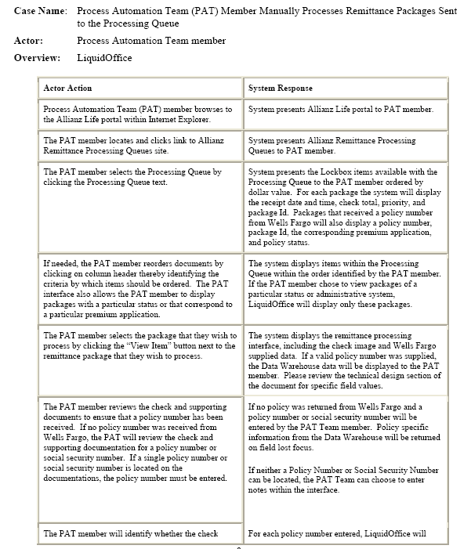
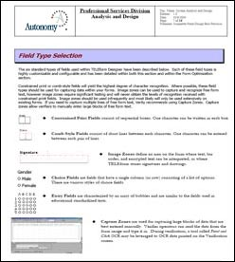
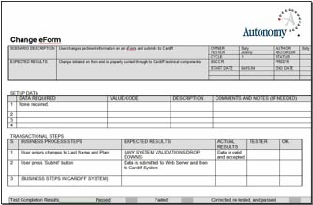
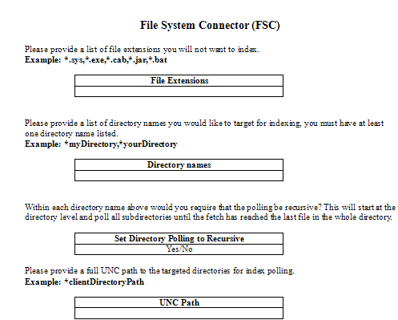
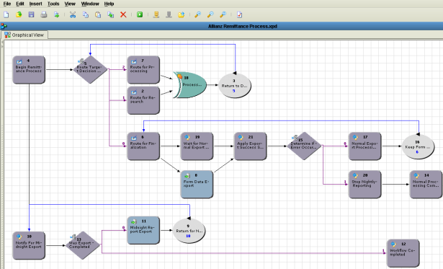
Project Tools and Deliverables
Architecture guides
Business forms
Business process maps
Communication plans
Connector guides
Configuration steps
Design documents
Process overviews
Project performance metrics
Project closure plans
Risk & issues tracking logs
Status reports/dashboards
System documentation
Training guides
White papers
Workflow specifications
Business process narratives
Training material
UAT/Integration test scenarios and scripts
ã
Technical Guides &
Questionnaires
Proven practices - business flows
Autonomy enters each project with defined best practices, templates and guides to aid in accelerating timelines and mitigating risk.
Copyright © 2013 Autonomy Inc., an HP Company. All rights reserved. Other trademarks are registered trademarks and the properties of their respective owners.
41

Slide 42
Upgrade / Migration Process

Slide 43
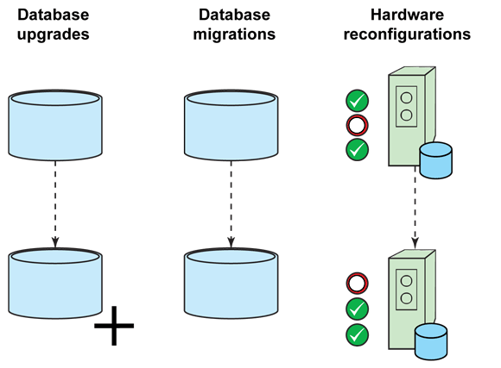
Dual Project
TRIM
ARM / Meridio
HPRM
HPRM

Slide 44
Records Management Consolidation
Autonomy Records Manager
HP TRIM
HP Records Manager
Meridio
HP WorkSite
Records Manager
iManage
Records Manager

Slide 45
Process Outline
Preparation
Upgrade planning, data mapping, scheduling the work and preparing for the upgrade
Environment upgrade / installation
Install/upgrade the software, upgrade the datasets, rebuild the content indexes, migrate metadata data
Post production
Update global settings, perform environmental enhancements and provide on site support

Slide 46
Core Tasks
Back-up existing database(s)
Upgrade/build the non-production server environment
Perform a trial upgrade/migration
Prepare and test the client deployment package (by deploying UAT workstations)
Perform UAT
Upgrade the production server environment
Upgrade/migrate the production dataset
Rebuild the Document Content Index
Deploy the new client software
Notes:
This is our best practice sequence of events that we have used to successfully upgrade many clients

Slide 47
Solution Architects

Slide 48
Design the new system
New server topology?
RM8 infrastructure pre-requisites
Notes:
If you have an older version of HP TRIM, say 6r2 then it likely that your server environment will be a single workgroup server, perhaps also hosting the database server.
More recent implementations typically use multiple servers, such as a separate workgroup and database server.
RM8 requires at a minimum a single workgroup server, and a separate IDOL server. We find that many client now host an enterprise-wide database server. This means that a typical RM8 environment will be comprised of three servers.
If your site is

Slide 49
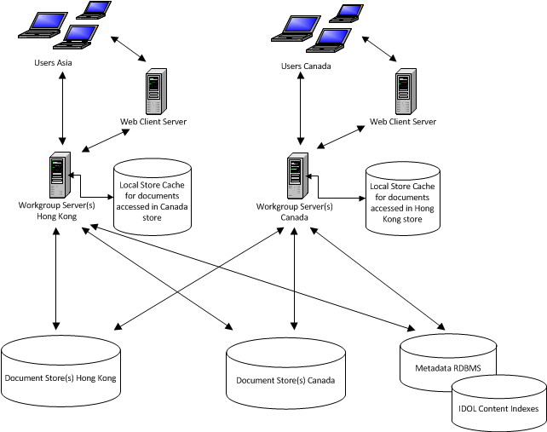
Distributed HP Records Manager Stores and Caches

Slide 50
Workgroup Server (user connections)
Windows 2008 SP2 64 Bit
Windows 2008 R2 SP1 64 Bit
Windows Server 2012
8 Gb RAM
4 CPU (2 GHz or faster)
Can be virtualized
Can be set up as Active/Passive Windows Cluster
Minimum of 2 in each deployment, more depending on distribution requirements and user numbers
~ 5000 users per server (depending on activity levels)
Dedicated servers recommended for large import jobs, e.g. SAP ArchiveLink integration
Position geographically close to users

Slide 51
Workgroup Server (Event Processing)
Windows 2008 SP2 64 Bit
Windows 2008 R2 SP1 64 Bit
Windows Server 2012
16 Gb RAM
8 CPU (2 GHz or faster)
Can be virtualized
Split out processing intensive tasks such as retention calculations and word indexing
Position geographically close to data tier

Slide 52
Web Server
Windows 2008 SP2 64 Bit / IIS 7.0
Windows 2008 R2 SP1 / IIS 7.5
Windows Server 2012 / IIS 8.0
16 Gb RAM
4 CPU (2 GHz or faster)
Can be virtualized
Can co-exist with Workgroup Server
Can be configured to use Network Load Balancing

Slide 53
IDOL Indexing Server
Windows 2008 SP2 64 Bit
Windows 2008 R2 SP1
Windows Server 2012
64 Gb RAM
16 Core
Up to 8 Content Engines
Index size limit 10 Million documents (recommended 7 Million)
Separate disks for each content engine (or max 2 engines per LUN)

Slide 54
Sequence of events
The sequence of events shown earlier follows our ‘best practice’
RM8 clients can be deployed before upgrading 7.x servers
Best practise in Virtual environments is to build new RM8 servers (WGS) instead of upgrading an existing server.
This is generally not an option with physical servers.
Custom scripted upgrades – stages, speedups
Implementing IDOL Content Indexing
DCI for HP TRIM 7.1 → HP TRIM 7.2, 7.3, HP RM 8.x requires full re-index of Content Store
Notes:
If client deployment is problematic or there is a need to minimise the disruption we can deploy the clients before upgrading the servers. RM8 is designed to work with a 7.1 server environment
In virtual environments we prefer to build new servers early in the project (at the same time as we are working on the non-production environment)

Slide 55
Technical Consultants

Slide 56
Functional Planning
Things to consider
Functional considerations
Custom reporting
Regulatory compliance
Business requirements
Custom reports
Custom bar code labels
Integration with business applications
In-house skill set
User adoption

Slide 57
The detailed plan
1. Initiation
Scope
2. Project analysis
Migration utilities
4. Solution build
Resources
3. Solution design
System review
Integration
Customization
Infrastructure
Design
Sizing
Installation
Configuration
Test upgrade

Slide 58
The detailed plan
5. Data migration
6. Testing
8. Deployment
7. Knowledge transfer
9. Project Closure
Convert/import data
Trial conversions
Data integrity
Joint testing
Deployment readiness
Training sessions
User enablement
Production install
Configuration and customization
Detailed handoff
Final meeting
Questions

Slide 59
Data Migration Methodology
Basic Configuration
Data Cleansing
Customer Review & Signoff
Reconcile Data
Data Analysis
Data Mapping
Test Data Conversion
Final Data Conversion
Understand the data to be migrated or converted
Define scope
What to keep
What to delete
Metadata
History
New fields
;
Data consistency
Data quality
Default values
Partial
Migration
Test data export
Test data import
Quality control
Customer review /
approve
test results
Execute
data export and data import programs
Document results and errors
Validate success of
Ddta migration or conversion

Slide 60
Other factors to consider
Administrator tasks:
Check in any remaining documents that are checked-out (discard changes)
Screenshot the global settings
Screenshot user favourites
Screenshot saved searches
Prepare UAT test results
Server tasks:
Database integrity/constraint check
Database Schema repair
Clear event, index table
Notes:
Depending upon your current TRIM version, certain information will not be migrated.
If you are upgrading from TRIM Context 6 you will lose:
Global settings
All shortcuts
All favourites
User settings (toolbars, integration)
Saved Searches
Upgrading from TRIM 7 you will lose:
Toolbars
Favourites
Work tray
Saved searches

Slide 61
Post Production Tasks
Apply global settings
Check/set system options
On-site support
Training

Slide 62
Training and Education
Formal Training Classes
Notes:
We’ll begin with the usability and access, which we designed on the basic premise that we need to be able to reach any user, wherever they are, on whatever device they want to use.

Slide 63
Formal HP RM Training
HP.RM200 – HPRM Advanced User Training (2 days, 6 Units, $1500usd)
HP.RM220 – HPRM Workflow Essentials (1-day, 3 units, $750usd)
HP.RM240 – HPRM Archiving and Retention Essentials (1-day, 3 units, $750usd)
HP.RM300 – HPRM Administration Training (2 days, 6 Units, $1500usd)
HP.RM500 – HPRM Installation and Maintenance (2 days, 6 Units, $1500usd)
CLASS LISTING: https://registration.autonomy.com/trim

Slide 64
Upgrade Resources

Slide 65
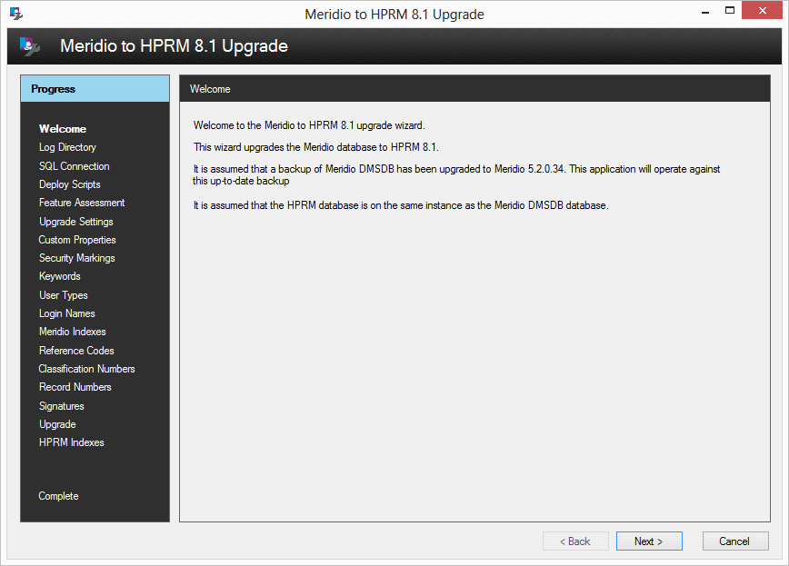
HP Records Manager upgrade program
ARM and Meridio migration tools
Migration guides
Migration pre-requisites
Pre-migration tasks
Post-migration tasks
Using the upgrade wizard
Metadata conversion mappings
Upgrade wizard
Metadata transfer
Content repository transfer
Logging

Slide 66
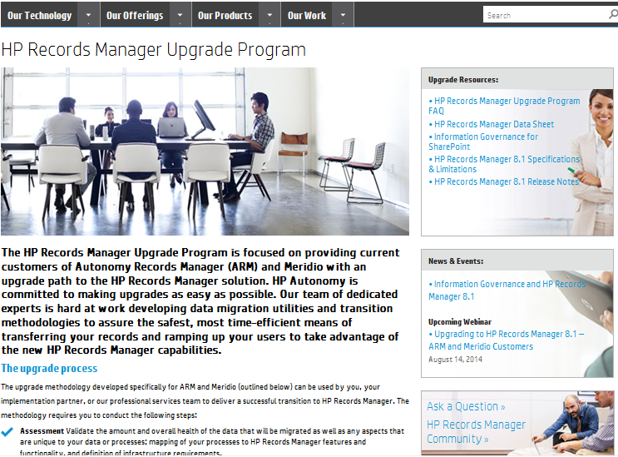
HP Records Manager upgrade program
Visit the upgrade program web page:
Latest upgrade and product information
FAQ's
HP Records Manager data sheets
Details of upcoming events
Ask a Question: hprm_info@hp.com
Login:
Username: HPAutonomy
Password: RecordsManager
http://www.autonomy.com/campaigns/authen/hp-records-manager-upgrade-program
Notes:
We recently launched a microsite on Autonomy.com for ARM and Meridio customers. This site will be used to provide customers with updates on the migration program and HP Records Manager. We will also be posting information about upcoming information webcasts and user groups meetings.

Slide 68
Thank You!

Slide 69
SharePoint Governance and Compliance using HP Records Manager
Jaimie Tilbrook, Product Development Manager – HPRM Governance and Compliance SharePoint App

Slide 70
What is the problem we are trying to solve?

Slide 71
SharePoint strengths
Strong adoption in the market – industry standard ECM platform
The centre piece of enterprise strategy
Strong search capabilities
Strong collaboration capabilities
Create content IAW how you work…
Notes:
SharePoint is a fantastic technology. As a result it has strong market adoption and is by many is recognised as the industry standard platform for ECM
It is at the heart of Microsoft’s enterprise strategy integrating seamlessly with the Office suite and providing strong enterprise search capabilities.
Perhaps the most renowned feature of the product is around its collaboration capabilities allowing users to work together in dedicated workspaces to collaborate on project based work.
The most understated feature that is attractive to users though, is the ability to create content in accordance with how they like to work with it. And this can lead to content management issues

Slide 72
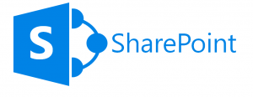
Where is the content in SharePoint
Notes:
Lets take a quick look at where content is actually stored in SharePoint just to set a baseline understanding of this
Consider SharePoint as a dotted line system for the purposes of this discussion

Slide 73
Where is the content in SharePoint
Sites
SITE
Notes:
SharePoint supports the concept of sites. Sites allow you to logically group together information that is related in some way

Slide 74
Where is the content in SharePoint
Sites
SITE
SITE 1
SITE ..n
Notes:
SharePoint can have many sites

Slide 75
Where is the content in SharePoint
Sites
SITE
SITE
SITE
SITE
SITE
SITE
Notes:
Typically sites are related in a hierarchical structure.
If you have used SharePoint before you may have in your organisation had a top level site for your company, then sub sites for the finance, HR and sales departments

Slide 76
Where is the content in SharePoint
Lists
SITE

Slide 77
Where is the content in SharePoint
Lists
SITE
LIST
Notes:
Sites can have lists

Slide 78
Where is the content in SharePoint
Lists
SITE
SITE
LIST
LIST 1
LIST ..n
Notes:
A site can have many lists
If you have used SharePoint before, then you have used lists.

Slide 79
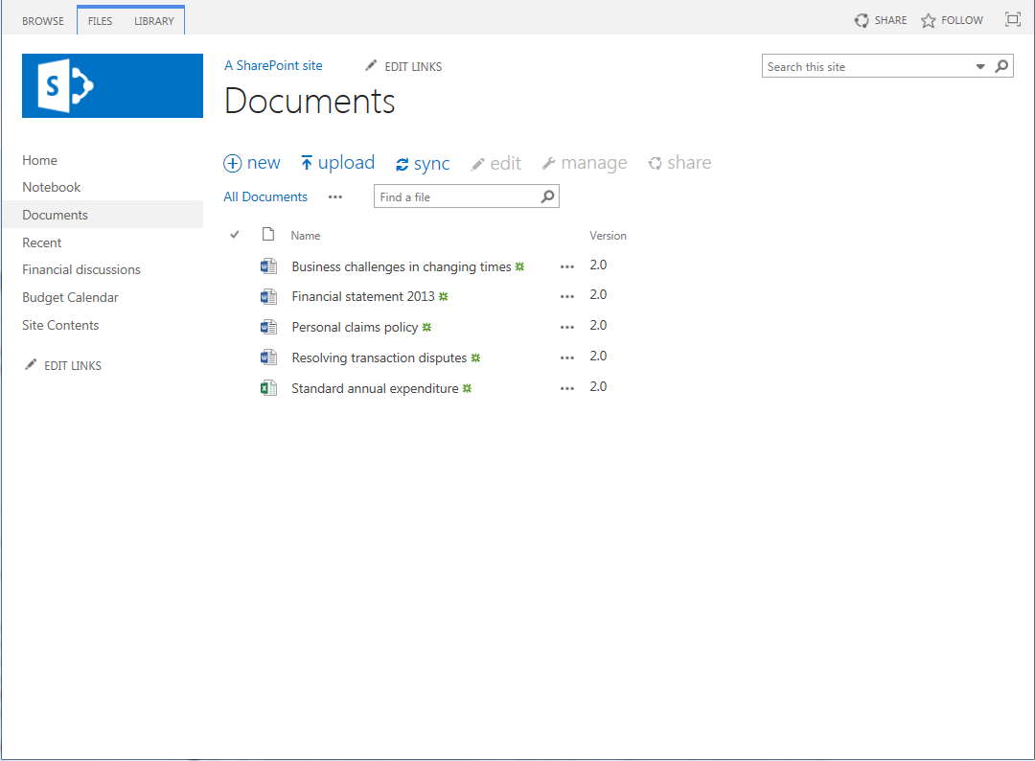
Where is the content in SharePoint
Lists
SITE
LIST
Notes:
Document libraries are lists

Slide 80
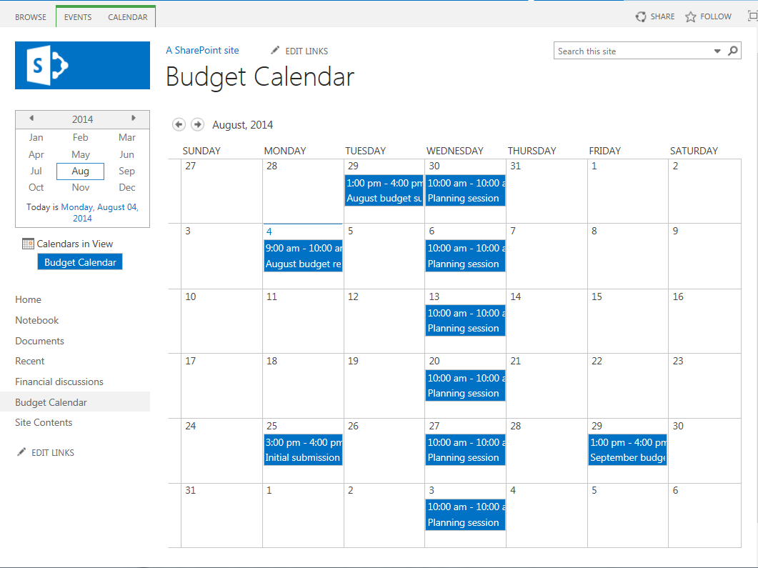
Where is the content in SharePoint
Lists
SITE
LIST
Notes:
Calendars are lists

Slide 81
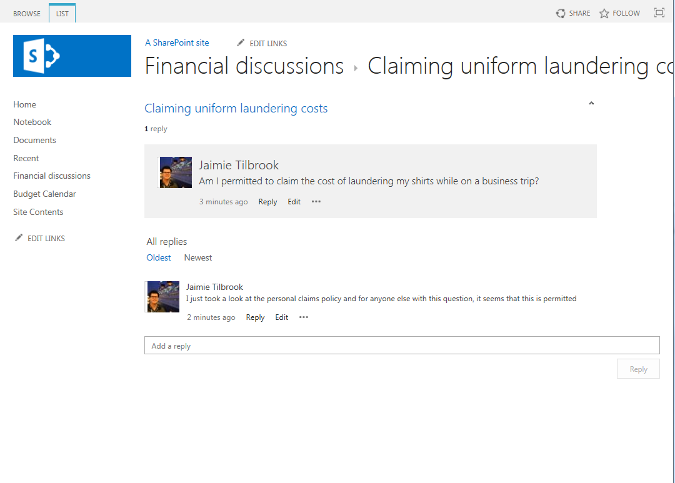
Where is the content in SharePoint
Lists
SITE
LIST
Notes:
Discussion boards are lists
These are just examples of the many types of lists that are available in SharePoint

Slide 82
Where is the content in SharePoint
List Items
SITE
LIST
LIST ITEM
LIST ITEM
LIST ITEM
Notes:
Lists contain list items

Slide 83
Where is the content in SharePoint
List Items
SITE
LIST
LIST ITEMS
DOCUMENT
DOCUMENT
DOCUMENT
Notes:
In the case of a document library, the documents are list items

Slide 84
Where is the content in SharePoint
List Items
SITE
LIST
EVENT
EVENT
LIST ITEMS
EVENT
Notes:
For a calendar, the events are list items

Slide 85
Where is the content in SharePoint
List Items
SITE
LIST
DISCUSSION
LIST ITEMS
POST
POST
Notes:
And discussions and posts in discussion boards are also list items

Slide 86
Where is the content in SharePoint
List Items
SITE
LIST
LIST ITEM
LIST ITEM
This is the content!
LIST ITEM
Notes:
So when you are talking about the content in SharePoint, it is the list items that you need to consider

Slide 87
Content proliferation
Notes:
So back to the problem. With the great capabilities that SharePoint provides to create site structures with lists on them

Slide 88
Content proliferation
SITE
LIST
LIST ITEMS
SITE
SITE
LIST
LIST
LIST ITEMS
LIST ITEMS
SITE
SITE
LIST
LIST
LIST ITEMS
LIST ITEMS
Notes:
If not controlled, many organisations find that things can rapidly get out of control.
They find that the user-empowered nature of SharePoint means that sites and lists get created all over the place.
Often these are forgotten about or abandoned, but still remain in SharePoint, causing challenges for the IT department maintaining SharePoint and ensuring it performs well.
Traditionally SharePoint is managed by IT. But how can the IT department identify problem areas, worse still, how can they know which content could be removed?
This should really be the remit of information managers, compliance officers, and records officers.

Slide 89
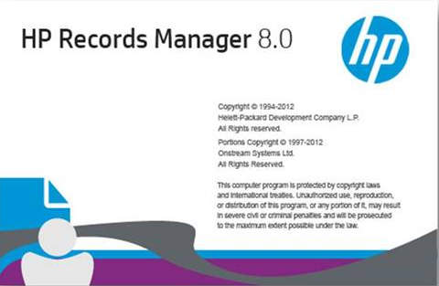
Management paradox
HP Records Manager
SITE
LIST
CONTAINER
RETENTION SCHEDULE
SECURITY
LIST ITEMS
RECORDS
CONTAINER
SITE
SITE
RECORDS
LIST
LIST
LIST ITEMS
LIST ITEMS
CONTAINER
RECORDS
SITE
SITE
CONTAINER
LIST
LIST
RECORDS
LIST ITEMS
LIST ITEMS
Notes:
From a records management perspective, this provides somewhat of a dilemma
Whilst SharePoint users love arranging content how they want to use it, whilst creating it on an ad-hoc basis
Best practice records management principles dictate that you should use an organized, shallow container-based structure
All records that are related from a compliance perspective are located in containers. This provides record context.
And things like retention schedules and security are applied to the container, rather than the records themselves

Slide 90
par·a·dox [par-uh-doks]: any person, thing, or situation exhibiting an apparently contradictory nature.
HP Records Manager
SITE
LIST
CONTAINER
RETENTION SCHEDULE
SECURITY
Users want to organize information in a fashion that relates to how they create and consume it.
LIST ITEMS
RECORDS
CONTAINER
Records managers want to structure information in a manner that offers the organization compliance with relevant legislation.
SITE
SITE
RECORDS
LIST
LIST
LIST ITEMS
LIST ITEMS
CONTAINER
These two approaches almost always conflict with each other…
RECORDS
SITE
SITE
CONTAINER
LIST
LIST
RECORDS
LIST ITEMS
LIST ITEMS
Notes:
So this gives a paradox
Users want to organize information in a fashion that relates to how they create and consume it.
But
Records managers want to structure information in a manner that offers the organization compliance with relevant legislation
These two approaches almost always conflict with each other…
Records managers dislike SharePoint because to them, the information is arranged in a manner that they see as chaotic. User-empowered/ad-hoc content creation scares them.
Users dislike records management because it forces them to organize information in a manner that is not consistent with how they do their job. It can be perceived as a barrier to productivity.

Slide 91
What is the problem we are trying to solve?
HOW
WHAT
WHEN
Notes:
So if we look at the problem we are trying to solve it can be summarised as:
How should SharePoint content be managed?
What content in SharePoint needs to be managed?
And
When should that content in SharePoint be managed?

Slide 92
What is the problem we are trying to solve?
How
Solving the management paradox
How to fit a chaotic structure into a flat structure
How is the content captured?
Metadata
Document
SharePoint Columns vs Record fields
SharePoint Content Types vs Record Types
What is left in SharePoint?
Manage in place?
When do we remove content from SharePoint?
What can users do with managed content?
Allowing full functionality of SharePoint
How do users find content removed from SharePoint
Notes:
Starting with the “How” the problems that we need to try and solve are
Firstly, the management paradox. How do we fit a chaotic structure into the nice organized flat structure that records managers want
When we manage content, what do we need to capture?
The metadata?
The document?
Both
What relationship is there between content in a SharePoint column to values in fields on a record
Is there a relationship between the content type in SharePoint and the record type required in HPRM
If we manage content, what do we leave behind in SharePoint
Do we remove it or do we leave it in place?
When content is managed, what do we let users do with it?
Should they still be able to use the full functionality of SharePoint with it?
And if we are getting rid of content from SharePoint, how do users find if they need to?

Slide 93
What is the problem we are trying to solve?
HOW
How is the content captured?
WHAT
WHEN
What is left in SharePoint?
What can users do with managed content?
Solving the management paradox
Notes:
There is a lot to think about with the how

Slide 94
What is the problem we are trying to solve?
What
What content should be a record?
Who decides?
Can the decision be automated?
How to make sure content is compliant?
What types of SharePoint content
Documents
Metadata – many content types are only metadata
What about trivial content?
Do we need to provide options to dispose of?
Notes:
But how do we decide what SharePoint content needs to be a record. Surely not everything is a record?
Most organizations will agree on record definitions such as “evidence of a business transaction”. But that is about where the agreement stops.
What constitutes a record can vary wildly from one organization to another.
Therefore, a “one size fits all” definition is never going to be suitable
Using an organizations rules for determining what should be a record, who in the organization should actually be able to make that determination?
Can these rules be automated?
And how do we make sure the rules or policies are being applied correctly so that the content is actually compliant?
What types of SharePoint content do we need to consider?
Do we just look at document based content or do we also consider metadata only content
It is important to recognise that many content types in SharePoint are only metadata, things like calendars, discussion boards and announcements
And what about the content that isn’t going to be a record?
Do we need to provide options to clean this up as well?

Slide 95
What is the problem we are trying to solve?
HOW
How is the content captured?
WHAT
What content should be a record?
WHEN
When does content become a record?
What is left in SharePoint?
Metadata and/or document
What can users do with managed content?
Solving the management paradox
Notes:
So once you have decided on what should be a record, you need to consider, at what point should this content become a record

Slide 96
When does content become a record?
INFORMATION LIFECYCLE
CREATION
DESTRUCTION
TIME
Notes:
Lets take a look at the information lifecycle
This starts when content is created and ends when the content is ultimately destroyed

Slide 97
When does content become a record?
INFORMATION LIFECYCLE
CREATION
DESTRUCTION
???
LEGISLATION
INTERNAL POLICY
LITIGATION
TIME
Notes:
But what determines when the content can be destroyed?
There are host of things including industry and locale specific legislation
As well as internal policies
And perhaps a litigation activity means that the content cannot yet be destroyed

Slide 98
When does content become a record?
SHAREPOINT LIFECYCLE
CREATION
COMPLIANCE LIFECYCLE
DESTRUCTION
TIME
Notes:
But when we talk about SharePoint, the lifecycle can be broken into two distinct parts
The SharePoint lifecycle starts when content is created in SharePoint and ends when it is deleted from SharePoint
The compliance lifecycle starts when a record is created and ends when that record is destroyed.
These two parts of the lifecycle are not the same thing and they must be treated differently

Slide 99
When does content become a record?
“Simple” records management
CREATION
SHAREPOINT LIFECYCLE
DELETION
COMPLIANCE LIFECYCLE
RECORD
CREATION
DESTRUCTION
Notes:
Lets look at what I call a “simple” records management approach
In this approach, content is created in SharePoint, then at some point is removed from SharePoint therefore finishing the SharePoint lifecycle
And it is put into a system of record to carry out the compliance lifecycle.
This is the sort of approach we see from organisations that don’t have mature records management practices.
There are some big issues with the approach

Slide 100
When does content become a record?
“Simple” records management
CREATION
SHAREPOINT LIFECYCLE
DELETION
LEGISLATION
Retain for 1 year
COMPLIANCE LIFECYCLE
EXPOSED
DESTRUCTION
RECORD
CREATION
DESTRUCTION
2 YEARS
Notes:
For a piece of content, lets consider that the legislation says that this content should be retained for a minimum of 1 year
But in this scenario, the content has been sitting in SharePoint for 2 years before it became a record
The problem is, that this content could have been destroyed a year earlier
Because the organisation held onto this for 2 years before even making it a record, they have held the content for a year longer than they needed to
This information could leave them exposed in a litigation or request for information scenario

Slide 101
When does content become a record?
“Trigger” based records management
CREATION
SHAREPOINT LIFECYCLE
DELETION
COMPLIANCE LIFECYCLE
RECORD
CREATION
DESTRUCTION
Notes:
What we tend to see in organizations with mature records management practices is trigger based records management
In this case, the content is created in SharePoint
At some point, something triggers the creation of a record. It could be that a certain period of time has elapsed of the value of a piece of metadata matches a criteria
At some later point, another trigger causes the content to be removed from SharePoint
The content then sees out its days in the system of record until it is ultimately destroyed

Slide 102
When does content become a record?
“Trigger” based records management
CREATION
SHAREPOINT LIFECYCLE
DELETION
COMPLIANCE LIFECYCLE
LEGISLATION
Retain for 1 year
RECORD
CREATION
DESTRUCTION
2 YEARS
Notes:
If we consider the scenario before in the naïve records management situation

Slide 103
When does content become a record?
“Trigger” based records management
CREATION
SHAREPOINT LIFECYCLE
DELETION
LEGISLATION
Retain for 1 year
DESTRUCTION
RECORD
CREATION
2 YEARS
Notes:
This time, if the legislation said to retain for 1 year, what would happen is that compliance system would destroy the content after 1 year

Slide 104
When does content become a record?
“Trigger” based records management
CREATION
DELETION
LEGISLATION
SHAREPOINT LIFECYCLE
Retain for 1 year
DESTRUCTION
RECORD
CREATION
1 YEAR
Notes:
This would bring to an end the SharePoint lifecycle as well, as the content would also be removed from SharePoint.
The result is that the content would only be kept for 1 year and that period of unnecessary exposure avoided.

Slide 105
What is the problem we are trying to solve?
Why
SharePoint is not a governance and compliance platform
Does not differentiate between the 2 parts of the information lifecycle
Content retained in SharePoint past the “useful” date
Higher storage costs
Stale content cluttering
Notes:
Lastly though, it is important to reflect on why we have a problem.
As fantastic as SharePoint is as an ECM platform, it is not a governance and compliance platform
It does not differentiate between the 2 parts of the information lifecycle
As a result, content is retained in SharePoint long after it is considered useful
If legislation says that a piece of content needs to be retained for 10 years, then it will sit in SharePoint for 10 years even though people lost interest in it 9 years and 10 months ago
This means higher storage costs
As well as stale content cluttering SharePoint and detracting from its ease of use

Slide 106
Solving the problem
Notes:
So now that we understand the problem, lets talk about how to solve it

Slide 107
Solving the problem
How
Notes:
Starting with “how” to we manage content

Slide 108
Solving the problem
How
SITE
LIST
LIST ITEM
LIST ITEM
This is the content!
LIST ITEM
Notes:
Going back several slides, we know that if we want to manage the content of SharePoint, we really need to be talking about the list items

Slide 109
Solving the problem
How – Managing a list item
MANAGEMENT PROCESS
Record created
Record and list item synchronized
HP Records Manager
SITE
MANAGE
LIST
LIST ITEM
RECORD
LIST ITEM
LIST ITEM
Notes:
At the core of how this product works is the concept of managing a list item
This means creating a record in HPRM to represent the list item
Then keeping the 2 in synch
If the list item is modified, then the record is updated
If the record is updated then the list item is also updated
If for any reason HPRM won’t allow the list item modification due to security, legal holds or other then the list item change is prevented
Remember, once the list item is managed, the HPRM record is the authority

Slide 110
Solving the problem
How – Managing a list item
A record is not always finalized
US market tends to work this way
Other markets capture “in progress” records
Notes:
Often when we describe this behaviour to people, they say “but a record is final, why would you ever want to edit it”
A record is not always final.
Some organisations have records management practices that enforce this. We find this typically in US based organizations
But many more markets don’t.
For example, in Australia, organisations like to capture content as a record as soon as it is created, even if it is still in progress
The ability to manage content in place like this is important for those markets
For the rest of this presentation, bear this in mind.
If you can’t get your head around that concept, then bear in mind that we can also handle the use case of making content final as soon as it is a record

Slide 111
Solving the problem
How – Managing a list item
MANAGEMENT PROCESS
Metadata is always captured
HP Records Manager
SITE
LIST
MANAGED LIST ITEM
MANAGE
RECORD
METADATA
METADATA
Notes:
Lets look more closely at what happens during management
If we consider a metadata only list item like a discussion post, when we manage the list item, the metadata is captured on the record
In all cases, we always capture the metadata

Slide 112
Solving the problem
How – Managing a list item
MANAGEMENT PROCESS
Metadata is always captured
Document stays in SharePoint while managed
HP Records Manager
SITE
LIST
MANAGED LIST ITEM
MANAGE
RECORD
METADATA
DOCUMENT
METADATA
Notes:
In the case where the list item has a document, be it a document in a document library or an attachment to list item
While managed, the document only resides in SharePoint. It is not copied to the record

Slide 113
Solving the problem
How – Managing a list item
MANAGEMENT PROCESS
Metadata is always captured
Document stays in SharePoint while managed
Document “moved” to HPRM during:
Relocate
Archive
Delete
Document removed from SharePoint during disposal
HP Records Manager
SITE
LIST
MANAGED LIST ITEM
RELOCATE
RECORD
DOCUMENT
METADATA
DOCUMENT
METADATA
Notes:
It is only when the list item is relocated that we capture the document on the record
During relocate, the document is copied to the record, then the list item is deleted.
This also applies to the archive process and if someone tries to delete a managed list item from SharePoint
During record destruction, the document is simply deleted from SharePoint. There is no need to copy it just for it to be deleted

Slide 114
Solving the problem
How – the four core actions
MANAGE
FINALIZE
RELOCATE
ARCHIVE
In-Place management
Active content
Finalized in HPRM
Read-only in SharePoint
Active in HPRM
Finalized in HPRM
Surfaced in SharePoint
Removed from SharePoint
Notes:
‘Manage’ is one of 4 core actions that the product has.
As we have seen, managing content is “in place” management. The content is still editable and still surfaced through SharePoint
The Finalize process, manages the content if it is not already managed then finalises the record and makes the item read only in SharePoint
The relocate process, manages the content if it is not already managed, then removes it from SharePoint. The end user perceives it as moving from SharePoint to HPRM
The archive process, relocates the item and finalizes the record
You do not have to go through all 4 processes. You can start at any point depending on your requirements.
These four core actions can be applied to:
- Individual items
- Multiple items
- Lists
- Sites

Slide 115
Solving the problem
How – advantages of this approach
Can manage all content, not just documents
Can continue to use all functionality of SharePoint
Can continue to use most functionality of HPRM
User does not have to be aware that content is managed
Notes:
There are some big advantages to the in place management approach.
Because it targets list items, any list item can be managed.
Sure, documents are important but there are so many other rich data types in SharePoint such as blogs, wikis, discussion boards that contain content that needs to be retained in a compliant manner.
This approach allows you to do that
Because a managed list item is still just a list item, SharePoint knows how to work with it.
You can still use all the features of SharePoint with it such as views, filters, alerts and workflows
Other vendors replace content with a stub or a link. These are proprietary approaches that SharePoint does not understand and cannot work with
A record that represents a list item is just a record. You can continue to use most functionality of HPRM with these records.
The only limit is that documents can’t be edited in HPRM while still in SharePoint, although changes to metadata can still be made.
And best of all, because there is no change in behaviour to the SharePoint item, the end user doesn’t even need to be aware that the content is managed
HPRM is just looking after the content behind the scenes without the user even know it.

Slide 116
Solving the problem
HP Records Manager
SITE
LIST
CONTAINER
RETENTION SCHEDULE
SECURITY
LIST ITEMS
RECORDS
CONTAINER
SITE
SITE
RECORDS
LIST
LIST
LIST ITEMS
LIST ITEMS
CONTAINER
RECORDS
SITE
SITE
CONTAINER
LIST
LIST
RECORDS
LIST ITEMS
LIST ITEMS
Notes:
We talked about the management paradox, how do we get a chaotic structure into a shallow container based one.
Records management options provide configuration options to determine where content goes in HPRM.
This therefore allows all information that is related from a compliance perspective to be managed in the same container, regardless of where it resides in SharePoint
This allows end users the freedom to organize information in SharePoint in the way which they work
But it keeps the records managers happy by managing it in accordance with best practice records management principles.

Slide 117
Solving the problem
HP Records Manager
SITE
LIST
LIST ITEMS
RECORDS MANAGEMENT OPTIONS
RECORD
CLASSIFICATION 1
MANUAL
RECORD
CLASSIFICATION 2
SITE
SITE
LIST
LIST
RECORD
CLASSIFICATION 3
LIST ITEMS
LIST ITEMS
AUTO CLASSIFICATION
SITE
SITE
LIST
LIST
LIST ITEMS
LIST ITEMS
Notes:
For organizations that do not do container based records management, the capability to apply classifications or file plans directly to records is also included:
Records management options can be used to assign classifications
Users can set the classification or file plan directly on the item in SharePoint itself.
The auto classification feature of HPRM can be used to determine the classification for you

Slide 118
Solving the problem
What and When
Manual instigation capabilities
Requires users to make the decision
Human error makes this not desirable
Automation capabilities
Allows implementing compliance rules
Removes human error
Notes:
That is “how” we manage content. Now lets talk about what we manage and when we manage it
We will discuss these together as they go hand in hand
The product provides the ability for users to manually kick off any of the 4 core processes
They can for example select 1 or more list items and manage them
But requiring users to make those decisions is not always the best approach.
Leaving the decision to end users requires them to make the right decision, and also to remember to make that decision
This introduces significant risk of human error, adds training cost, and can undermine your efforts to govern content.
The better approach is to automate this process
This ensures that everything that should be managed is and it ensures that it is managed at the right time
It can also deliver a consistent approach across multiple business units
The product includes the ability to automate your compliance rules and therefore largely mitigate the risk of human error

Slide 119
Solving the problem
What and When
CREATION
SHAREPOINT LIFECYCLE
DELETION
COMPLIANCE LIFECYCLE
LIFETIME MANAGEMENT POLICIES
RETENTION SCHEDULES
RECORD
CREATION
DESTRUCTION
Notes:
Lets return to this diagram from earlier in the presentation
The compliance lifecycle is managed in HPRM using retention schedules. This is where rules around retention and destruction can be defined
In SharePoint, we provide lifetime management policies to govern if and when a record is created and when the content is removed from SharePoint

Slide 120
Solving the problem
What and When
CREATION
MANAGE
FINALIZE
RELOCATE
SHAREPOINT LIFECYCLE
COMPLIANCE LIFECYCLE
RECORD
CREATION
FINALIZE
DESTRUCTION
Notes:
Looking at a more complex lifetime management policy, it is possible to nominate the conditions under which
A record is created, the content is finalized and finally, removed from SharePoint

Slide 121
Summary

Slide 122
Summary
HOW
WHAT
Lifetime Management Policies define what should be a record
WHEN
Lifetime Management Policies define when content should become a record
True in-place management
Users unaware that content is managed
Manage all SharePoint content not just documents
Captures metadata and documents
Users can manually decide what is a record
Lifetime Management Policies define when content should be removed from SharePoint
Notes:
To summarise
To address the problems of managing SharePoint based content, the HPRM governance and Compliance app provides
True in place management that allows management of content that is in progress – No need to copy or move content to declare it as a record
Users are unaware that this content is managed as they can just continue to use SharePoint – Delivers a much better user experience, with no disconnect
All SharePoint content, not just documents can be managed – This is important to allow capture of record context, other supporting information may be vital
And both the metadata and documents associated with the list item is captured
To govern what is managed, lifetime management policies allow you to define rules for determining what is a record –Delivers policy-driven governance based on record triggers
Users can even manually make this decision themselves – Supports policy-based capture where circumstances demand user interaction
Lifetime management polices also allow you to define rules that dictate when content is managed and when it should be removed from SharePoint

Slide 123
Summary
What’s new in 8.1
Document remains in SharePoint until relocation
LMP creation interface
Deployment via the SharePoint app model
Full support for Office 365/SharePoint Online
Notes:
That is “how” we manage content. Now lets talk about what we manage and when we manage it
We will discuss these together as they go hand in hand
The product provides the ability for users to manually kick off any of the 4 core processes
They can for example select 1 or more list items and manage them
But requiring users to make those decisions is not always the best approach.
Leaving the decision to end users requires them to make the right decision, and also to remember to make that decision
This introduces significant risk of human error, adds training cost, and can undermine your efforts to govern content.
The better approach is to automate this process
This ensures that everything that should be managed is and it ensures that it is managed at the right time
It can also deliver a consistent approach across multiple business units
The product includes the ability to automate your compliance rules and therefore largely mitigate the risk of human error

Slide 124
Q&A
Follow us
@hprmsharepoint
www.imsharepoint.net

Slide 125
Thank you

Slide 126
HP’s Implementation of HP Records Manager
A glimpse into structured record onboarding
Jennifer Vazquez / October 28, 2014

Slide 127
HP Business Challenge
Business operations:
Software
Services
Hardware
Customer segments:
160+ countries
Retrieve, produce, maintain, dispose records
Transactions:
1 million+ / day
Jurisdiction regulations

Slide 128
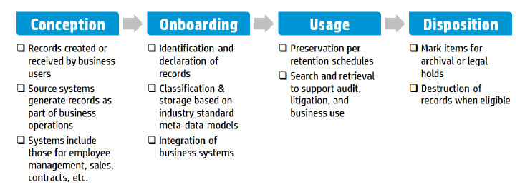
Business Record Lifecycle and HPRM Value

Slide 129
Conception
Hundreds of applications
Identifying systems of record

Slide 130
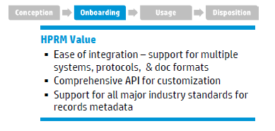
Onboarding
Access controls
Security
File formats
Adapters to systems

Slide 131
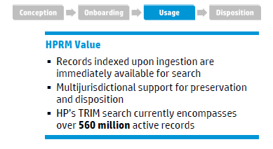
Usage
Word indexes
Content indexes
Complex retention per jurisdictions

Slide 132
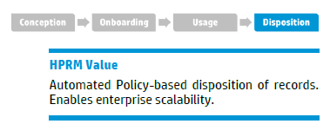
Disposition
Disposition choices:
Inactive
Archived
Destroyed
Disposition policies

Slide 133
Implementation

Slide 134
Thank you

