Slide 1
City of Grand Junction 2015 Budget
Rich Englehart, City Manager
December 17th, 2014
Notes:
Mayor and Council, I will begin this evening and present the 2015 Budget, answer any questions you may have or I have staff address it if I am unable to. I will then have Jodi come up and present the supplemental and 2015 appropriation ordinances to you.

Slide 2
Policy Direction
City Council and Community areas of emphasis:
Public Safety, Infrastructure, Economic Development
Growth in sales tax for 2015 projected at 3%
$18.5 million as a total reserve in General Fund
$11.9 million in unrestricted funds (after internal loans)
Engage the Council in balancing the budget for both capital and operations with amounts delivered beyond the minimum reserves
Maximize use of resources to put the Council’s Economic Development Plan to work in the community through a strategy of direct involvement, staffing, and funding
Look beyond just the current year
Notes:
As we begin tonight I would like to revisit the Policy Direction.
This all starts with Council setting the policies that establish the base that the entire budget is built around**********.
Council established three areas of emphasis that we have and continue to follow. Those were reiterated again back in June of this year and continue to be Public Safety, Infrastructure and Economic Development.
Based on tracking Economic Indicators throughout the year and using those to project what may be on the horizon, Council agreed to a 3% projected growth in sales tax for the coming year. As of this last month our sales tax growth over the prior year is 3.3% .
We maintained the total reserve amount of $18.5 which includes $11.9 million of unrestricted funds.
The Council was engaged in balancing the capital fund in which some projects were put out till 2016 and some were move back in. Using a series of options for both for capital and operations the Council had the opportunity to make final adjustments with the amounts delivered over and above the minimum reserves.
The budget continues to carry forward work that has begun this year and will go throughout 2015 in order to maximize the Council’s ED Plan.
Staff also presented and will continue to work on 3-5 capital plans as well as bringing forward the ideas and thoughts that surfaced as a result of the budget process. Some of the visionary discussions have already taken place this week.

Slide 3
Building the Budget City Council Budget Sessions
June 30th, July 14th, August 4th, 18th, and 20th
Department Presentations
Utility Rates
October 13th
Capital and Economic Development
November 3rd
TABOR Calculation
General Fund
Labor Budget
November 17th
Enterprise and Internal Service Funds
Fund Balance Worksheet
Budget Detail By Fund
Notes:
As the dates will indicate, the development of the budget takes a great deal of time and effort.
The time between the end of August and October 13th staff is putting the information gathered from Council into numbers and establishing the first set of budget documents to work from.
October and November are spent balancing that lead us to establishing the year end supplemental appropriation and the 2015 appropriations that Jodi will present in a short bit.

Slide 4
Budget History
$154
$141
$147
$146
$143
$137
Notes:
This next slide shows the budget history for the last five years plus tonight’s 2015 proposed budget.
*****the blue section represents the total labor budget (including wages and benefits and insurance) and as you can see has remained relatively consistent since 2010
*****the red section is our operating costs which includes the Council’s economic development and community partnerships budget of around $2 million*****followed by our internal service costs which includes technology, fleet, communication center charges, insurance and the newly established facilities management. As you can see this accounts for the majority of the increase in the overall budget increase from 2014
*****the purple section is debt and as I will mention in the following slides, we will experience the full benefit of refinancing the Riverside parkway debt in 2015
*****finally the turquoise section represents the capital investment portion of the budget which remains strong from year to year. The large investments in 2012 and 2013 was from the public safety and stadium projects.
*****total budget in 2015 is $143 million

Slide 5
2015 Budget Overview
$143 million Total Spending Budget
4.4% increase from 2014
Operating & Internal Services
Operating expense has decreased and internal service expense has increased compared to 2014:
12% increase in Information Technology charges due to implementation and upgrades of new software systems and infrastructure (primarily public safety) over the last three years
13% increase in Fleet charges due to charging full accrual rate after reaching target fund balance
Expansion of Fleet services to Grand Valley Transit
Establishment of self-insured dental program
Establishment of Facilities Management Fund

Slide 6
2015 Budget Overview
Labor
3% increase in total labor budget compared to 2014
Partial 2014 market wage implementation
Average wage increase of 2%
Mid-Year assessment for remainder of market
Increase in Health Insurance Costs of 2.96%
Council approved paying employee’s share of increase
4 New Positions
2 in Fleet funded by Grand Valley Transit contract
2 in Sewer Fund operations
Also approval of extending parks patrol by 4 months
13% Decrease in Debt Service
2015 is first year of full benefit from refinancing Riverside Parkway debt to a lower interest rate
Notes:
Park Patrol was 21 weeks May – September, full-time. Budget includes additional 17 weeks of part-time coverage from March-April and Oct.-Nov.

Slide 7
2015 Budget Overview (continued)
Capital
Police Annex Planning
Investigative Equipment
Fire Station 4 Relocation
Public Safety Training Facility Water Infrastructure
Street Overlays
1st Street Reconstruction Planning
Horizon Drive Interchange

Slide 8
2015 Budget Overview (continued)
Capital
North Avenue Streetscape
Leach Creek Flood Control Dam
Community Hospital Transportation Improvements
Las Colonias First Phase Development
Las Colonias Park Amphitheatre
Orchard Mesa Pool Sliding Glass Door Replacement
Water & Sewer Systems

Slide 9
2015 Source of Revenue
Other revenue is made up of fines, tap charges, licenses, permits, and interest.
Intergovernmental revenue is State or Federal grant revenues.
The majority of Charges for Service comes from utility fees, rural fire district contract, ambulance transports, and the E911 surcharge.
Nearly 3/4 of Taxes are from Sales and Use Taxes. Also includes property, lodging, highway users, severance, and franchise tax.
Notes:
This chart shows the source of revenues for the City***** This is what we use to begin the process of allocating the expenses by projecting what we have to work with. and as you know we have conservatively projected 2015.
*****Taxes are our single most significant source of revenue and support all our general government operations including public safety, streets, and parks. The blue section represents this and includes property taxes, highway user’s tax, and severance taxes. Sales and Use tax Revenues make up the majority of the general fund revenues and we have projected these revenues to be 3%.
*****The red section is charges for services and includes utility fees, the rural fire district contract, ambulance transport fees and the E911 surcharge revenue.
*****------*****The green and purple sections combined make up 10% of revenue and include grant revenues, followed by fines, license, and permit fees. *****

Slide 10
Spending By Type
16% in 2014
8% in 2014
46% in 2014
19% in 2014
11% in 2014
Notes:
*****This chart will show where the 2015 dollars are planned to be spent, and the relative percentage of the pie based on the $143 million dollar total budget.
*****Labor expenses are 44% of our budget. Down from 46% of the budget for Adopted 2014.
*****Internal Service expense is the cost of technology, fleet, insurance, and the E911 Regional Communication Center and with the addition of Facilities Management is now 13% of our budget
*****Operating expense is 19% of our budget and includes expenses for things like ammunition, road salt, chemicals and fertilizers, vehicle parts, repairs & maintenance, utilities, contract services, economic development, and community partnerships. This is the same piece of the pie that was spent on operating expense as Adopted 2014.
*****Debt Service is 7% of the budget. As discussed earlier In 2015 we will begin getting the full benefit of the refinance of parkway debt, with a corresponding reduction of the annual Parkway debt service by $1.4 million.
*****The capital spending in 2015 is at $24.4 million or 17% of our budget which is an increase from our 2014 capital allocation primarily in street infrastructure*****

Slide 11
Spending By Department
Notes:
*****This next pie will show the 2015 operating budget of $108.9 million by department. This budget includes labor, internal service charges, and operating expenses.
*****For 2015, we have 641 authorized full time positions and during the height of our seasonal time we add another 300 positions at the equivalent of about 82 full time positions. As you will see the majority of employees are in the public safety and public works areas.
*****The police department with 196 employees makes up the largest piece of the operating budget at $27.2 million per year. This includes all of police operations as well as the E911 Regional Communication Center.
*****Public Works, Utilities, and Planning are nearly the same size as Police with 133 employees and 23% of the budget. This department includes the water, sewer, trash, traffic, streets, and engineering operations as well.
*****Convention, and Visitor Services have 22 employees and are 4% of the budget at $4.5 million. This includes our Visitor and Convention Bureau operations as well as Two Rivers Convention Center and the Avalon Theatre.
The next 5 pieces of the pie are what are considered our internal support of the organization and combined have 104 employees.
*****First is titled Administration and includes the City Council’s economic development and community partnership budget as well as internal support functions of Finance, Human Resources, and Purchasing.
*****Next is our Information Technology operation which includes our GIS division and support, maintenance, and replacement of the advanced and complex technological systems of the City
*****The fleet operations maintains all of the City’s rolling fleet including Trash trucks, patrol vehicles, fire engines, and dump trucks.
*****Self insurance manages the health, property, liability, and employment insurance needs for the organization.
*****The newly established facilities operations maintains the City’s buildings and manages utilities for the organization. This operation was previously accounted for among the separate departments but will now be accounted for under one fund and begin to function as an internal service operation in 2015.
*****The next section is our Fire department which includes fire response, emergency medical services, and ambulance transport. Fire has 120 employees and makes up 14% of the budget.
*****Last but not least is the Parks and Recreation department with 66 employees and 10% of the budget. Parks & Recreation includes the operation of 2 swimming pools, 2 municipal golf courses, recreation programs, numerous parks and open spaces. *****

Slide 12
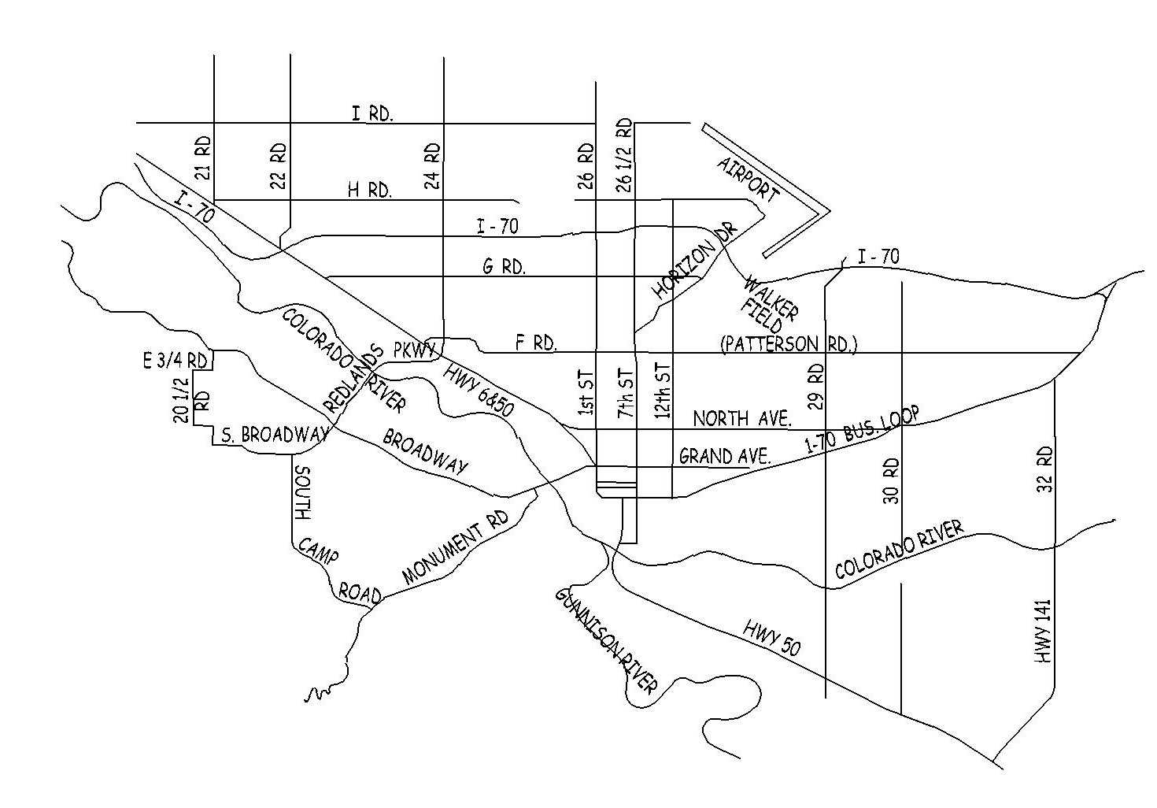
Leach Creek Flood Control Dam
North 27 ¼ Rd
Community Investment
by Location - 2015
Horizon Drive Interchange
25 Rd Turn Lane at Waite Street (Local Imp - TCP)
Sewer Interceptor Rehabilitations
Bridge Replacement 31 & F ½ Roads
Community Hospital (TCP)
Sewer Line Replacements
Sewer Interceptor Rehabilitation
Chipseal Program
Veteran's Administration Turn Lane (TCP)
Buthorn Drain Improvements
CNG Slow Fill Stations
North Avenue Streetscape
Water Line Replacements
Las Colonias
OM Fire Station 4 Relocation
Other Improvements: Kannah Creek intake improvements, Whitewater Hill training facility water infrastructure, street overlays and curb- gutter-sidewalk improvements, traffic signal equipment upgrades, OM pool sliding glass door replacements, skate park improvements, and Riverfront Trail repair. Start design work on 1st Street (North to Ouray), Orchard Ave (Normandy to 29 Rd), B ½ Road Overpass at US50 Multimodal Conversion, and Police Department Annex.
Notes:
This next slide will give you an idea of where the City’s capital investment will be made in the coming year
*****as planned and discussed the OM Fire Station will be relocated with a total project cost of $2.6 million in 2015 after design will be completed this year. Staff was successful in getting 2 DOLA grants for this project with the second one just being awarded yesterday for $1.5 million
*****The North Avenue Streetscape project will be completed next year. Again a project largely funded by securing grant funds.
*****Las Colonias next phase development and Amphitheatre designed are planned in 2015.
*****Bridge replacement at 31 and F ½ Road
*****Our two major storm drainage projects next year will be the completion of the Leach Creek Flood Control Dam for $525,000 but hopefully will be successful in getting a $200,000 DOLA grant which will free up that same amount of funds for another capital project. The other drainage project is the Buthorn Drain Improvements.
*****the Chipseal program will concentrate in the area between North and Patterson in the east part of the community.
The next three projects are the transportation capacity projects for the year *****and include work on a turn lane at 25 rd and Waite, Community Hospital, and a turn lane for a new parking garage at the Veteran’s Administration Hospital.
*****The Horizon Drive Interchange joint project with the Horizon Drive Business Improvement District will be completed in 2015
*****Next you’ll see where our sewer projects are planned for 2015. Of course we also have the biogas project happening next year.
*****We will complete the expansion of our Compressed Natural Gas system by construction an additional 10 slow fill stations.
*****Finally we will coordinate water line replacements in our chip seal area***** and we have noted a few other capital projects planned as well including the design work on major street reconstructions including 1st street north to ouray and Orchard avenue normandy to 29 rd. As well as the B ½ Road overpass project. ****

Slide 13
2015 Community Investment
Storm Drainage $655,400
Leach Creek, Buthorn Drain
CNG Biogas Project $1.2 million
Fleet, Facilities, Technology
$4.2 million
Fire Truck, Patrol Vehicles, Facility Improvements 800 MHZ Infrastructure
Parks & Pools
$1.4 million
Las Colonias, Matchett, OM Pool Riverfront Trail
City Council Economic Development & Community Partnerships
$2.2 million
Colorado Mesa University, Grand Valley Transit, 5.2.1 Authority, Commercial Catalyst, Branding and Marketing Plan
Public Safety
$3.5 million
Fires Station 4 Relocation, Police Annex , Whitewater Training Facility
Water & Sewer
$6.7 million
Replacements, Water Flow Line, Plant Backbone, Collection System Office
Street & Bridge Infrastructure
$6.8 million
Street Overlays, North Avenue, Horizon Drive, Chipseal
Total Investment $26.6 Million
Notes:
*****This chart shows a combination of the City’s capital projects, Council’s commitment to economic development, and many community partnership for a total investment of $26.6 million*****

Slide 14
Question & Answer
Rich Englehart – City Manager
John Shaver – City Attorney
Tim Moore – Deputy City Manager
Greg Lanning– Public Works and Utilities Director
Debbie Kovalik –Convention & Visitor Services Director
John Camper – Police Chief
Rob Schoeber – Parks & Recreation Director
Ken Watkins – Fire Chief
Claudia Hazelhurst – Human Resources Director
Jodi Romero – Financial Operations Director
Notes:
With that, this concludes the presentation. Again I want to thank you all for your involvement in this process. This budget is not just the City Manager’s or the City Council’s. It is our community budget. I am proud of the process and of our wise use of tax payers dollars. This budget creates the framework for addressing so many of the varied needs and dreams of the community we serve. So we are here to address any questions of Council at this time.

